Slide 1
TOPICS for November 25th, 2020 live session
1 Thanksgiving Kahoot!
2 Project 2
3 Quiz (Wednesday December 2nd)
Workbook (They are found in Teams A2.1 English III. Sharing Information and Ideas files)
PowerPoint Presentations
Language Summary.
It contains listening, vocabulary, grammar, reading and writing items.
4 Send ELL’s progress in PDF as an Outlook message. (Friday, November 27th)
5 Work on improvements.
6 Finally, invite me to do something as a good-bye gesture.

Slide 2
Objective QUESTIONS
Unit 3 How much are these?
How much is this/that? (Indicate object.) What color is it? / Is it cotton/gold/leather/plastic/rubber/silk/silver/wool?
How much are these/those? (Indicate objects.) What color are they? What are they made of?
Which one do you prefer/like better/like more? (Indicate object.) Why? Which one is cheaper/prettier/nicer/better/more stylish/more expensive/more attractive?
Which ones do you prefer/like better/like more? (Indicate objects.) Why? Which ones are cheaper/prettier/nicer/better/more stylish/more expensive/more attractive?
Ask a classmate about his/her clothing preferences.

Slide 3
Objective questions
Unit 4 Do you play the guitar?
What kinds of music do you like? Do you like [type of music]?
Who’s your favorite musician? What musical instrument does he/she play?
Do you play a musical instrument? What instrument do you play? Do you play the piano/guitar?
What kinds of TV programs do you like? Do you like [type of TV show]?
What kinds of movies do you like? Do you like [type of movie]?
Do you play video games? What’s your favorite video game?
Would you like to go to [event] this weekend? Why or why not?
Would you like to [activity] this weekend?
Ask me about music/TV shows/movies. or Ask [classmate] about music/TV shows/movies.

Slide 5
AT THE DEPARTMENT STORE
Look at the picture. Complete the conversations with this, that, these, those, one or ones.
one
one
those
ones
ones
these
this

Slide 7
more interesting
happier
more reasonable
more exciting
sadder
friendly
warmer
I like the silver one better. It is more interesting than the gold one.
I prefer the silk one. It is prettier than the cotton blouse.
I like the black shoes more. They’re cheaper than the purple ones?

Slide 8
Which pajama (pyjamas) do you like better, the silk one or the cotton one? (soft)
I like the cotton pajama better. It’s softer than the silk one.
Which one do you prefer, the wool socks or the cotton socks? (warm)
I prefer the wool socks. They are warmer than the cotton ones.
Which ones do you like more, the blue jacket or the red one? (stylish)
I like the blue jacket more. It is more stylish than the red one.
Extra practice:
https://www.perfect-english-grammar.com/comparative-adjectives-exercise-1.html

Slide 9
smaller than
bigger than
more attractive than
warmer

Slide 10
prettier than
better than
nicer
more expensive

Slide 11
Do you like romantic movies?
A= Yes, I do. I like them very much, because they are emotional.
A= Yes, I like.
A= No, I don’t like.
A= No, I don’t like much.
Do you like country music?
No, I don’t like it. They are boring./ Yes, I like it. Yes, I do,. I love it.

Slide 12
K. PRACTICE.
WHAT DO THEY LIKE?
Complete the conversations with yes, no, do, don’t, does, or doesn’t. Use information from the chart.
 | Kinds of movies they like | Kinds of TV shows they like
Samantha | comedies | game shows
Howard | science fiction, comedies | talk shows, game shows
1. | A: | Does Samantha like comedies?
 | B: | Yes , she does . She loves to laugh.
2. | A: | _________ Howard like comedies?
 | B: | Yes, he _________.
3. | A: | _________ Samantha and Howard like game shows?
 | B: | _________, they _________. They like them a lot.
4. | A: | _________ they like soap operas?
 | B: | _________, they _________.
5. | A: | _________ Samantha like talk shows?
 | B: | _________, she _________. She can’t stand them.
Does
does
Do
Yes
do
Do
No
don’t
Does
No
doesn’t

Slide 13
like
does
doesn’t
What
do
like
like
do
like
don’t
do
like
don’t
does
sings

Slide 14
it
him
them
her
POSSESSIVE Pronoun
These is his car.
These are his keys.
His shoulders are big and strong.
OBJECT pronoun
I love him.
I like him.

Slide 15
Yes, I’d like to. what time?.
I’d like to, but I can’t. I have to go on a trip.
B. PRACTICE. Respond to three invitations. Questions 1-3 require an acceptance or a refusal. Then write three invitations for the given responses. Questions 4-6 require an invitation.

Slide 16
QUORA BLOG
QUESTION: Why are one-word answers considered rude when a question can be answered with a simple yes or no?
A= I don’t know.
There, I gave you a short answer. It was 3 words long.
But I don’t know doesn’t help. “People usually want a better answer than just “yes” or “no”. It’s only a sentence, but it’s more interesting.
A= Yes and no are boring answers. Why are you saying yes? Why are you saying no? Why do you not have a strong opinion?
A= Yes and No can only be used in those places where affirmation or negation is required. All other questions require descriptive answering
Go further:
https://dictionary.cambridge.org/grammar/british-grammar/questions-yes-no-questions-are-you-feeling-cold

Slide 17
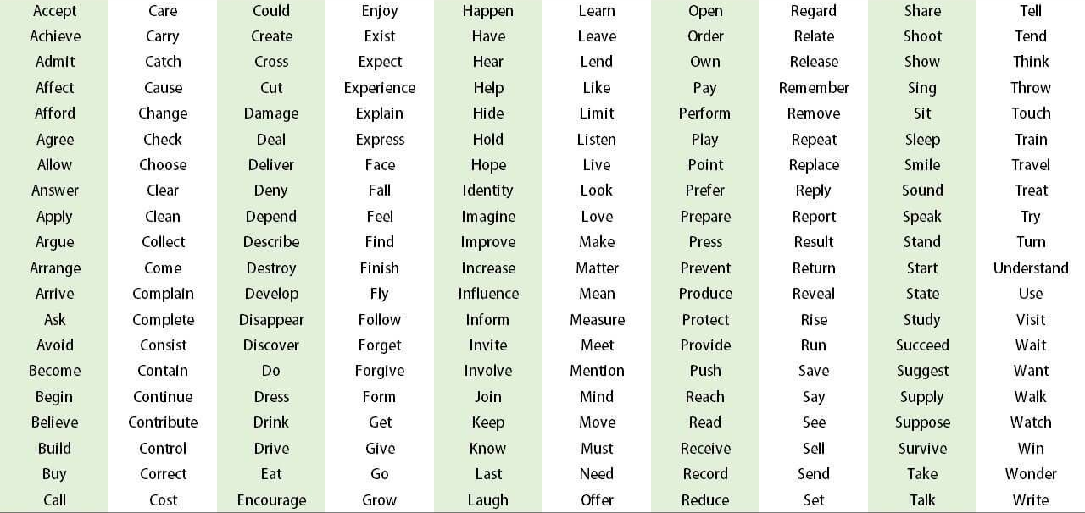
Make an invitation.
Would you like to have a cup of coffee with me?

