Slide 1
At the movies
Open this presentation as power point to see the animations

Slide 2
5

Slide 3
4

Slide 4
3

Slide 7
START

Slide 8
In your notebook

Slide 9
Watch the video

Slide 10
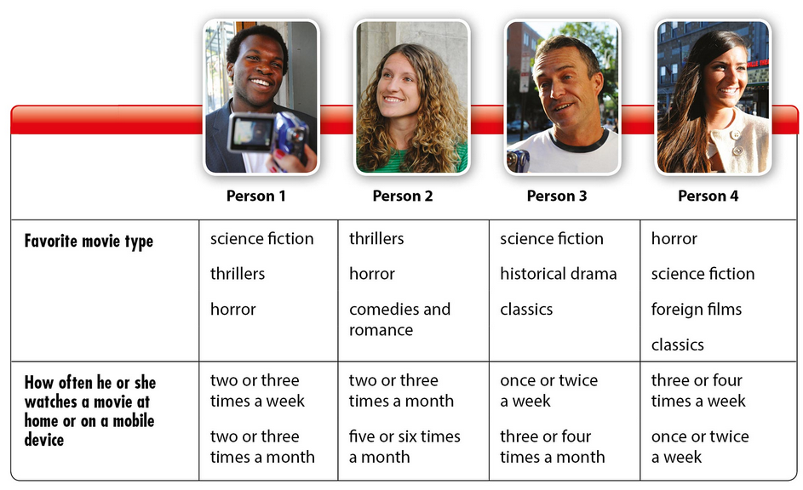
In your notebook check the correct answer

Slide 11
In your notebook Circle the people who gave these opinions

Slide 12
In your notebook Complete the conversation

Slide 13
GRAMMAR Object pronouns

Slide 14
In your notebook Fill in the blanks with him, her , it, them
Ex. 1

Slide 15
In your notebook Fill in the blanks with him, her , it, us or them
Ex. 2

Slide 16
LANGUAGE Giving reasons

Slide 17
LANGUAGE Giving reasons

Slide 18
LANGUAGE Giving reasons
Write in your notebook 5 statements about your preferences and give reasons for them. You Will share them on Friday 11th with your partners.

Slide 19
Answer key : conversation

Slide 20
Answer key: grammar
Ex. 1
Ex. 2

Slide 21
Use of templates
You are free to use these templates for your personal and business presentations.
We have put a lot of work into developing all these templates and retain the copyright in them. They are not Open Source templates. You can use them freely providing that you do not redistribute or sell them.
Do
Use these templates for your presentations
Display your presentation on a web site provided that it is not for the purpose of downloading the template.
If you like these templates, we would always appreciate a link back to our website. Many thanks.
Don’t
Resell or distribute these templates
Put these templates on a website for download. This includes uploading them onto file sharing networks like Slideshare, Myspace, Facebook, bit torrent etc
Pass off any of our created content as your own work
You can find many more free templates on the Presentation Magazine website www.presentationmagazine.com

