Slide 1
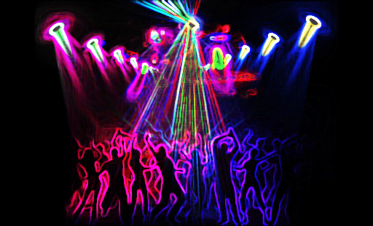
Unit 7
Cycle 2
We went dancing!
Aims:
Describe past daily and free-time activities
Describe past vacations

Slide 2
Objective questions
How did you spend yesterday? Where did you go? Did you have a good time?
Did you do anything special last weekend? What did you do? Was the weather OK?
Did you go anywhere on Friday night? Did you meet any friends? When did you go to bed?
Did you work on Saturday/Sunday? What time did you get up?
What was the best thing about your weekend? What would you like to do next weekend?
Did you see a movie last week? What did you see? How did you like it?
Did you [activity] last month? Were your friends with you? Who were you with?
Where did you spend your last vacation? How long were you there? Who were you with? What did you do there? How was the weather? How was the food?
Ask me about my last vacation. or Ask [classmate] about his/her weekend or last vacation.

Slide 3


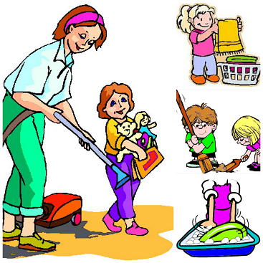

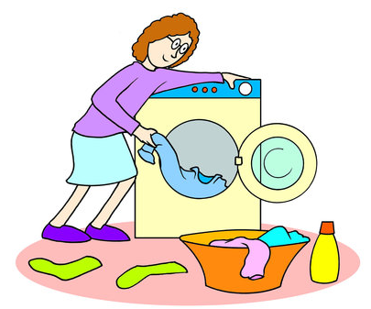


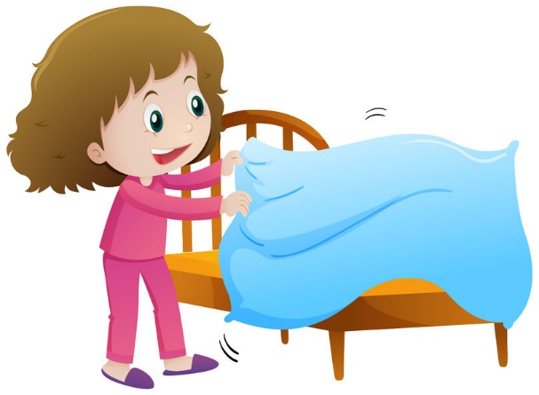



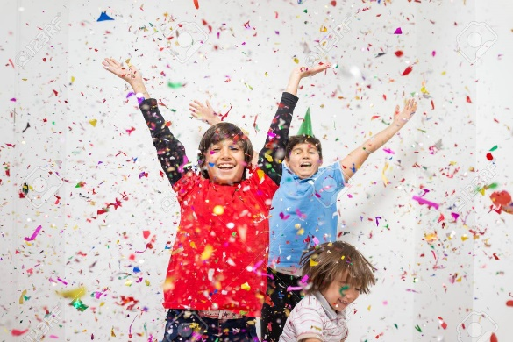

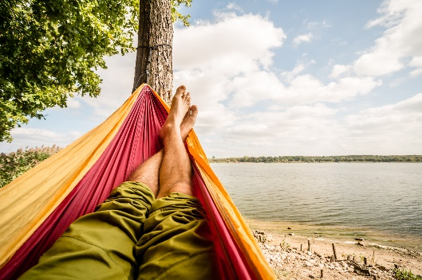
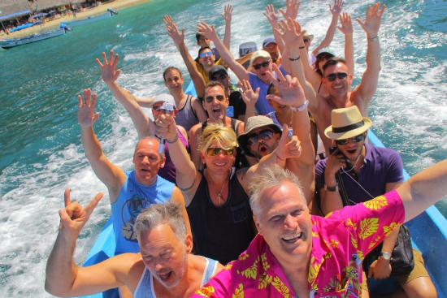
1
2
3
4
5
6
Live session activity
7
8
9
10
11
Match the WORD POWER Chores and activities with the pictures.
12
15
13
14

Slide 4
Live session activity
Collocations Survey
Work in teams. They take turns asking each other questions to complete the survey. Take notes. Join your group and take 10 min.
For example:
T: When was the last time you went shopping?
S: Yesterday morning.
T: OK, I’m writing Yesterday morning.

Slide 5

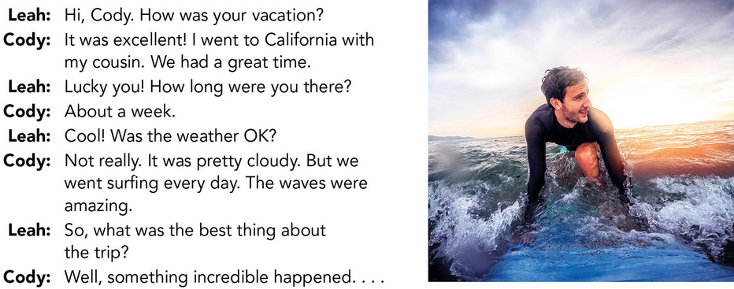
CONVERSATION Lucky you!
Learning objective: use the simple past of be in a conversation about vacations
A Listen and practice with a partner. Answer the questions.
Did Cody enjoy his vacation?
A=
Where did he go?
A=
How long was he there?
A=
Key words
went
won
made
posted
B Listen to the rest of the conversation. What happened?
A=

Slide 6
GRAMMAR FOCUS
Learning objective: use the past of be in questions and short answers
A Analyze these questions.
Verb be - (Infinitive form: to be)
Was the weather OK?
What was the best thing about the trip?
How was your vacation?
How long were you there?
Base form | Past Simple | Past Participle
am are is | was were | been
B What is the rule for forming yes/no questions?
A=
C What is the rule for forming Wh-questions?
A=

Slide 7
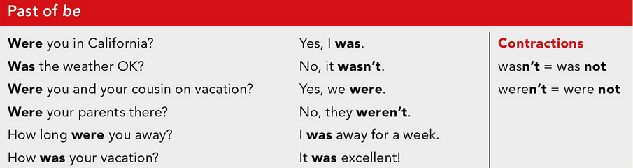
D Read and listen to the Grammar Focus box. Analyze it. When can we use was and were?
A=
I
He
She
It
You
They
We
singular
plural
E Watch and review the lesson.
Past Simple Tense be - was / were: Fun & Interactive English Grammar ESL Video
https://www.youtube.com/watch?v=O3FdGPehN-E

Slide 8
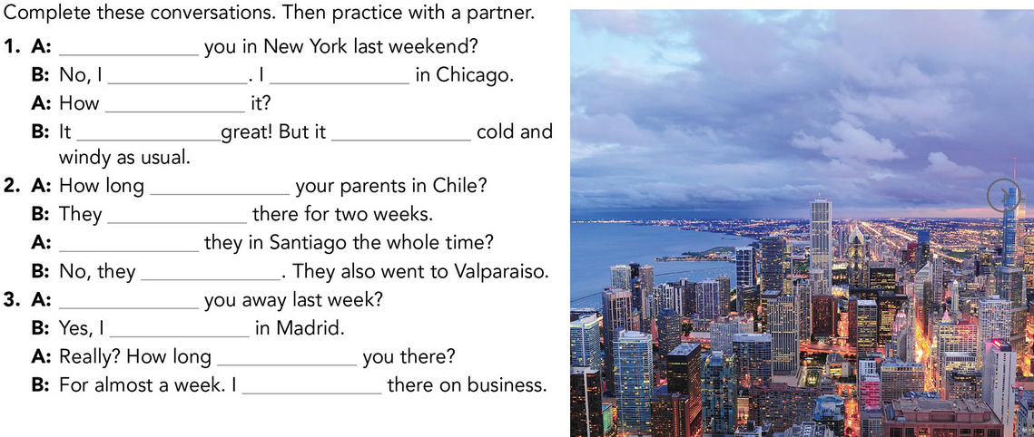
Live session activity

Slide 9
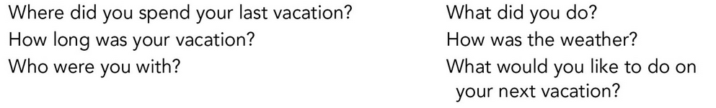
DISCUSSION Past and future vacations
Learning objective: discuss past vacations and retell a story using the simple past
Live session activity
B PRACTICE. Ask your classmates about their last vacations. Ask these questions or use your own ideas. Pay attention to the pronunciation of did you.
Join your sharing group and socialize. Take 20 min. Take notes. Then comeback to the general group and share. Who had an interesting vacation? Tell the class who and why?

Slide 10
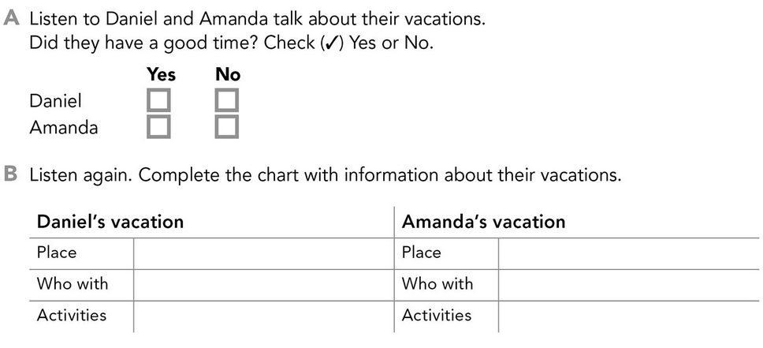
LISTENING I was on vacation.
Learning objective: listen for main ideas and details about vacations discussed using the simple past of be

Slide 11
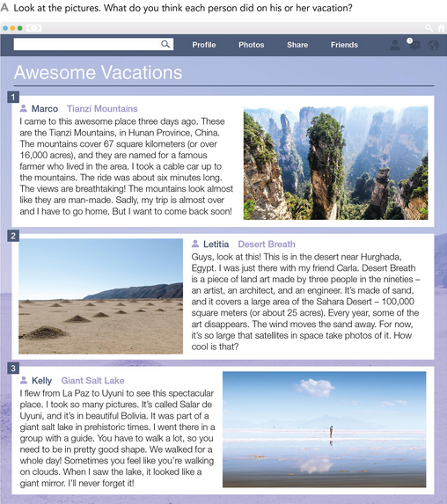
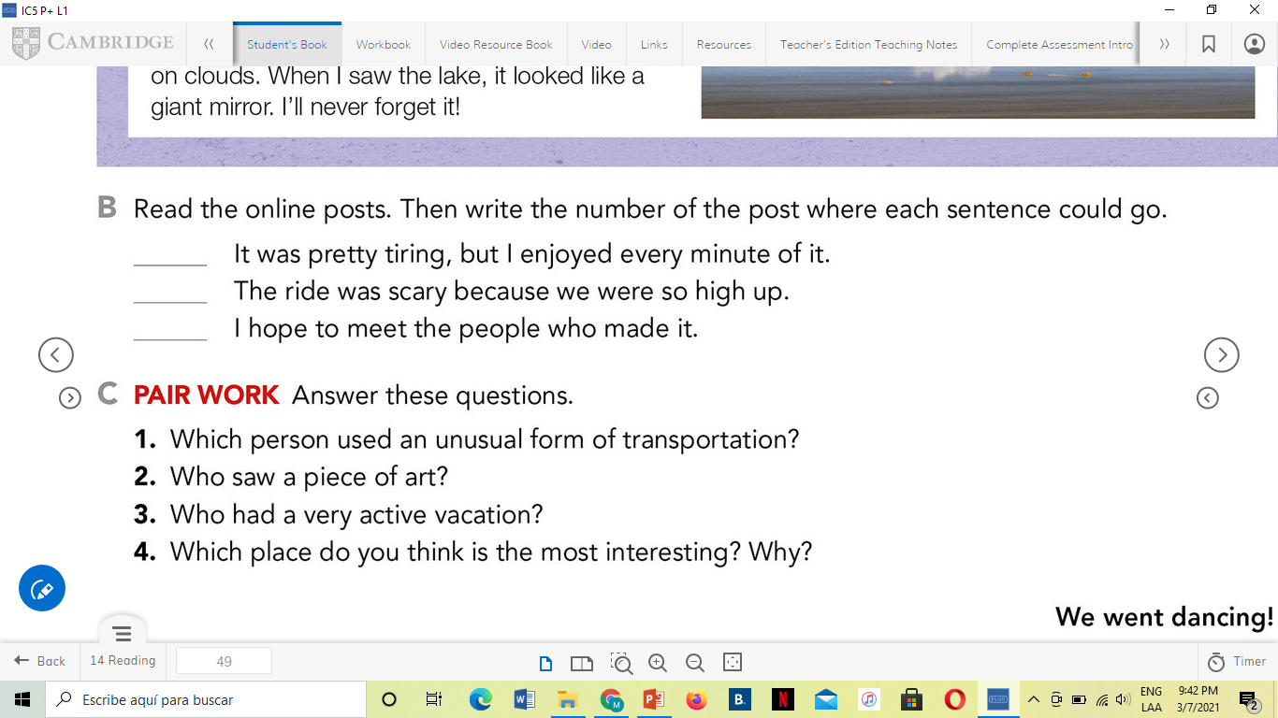
READING
Learning objective: read for main ideas and details in online posts about past vacations
A=
A=
A=
1. A=
2. A=
3. A=
4. A=

Slide 12
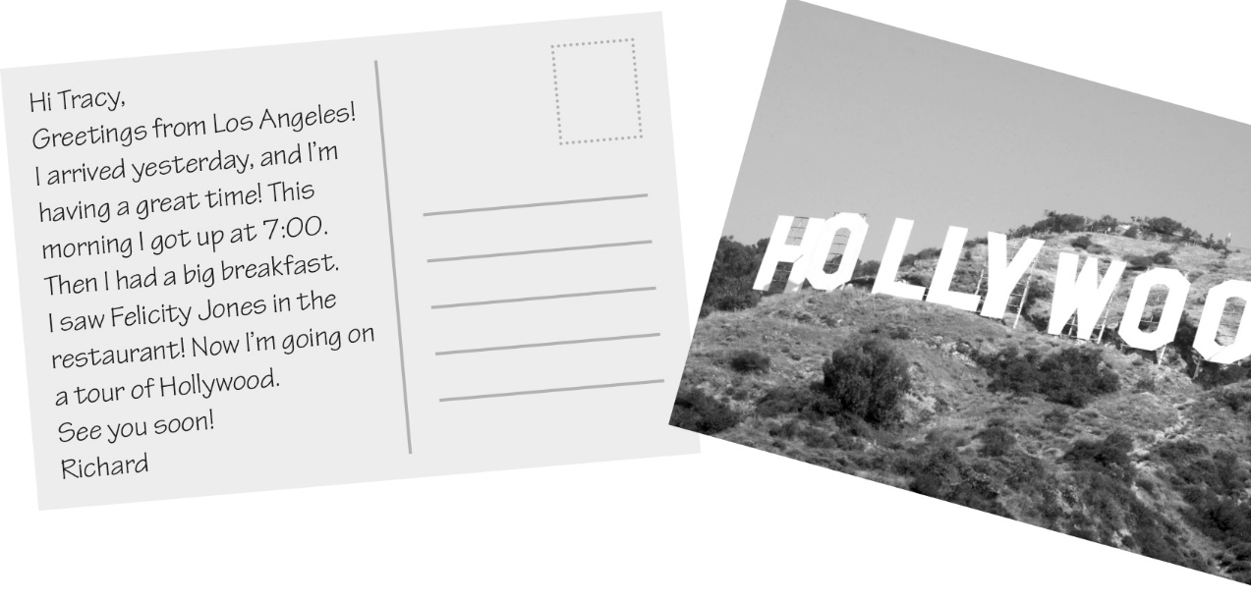
RICHARD’S VACATION
Read the postcard. Then answer the questions using complete sentences.
1. A: Where did Richard go on his vacation?
B: He went to Los Angeles.
2. A: When did he arrive?
B: ______________________________________
3. A: Did he get up late this morning?
B: ______________________________________
4. A: What time did he get up?
B: ______________________________________
5. A: What did he have this morning?
B: ______________________________________
6. A: Who did he see?
B: ______________________________________

Slide 13
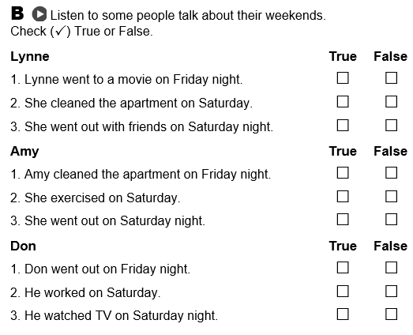
HOW WAS YOUR WEEKEND?
A
B
Listen again. What did each person do on Sunday?
A=
Lynne:
Amy:
Don:
Self-check

Slide 14
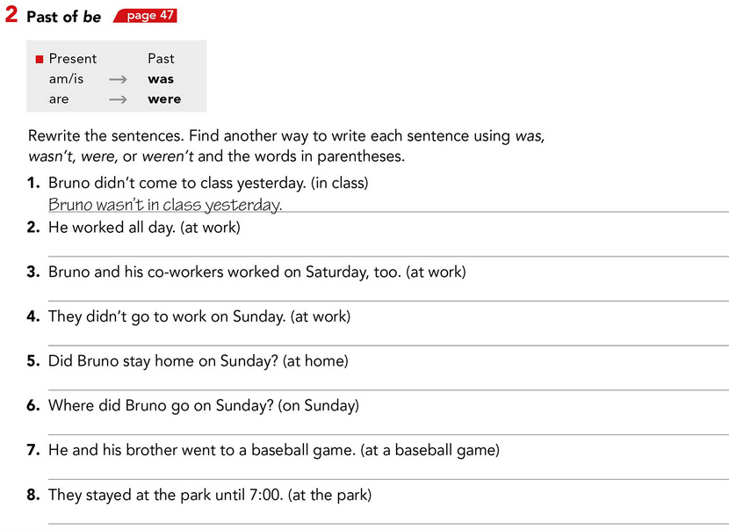
Live session activity

