Slide 1
UNIT 8
WHERE DO YOU WORK?
UNIT OBJECTIVES
Discuss Jobs and workplaces using simple present Wh questions
Discuss opinions about Jobs using be + adjective and adjective + noun

Slide 2
UNIT 8
WHERE DO YOU WORK?
Click on the following link to listen and practice the Jobs vocabulary
https://www.youtube.com/watch?v=mTrVih6zIHA
Click on the following link to practice the Jobs vocabulary
https://www.youtube.com/watch?v=1oxb7WRuijw

Slide 3
Listen and practice the vocabulary of Jobs
nurse
doctor
lawyer
manager/
businessman
accountant
cashier

Slide 4
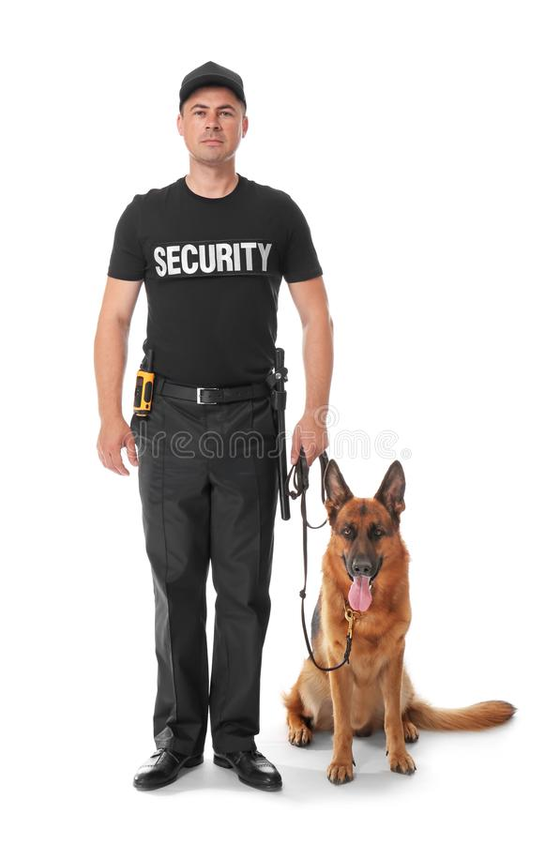
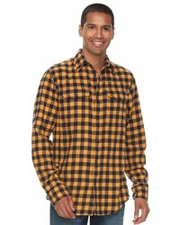
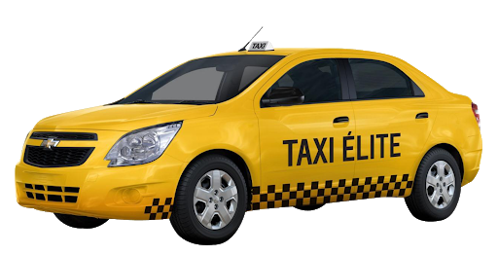
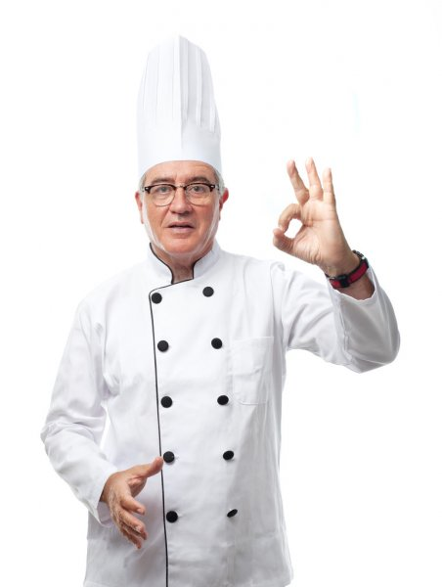
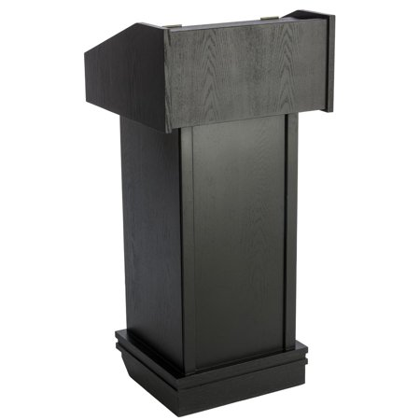
Listen and practice the vocabulary of Jobs
police officer
security guard
taxi driver
waiter/server
host
chef

Slide 5
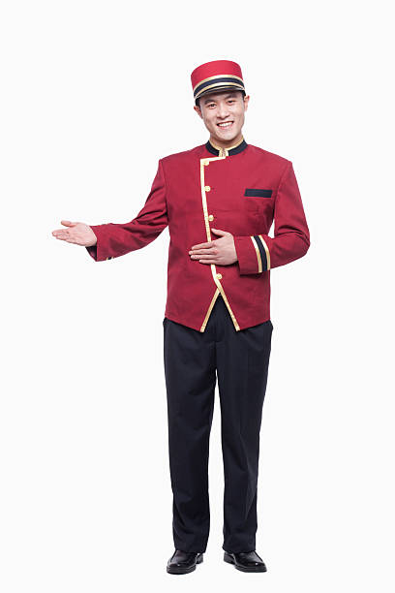
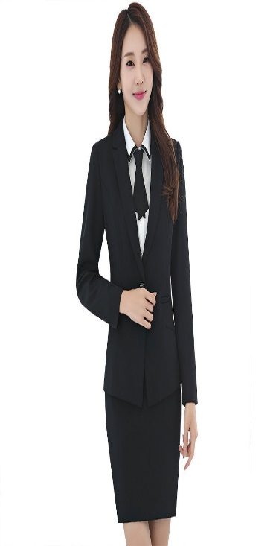
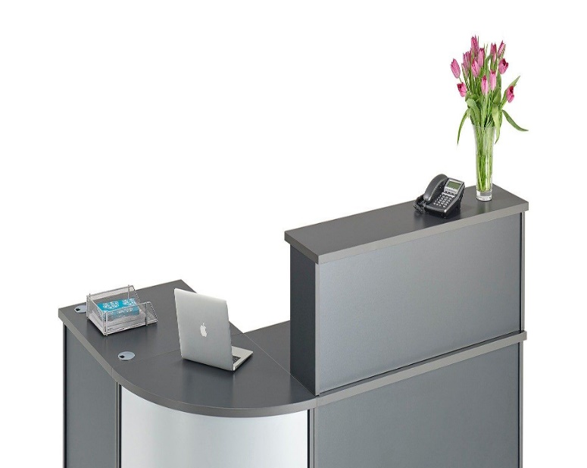
Listen and practice the vocabulary of Jobs
sales person
vendor /street vendor
front desk clerk
bell hop

Slide 6
Find the words.

Slide 7
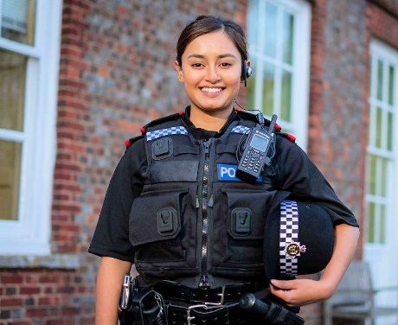
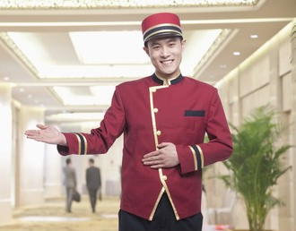
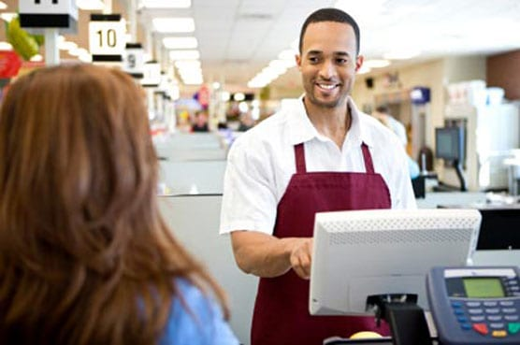
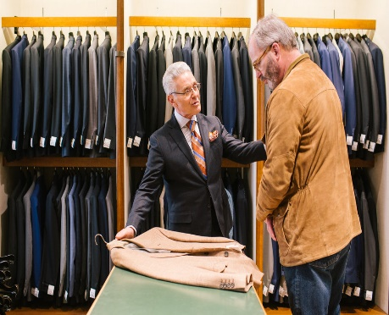
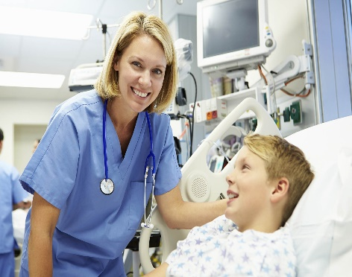
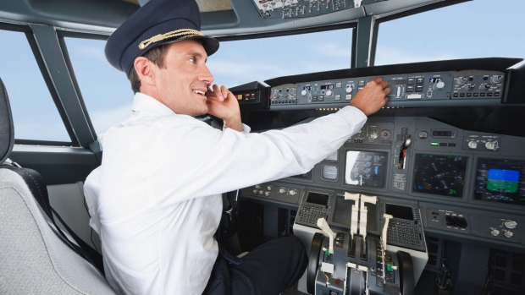
Match these Jobs with the correct picture
lawyer | ______
photographer | ______
bellhop | ______
police officer | ______
pilot | ______
nurse | ______
server | ______
sales person | ______
cashier | ______
front desk Clerk /receptionist | ______
a
b
c
d
e
f
g
h
i
j

Slide 8
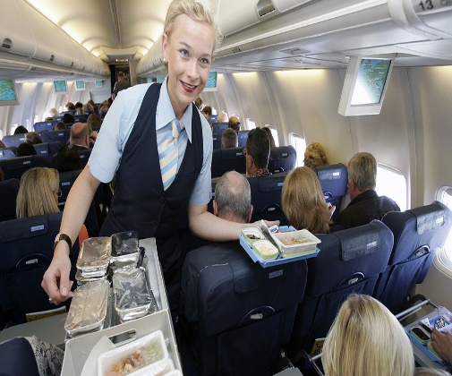
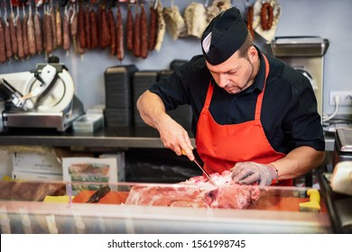
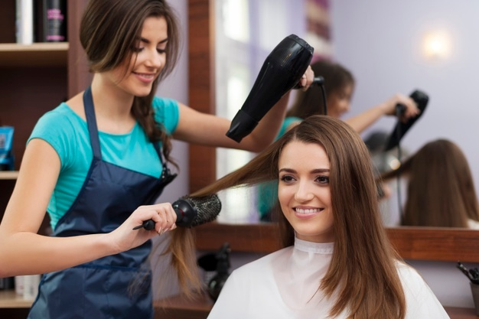
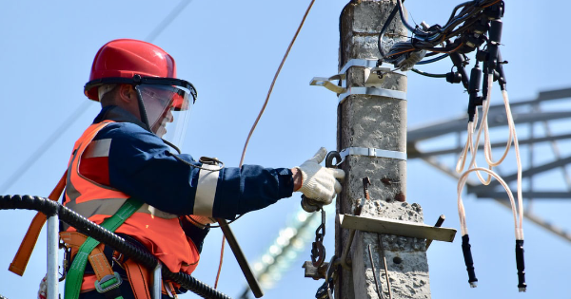
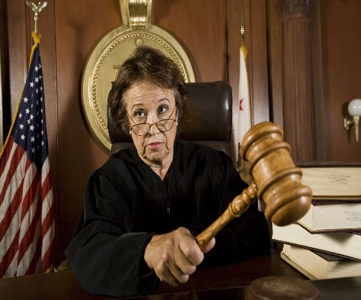
Label the following pictures with vocabulary of Jobs follow the example
She is a flight attendant

Slide 9
Click on the following links each of them is a listening activity. Practice and print screen of your results
https://learnenglishteens.britishcouncil.org/vocabulary/beginner-vocabulary/jobs
https://learnenglishkids.britishcouncil.org/word-games/jobs-1
https://es.liveworksheets.com/worksheets/en/English_as_a_Second_Language_(ESL)/Jobs_and_occupations/Listen_and_choose_professions_tiger_team_4_macmillan_ja1207092ls

Slide 10
LESSON 2
Grammar focus simple present tense
Afirmative statements
I
You
We
They
Verb
work in a hospital
He
She
it
Verb + S
works in a hospital
In affirmative statements, verbs with he/ she / it end ins –s She Works in a school. Remind to apply the spelling rules.
Negative statements
I
You
We
They
Aux don´t + Verb
don´t work in a school
He
She
it
Aux doesn´t + Verb
doesn´t work in a school
In negative statements, use don´t with I / you / we / they, use doesn´t with he/ she / it.
Remind not to add –s to the verb when using auxiliar.
Eg. She doesn´t live here. ( NOT: She doesn´t works in a school)

Slide 11
Write three statements in each category follow the example
(2 affirmative statements, 1 negative statement)
A front desk clerk works in a hotel
A bellhop works in a hotel
A pilot doesn´t work in a hotel

Slide 12
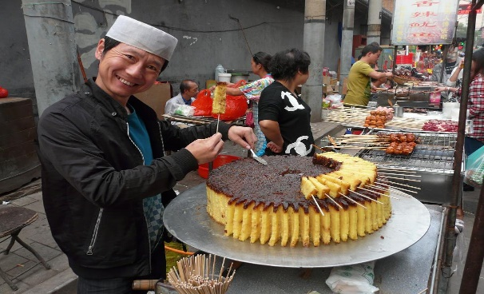
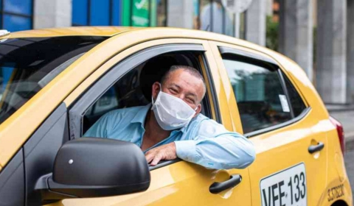
What do they do? Write sentences. Use the phrases in the
Helps people
Talks to people
Handles money
Sits all day
Stands all day
Wears uniform
Does not wear uniform
Works at night
Works in an office
Works hard
He´s a doctor
He helps people
He works in a hospital

Slide 13
What does he/she do? Match the pictures with the statements
cares for patients
cooks food
serves food
receives payment
handles money
sells products
An accountant

