Slide 1
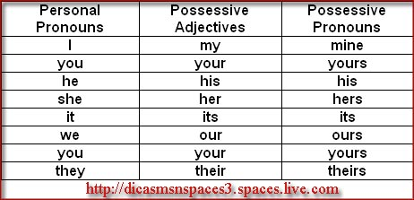
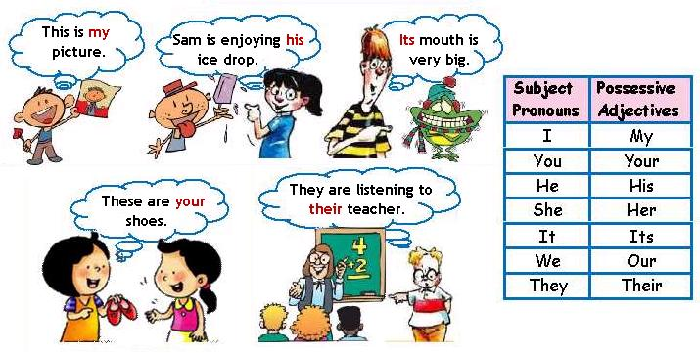
POSSESIVE ADJECTIVES

Slide 2
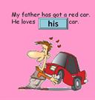
POSSESIVE ADJECTIVES
1.The boy likes _________school.
2.Mary sees_______ mother every day.
3.My friends bring ________children to our place on Saturdays.
4.The cat eats ________food quickly.
5.I often forget ________key.
6.You write in ________book in class.
7.We bring_______ pencils to class.
8.The men always bring_______ wives to the party.
9.Mr Adams teaches_________ class in the morning.
10.She likes to give presents to________ grandchildren.

Slide 3
1 He's from Spain.______ name's Alberto.
2 They're married. ________children's names are Lauren and Daniel.
3 We're brothers. ________parents are French.
4 She's eight._______ brother's nine.
5 I'm British._______ name's Peter.
6 You're students. _________books are in the classroom.

Slide 4
7. My friend John has a new dog, _______old dog died last week.
8. Mary hates when somebody touches_______ car.
9. The students must bring ________certificates tomorrow.
10. Harry Potter has learned how to use ______wand.
11. Don't use Martin's cup! It's _______!
12. Susan visits ______friends when she goes to England.

Slide 5
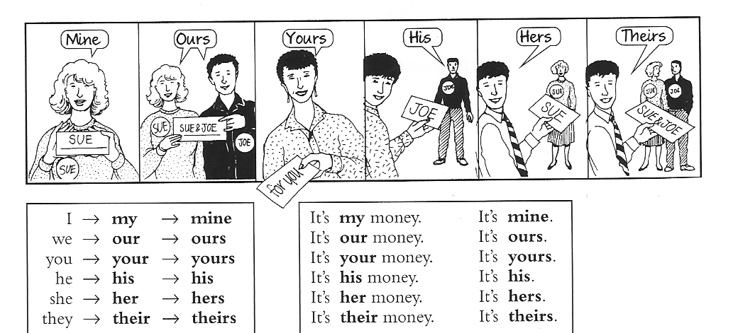
POSSESIVE PRONOUNS

Slide 6
POSSESIVE PRONOUNS
Complete the following with possesive pronouns
I have a bike. The bike is ____________.
Mum and I have a boat. The boat is ________.
The horse has an apple. The apple is _________.
John and Max have a skateboard. The skateboard is ______________.
You have a dog. The dog is _______________.
Max and you have a house. The house is ____________.
Susan has a very nice car. The car is _____________.

Slide 7
Complete the following sentences using possesive pronouns
Jane has already eaten her lunch , but I'm saving_______ until later
She has broken__________ leg.
My mobile needs to be fixed, but(CARLOS’ )_________ is working.
Ann computer’s is a Mac, but(my) _________is a PC.
We gave them___________ telephone number, and they gave us .
My pencil is broken. Can I borrow (your)___________?
Your car is cheap, but (Susan´s)_________ is expensive .
You can't have any chocolate! It's all(my) __________ !

