Slide 1
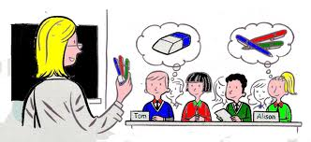
Complete with POSSESIVE PRONOUNS
(Help on grammar box stbk pg 39)
1.Whose pen is this? It's ___________ (Paul).
2. Whose dog is that? It's___________ (we).
3. Whose computer is that? It's __________ (the kids).
4. Whose car is this? It's __________ (Laura).
5. Whose book is that? It's __________ (I).
6. Whose glasses are these? They're __________ (Harry).
7. Whose dictionary is this? It's ______________ (you).
8. Whose album is this? It's _____________ (they).
9. Whose hat is this? It's _____________ (Mark).
10. Whose gloves are these? They're ___________(I).

Slide 2
Underline the right answer who's (who is) or whose in these sentences
1.- '__________ shoes are these?' shouted mum.
a) Whose
b) Who's
2.- I'm not sure __________ coming to the cinema tonight.
a) whose
b) who's
3 .- I couldn't tell _________ books were left on the table.
a) whose
b) who's
4.- Paul is the one _________ going to make this team something special.
a) whose
b) who's
5.- I would like to know _________ smelly socks these are.
a) whose
b) who's

Slide 3
Write the right answer who's (who is) or whose in these sentences
1. ____________ book is this? 2. ____________ your new English teacher? 3. ____________ father is a doctor? 4. ____________ camera is this? Is it yours, Janet? 5. ____________ your favourite teacher at school? 6. ____________ the queen of England? 7. ____________ your best friend? 8. ____________ house is that?

