Slide 1
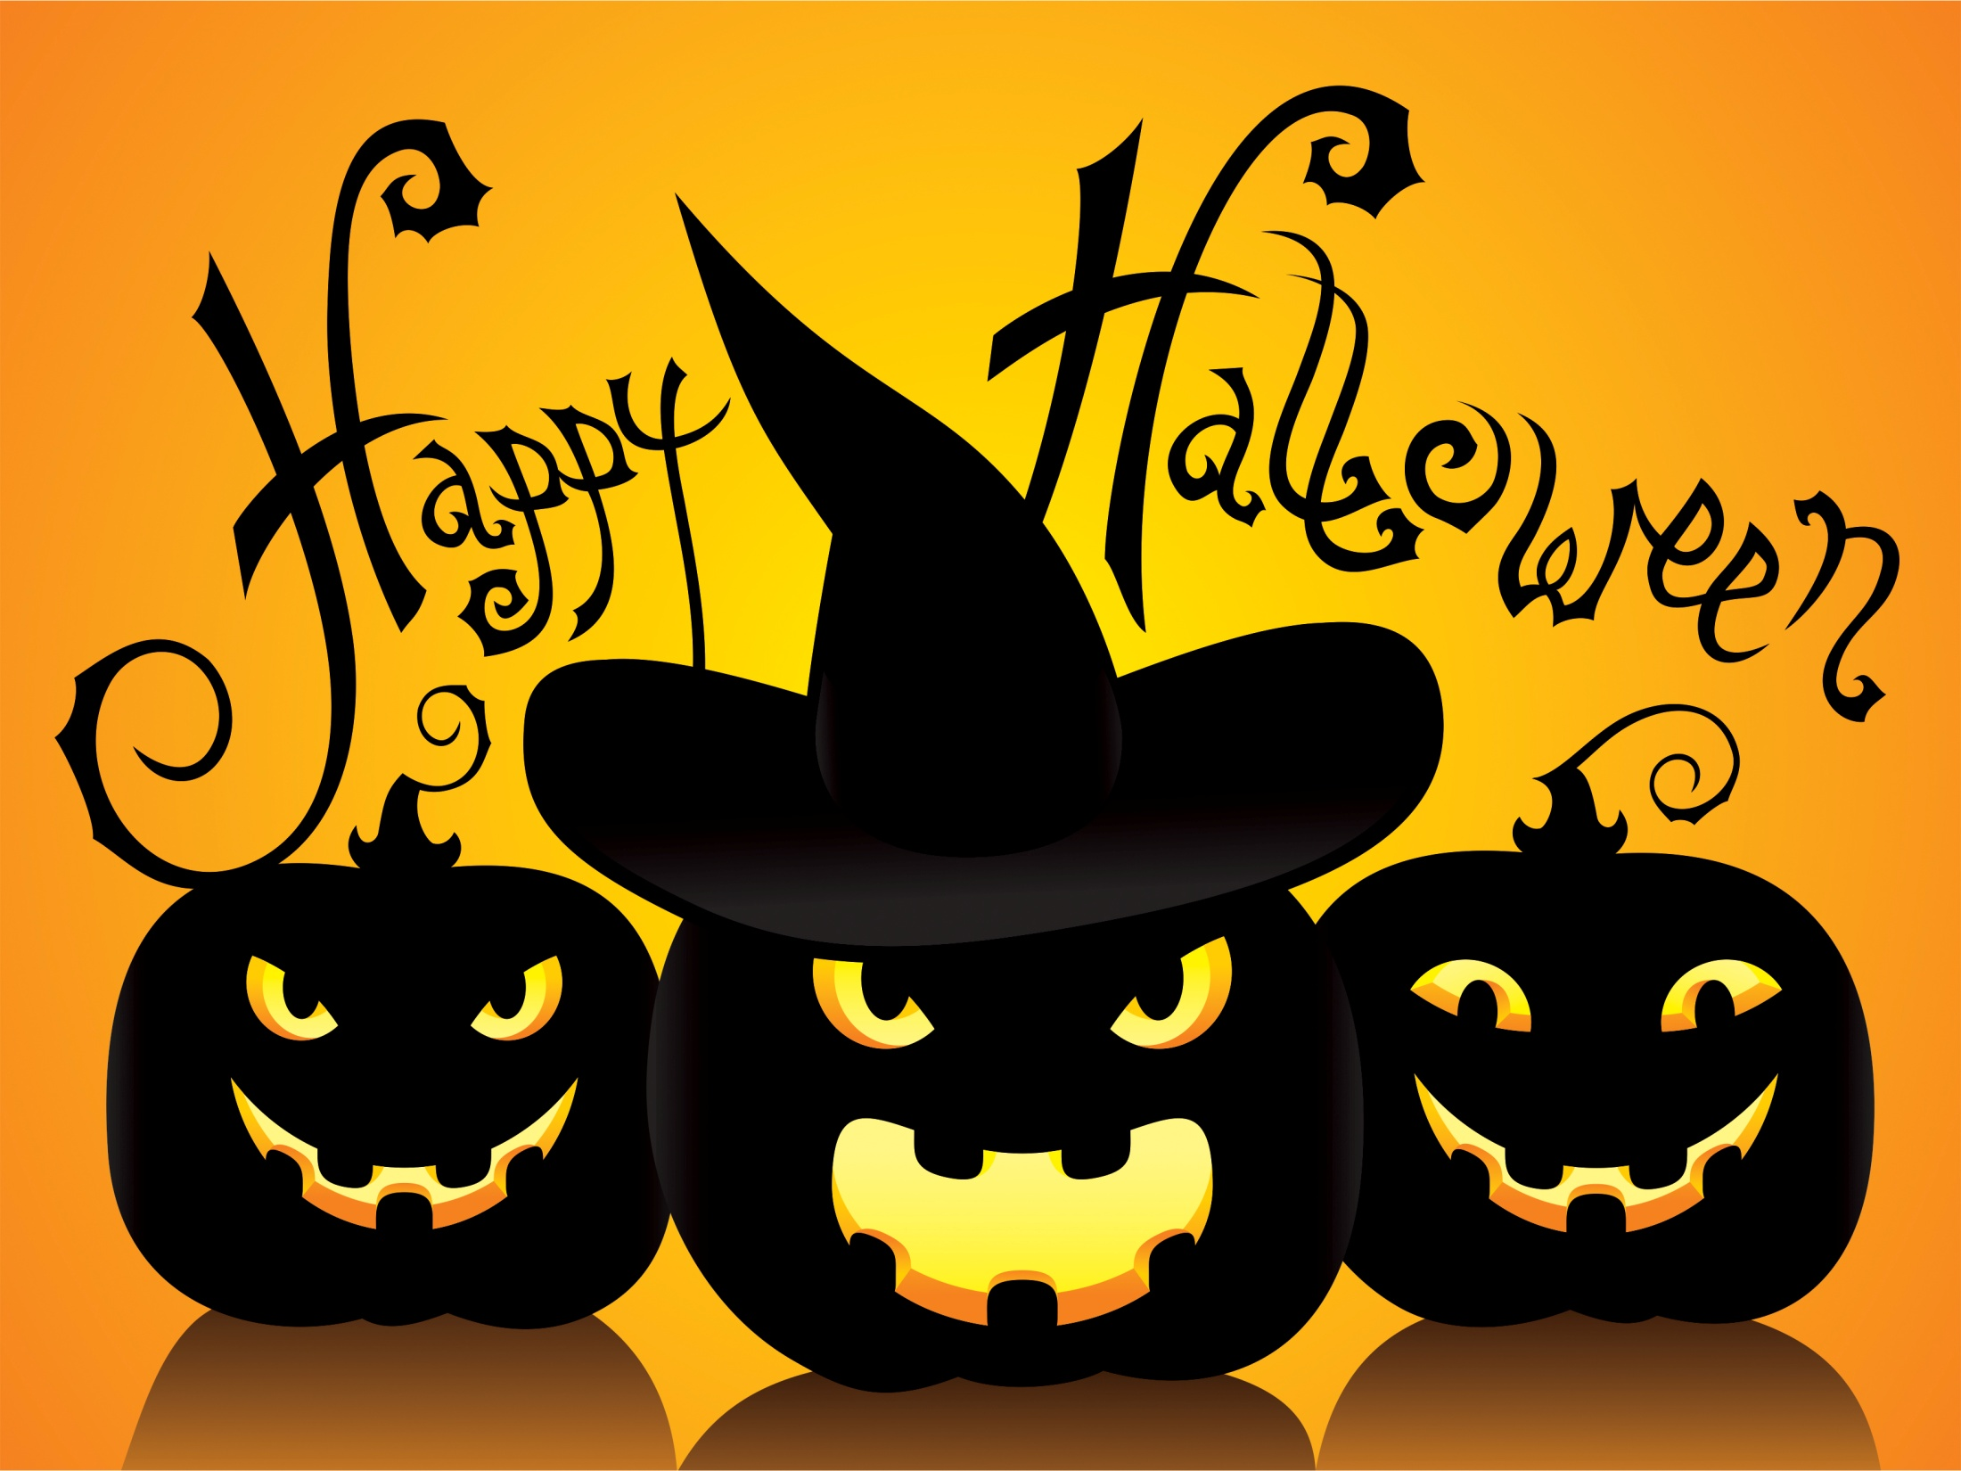

Slide 2
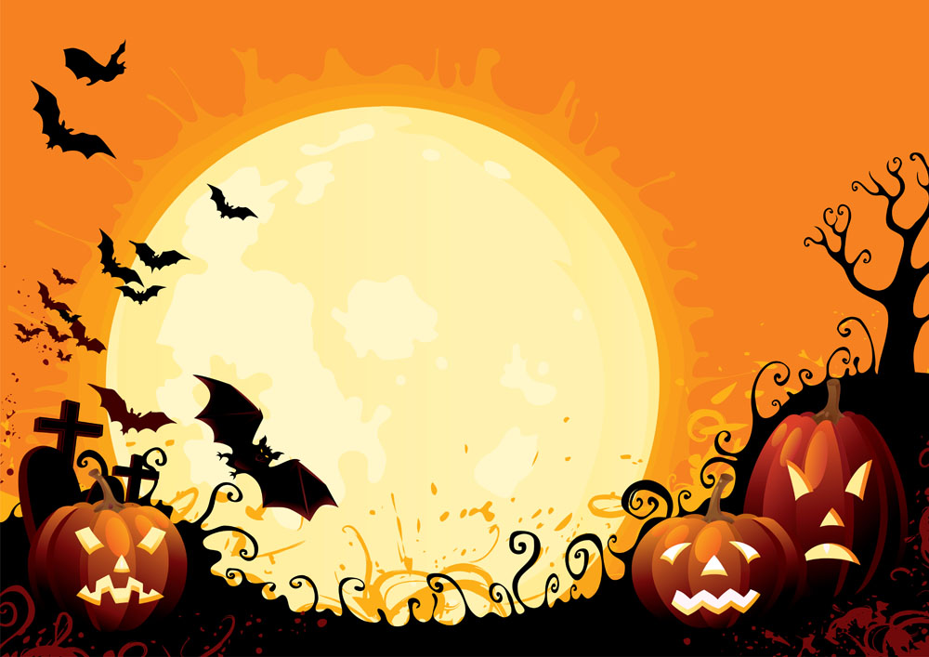
Bet you didn´t know ……
(click on the following links to know bit more about halloween)
1.http://www.history.com/topics/halloween/history-of-halloween/videos/bet-you-didnt-know-halloween

Slide 3
http://www.history.com/topics/halloween/pumpkin-facts

Slide 4
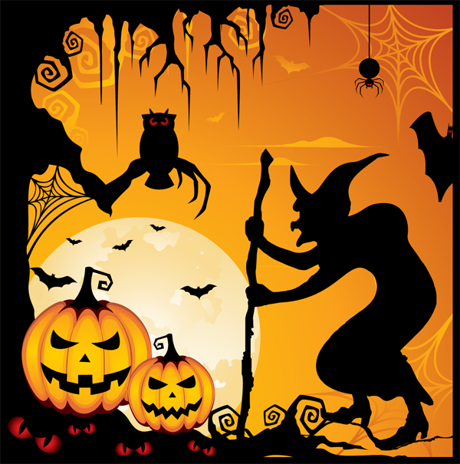
http://www.history.com/topics/halloween/history-of-halloween/videos/bet-you-didnt-know-witches

Slide 6
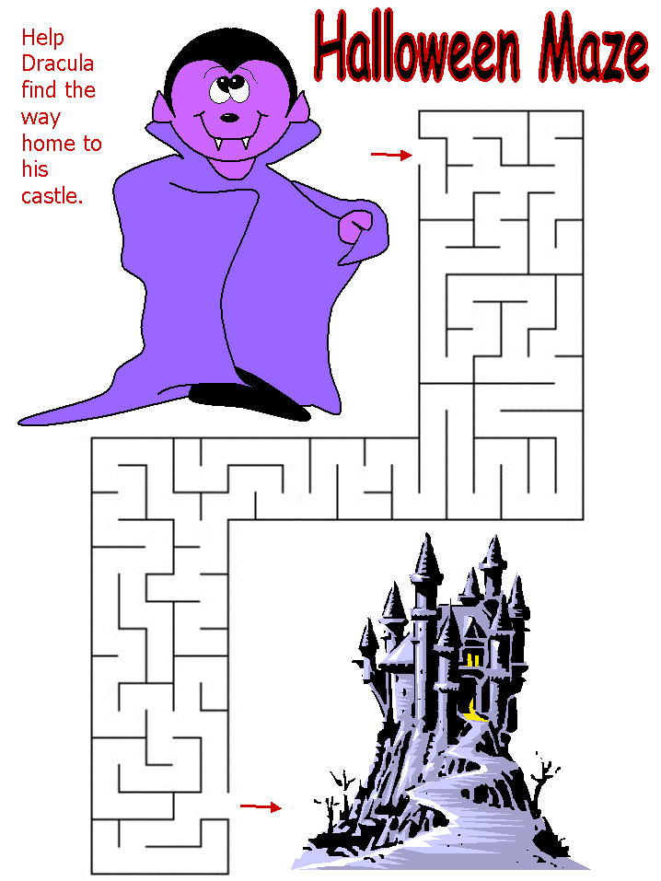

Slide 7
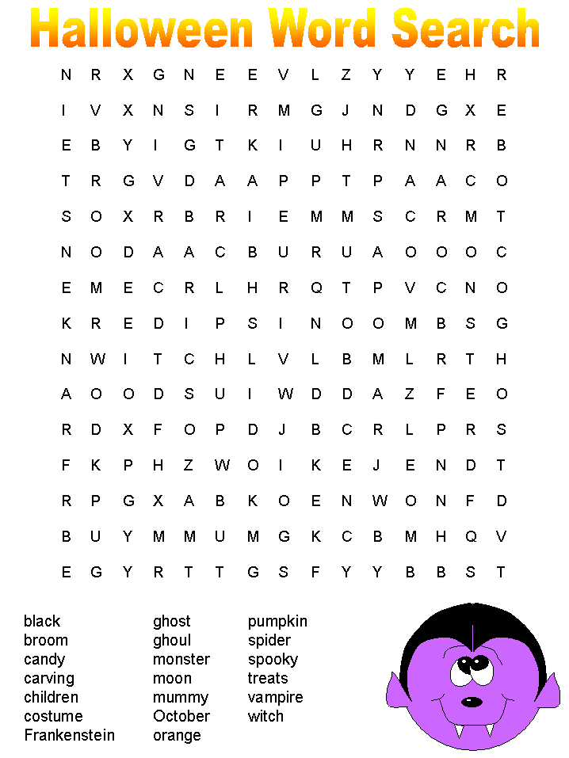

Slide 8
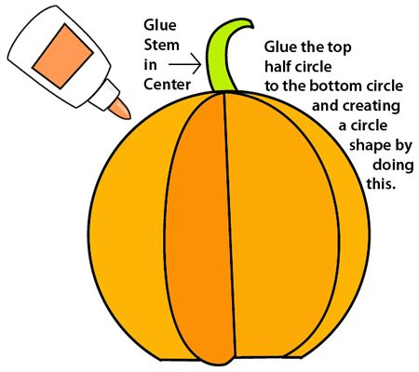

Slide 9
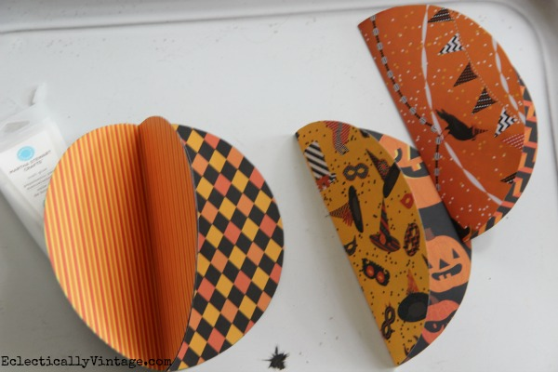
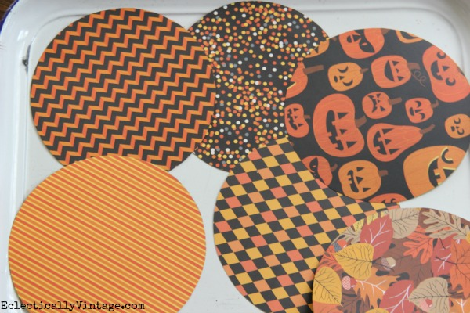
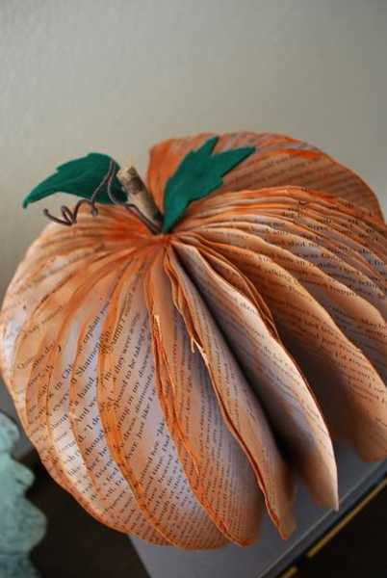
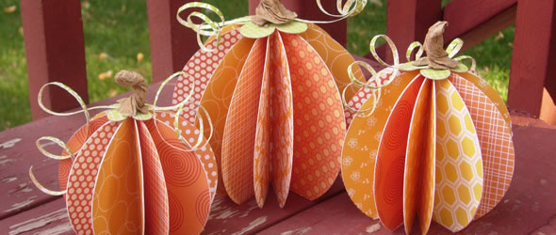

Slide 10
