Slide 1
Watch the following video
practice Can and Can´t
http://www.youtube.com/watch?v=a91oTyA0Oq8

Slide 3
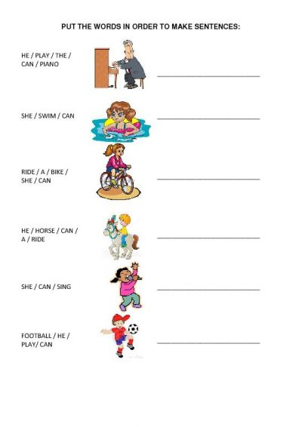

Slide 4
