Slide 1
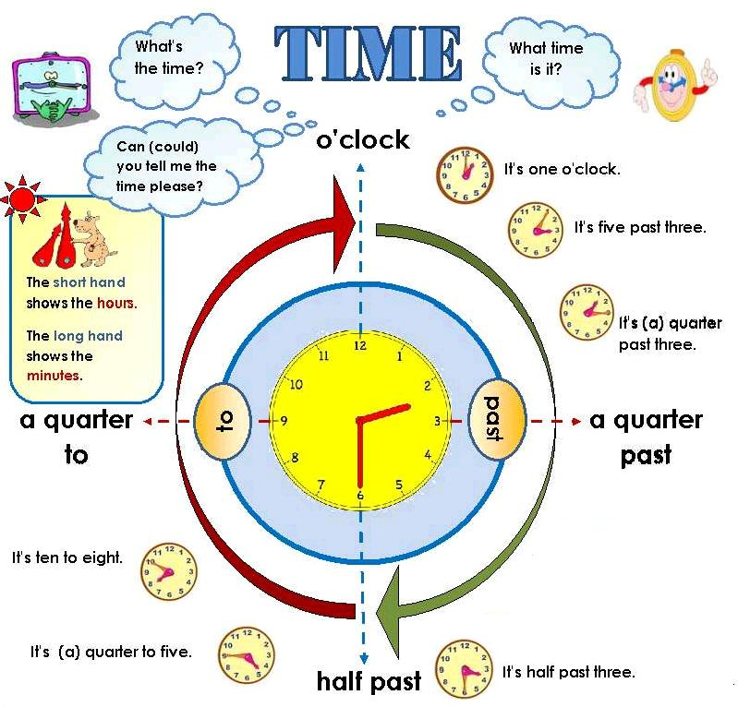

Slide 2
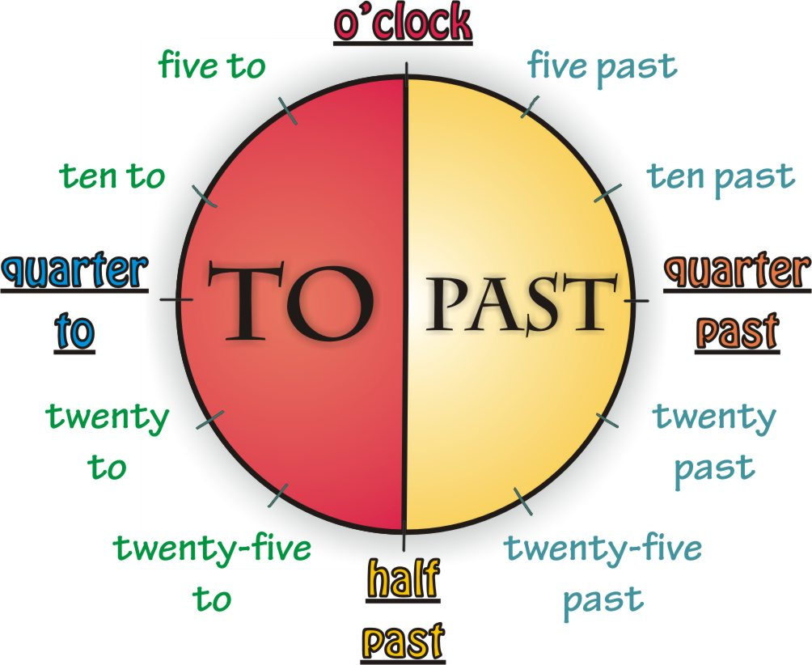

Slide 3
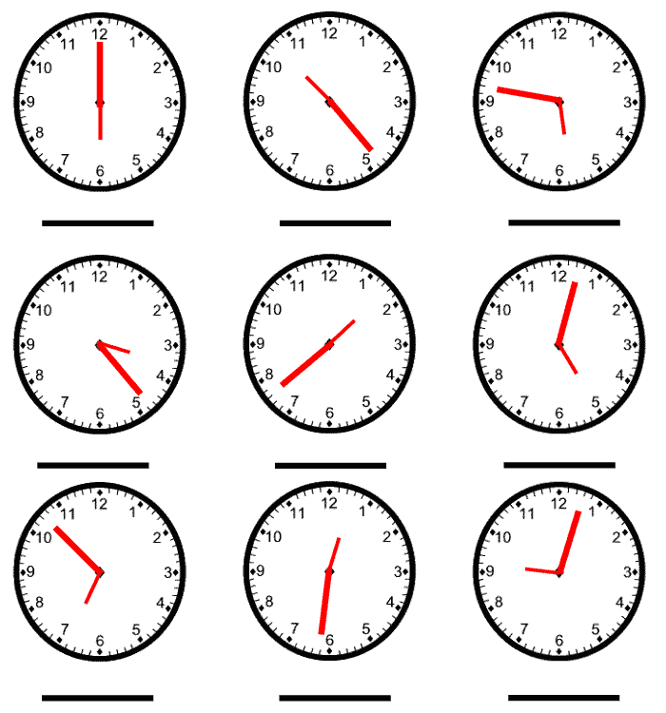

Slide 4
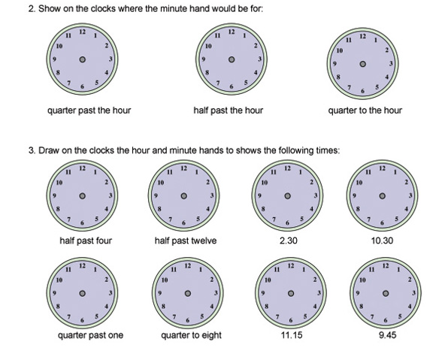

Slide 5
Practice with time click on the following link:
http://resources.oswego.org/games/BangOnTime/clockwordres.html

