Slide 1
Writing/Speaking Assignment | Write a paragraph of 10 lines min. answering the following questions, Support your pharagraph with the grammar and vocabulary of Unit 8 lessons 1-5 Would you have had a better life if you had lived in another era ? Would your life have been better if you´d been born in another place? If you hadn´t born in the place you were born, where would you have born? If you hadn´t studied this career what other career would you have chosen?
Due date | March 16th
Your Paragraph here: (Font arial 10, margin 1 )
I think I probably wouldn’t. It hasn’t been that long since women started fighting for their rights, If I had lived in another era I definitely wouldn’t have as many rights as I do today; putting that aside If I had had the chance to choose, I would’ve picked Amsterdam or France in 1870’s.
Chances are pretty good, I wish would have been born in a country with a better economical state, still, there’s also a big probability of being born in a country with a worse economical state than mine’s. But I also have to consider that my family has been living in here for many years, making roots and building a succesful business.
I wish a would have been born in the french provinces of Canada, as could’ve learned french and english since being a kid, making me able to speak both languages as a native speaker, I also really like the cold weather and I have never experienced skiing.
If I had the chance to chose again, I would’ve chosen something related to art or it’s history since i’m really passionate about it. I also wish I had traveled as an interchange student after I finished highschool. It would’ve given me the chance to explore and learn a lot more about culture and art.

Slide 2
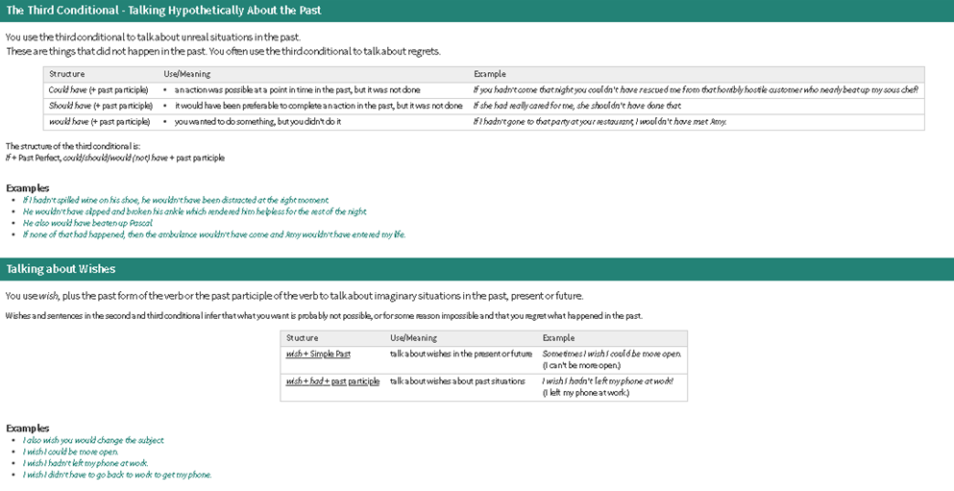
You must include the vocabulary, phrases and the following gramar content of the lesson 1-5

Slide 3
General Requiriment format (5pts) | Good (1) | Satisfactory (.5) | Poor (0)
The task fulfills all grammatical elements of unit content
The task fullfills functions and vocabulary (4 words min) of the unit content.
The task is clear sentences are well applied in context.
Ideas flow in the paragraph and clearly support the main idea.
There are not errors in spelling, capitalization or puncuation.
TOTAL

