Slide 1
Escuela Normal de Educación Preescolar
Ciclo 2020 – 2021
Dibeth Atziri Carreón
Cuarto Semestre
Miss Mayela Alejandra del Carmen Gaona García
ENGLISH B2 ONLINE
WRITING ASSIGNMENT 1.
Write a paragraph
March 3rd, 2021 Saltillo, COAH

Slide 2
Writing/Speaking Assignment | Write a paragraph of 10 lines min. answering the following questions, Support your pharagraph with the grammar and vocabulary of Unit 8 lessons 1-5 Would you have had a better life if you had lived in another era ? Would your life have been better if you´d been born in another place? If you hadn´t born in the place you were born, where would you have born? If you hadn´t studied this career what other career would you have chosen?
Due date | March 16th
Your Paragraph here: (Font arial 10, margin 1 )
I believe that if I had been born in another era, my life would probably be worse. In the old days women were treated unequally, and unfairly. We were put aside and not taken seriously, and I believe that now I live in an era where women are making themselves be heard, where women are standing up for themselves and eachother, so I think I was born in a good era.
I was born in Dallas, Texas and I can honestly say that it was a good place to grow up, I had a Good and fun childhood, I loved my friends, school was okay, I had many learning opportunities and I was able to grow up bilingual. I believe that obviously, there are always better places to grow up in. Dallas is a great city but it is not the safest, especially where I grew up; there was always fights, robberies and shootings. I think it would have been better to be born somewhere safer, like Finnland or Canada, where everyone is friendly.
If I hadn’t been born in Dallas, I believe with certainty that I would have been born here in Saltillo,Coahuila because this is were my mother is from. My dad is from Dallas so that’s why I was born over there instead of here, but if he hadn’t decided to move back to Dallas, I’m sure they would’ve lived here and have had all of my siblings and me here.
If i hadn’t decided to study preschool education, I know for a fact that I would be studying veterinarian practices. I wanted to be a vet my whole life, ever since I was a Little girl. If you see all of my school work about “what i want to be when I grow up”, it’s all about being a vet. I love animals and I always have, I have a very Deep connection to them. The reason why I decided to not be a veterinarian is because I have a chicken heart and I cannot stand seeing an animal in pain, let alone an animal dying. I would cry everyday and all the time. This is why I decided to become a teacher! I also love kids.

Slide 3
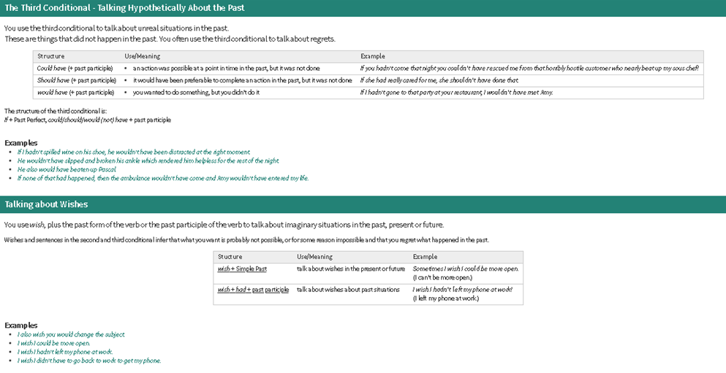
You must include the vocabulary, phrases and the following gramar content of the lesson 1-5

Slide 4
General Requiriment format (5pts) | Good (1) | Satisfactory (.5) | Poor (0)
The task fulfills all grammatical elements of unit content
The task fullfills functions and vocabulary (4 words min) of the unit content.
The task is clear sentences are well applied in context.
Ideas flow in the paragraph and clearly support the main idea.
There are not errors in spelling, capitalization or puncuation.
TOTAL

