Slide 1
Writing/Speaking Assignment | Write a paragraph of 10 lines min. answering the following questions, Support your pharagraph with the grammar and vocabulary of Unit 8 lessons 1-5 Would you have had a better life if you had lived in another era ? Would your life have been better if you´d been born in another place? If you hadn´t born in the place you were born, where would you have born? If you hadn´t studied this career what other career would you have chosen?
Due date | March 16th
Your Paragraph here: (Font arial 10, margin 1 )
If I had been born in another era I would not have liked it at all, because before there were many inequalities for women that would not have allowed me to progress or fulfill my dreams and I would not have been able to have a good life or not at all, although, I do believe that my life could have been better if I had been born in another place, because there are many opportunities out there that would have benefited me to undertake new things in different areas, also people tend to be more open to the new trends that exist and they would not judge you so much, but If I had not been born in Saltillo, I would have liked to be born in Hawaii, because most of the time their lifestyle is very good, people are very free there and that place has very beautiful places to visit and live that would have It helped a lot to be motivated, another place where I would have liked to be born is New York, because there are more opportunities and better schools, but life there is very expensive. Finally, if I were not studying preschool education, the career that I would have liked to study is marine biology or paleontology, because I think these careers are very good and I like them a lot because it is about discovering new species and caring for them, as well as you are in charge of taking care of its habitat so that people do not continue damaging it. I like paleontology because I have always liked dinosaurs and it makes me very interesting to know their past and the new species that existed on the planet.

Slide 2
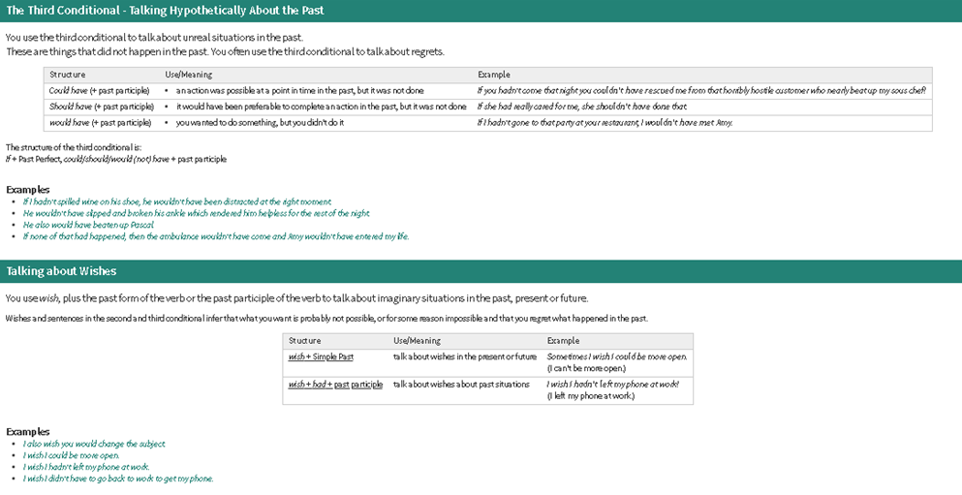
You must include the vocabulary, phrases and the following gramar content of the lesson 1-5

Slide 3
General Requiriment format (5pts) | Good (1) | Satisfactory (.5) | Poor (0)
The task fulfills all grammatical elements of unit content
The task fullfills functions and vocabulary (4 words min) of the unit content.
The task is clear sentences are well applied in context.
Ideas flow in the paragraph and clearly support the main idea.
There are not errors in spelling, capitalization or puncuation.
TOTAL

