Slide 1
Writing/Speaking Assignment | Write a paragraph of 10 lines min. answering the following questions, Support your pharagraph with the grammar and vocabulary of Unit 8 lessons 1-5 Would you have had a better life if you had lived in another era ? Would your life have been better if you´d been born in another place? If you hadn´t born in the place you were born, where would you have born? If you hadn´t studied this career what other career would you have chosen?
Due date | March 16th
Your Paragraph here: (Font arial 10, margin 1 )
I think I would be happier if I lived in another era, like in 1910. I have watched many movies that are developed in those years, without technology, and having contact with all the people arround them. I think I would have enjoyed my life more if I lived at that time.
When I was going to be born, my mom had the oportunity to give birth in the United States. So, I think my life could have been better now. Although I could have been born in U.S.A, I would like to have been born on a place near the beach.
If I hadn`t studien this career, what other career would I have chosen? Well, I wish I was a full time mom, but the truth is I have to work somewhere in the future, so if I hadn`t chosen this career,maybe I would continue studying medicine.

Slide 2
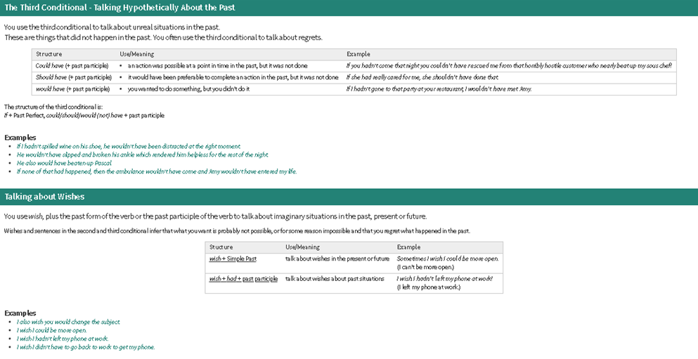
You must include the vocabulary, phrases and the following gramar content of the lesson 1-5

Slide 3
General Requiriment format (5pts) | Good (1) | Satisfactory (.5) | Poor (0)
The task fulfills all grammatical elements of unit content
The task fullfills functions and vocabulary (4 words min) of the unit content.
The task is clear sentences are well applied in context.
Ideas flow in the paragraph and clearly support the main idea.
There are not errors in spelling, capitalization or puncuation.
TOTAL

