Slide 1
Valeria Galindo Torres
English B2+
March 16, 2021

Slide 2
Writing/Speaking Assignment | Write a paragraph of 10 lines min. answering the following questions, Support your pharagraph with the grammar and vocabulary of Unit 8 lessons 1-5 Would you have had a better life if you had lived in another era ? Would your life have been better if you´d been born in another place? If you hadn´t born in the place you were born, where would you have born? If you hadn´t studied this career what other career would you have chosen?
Due date | March 16th
Your Paragraph here: (Font arial 10, margin 1 )
If I had lived in another era, I think that with what I know now, in some aspects it would be very fun and very beautiful, but I think it was a much more conservative life especially for women, with fewer opportunities and equality; I'm sure I couldn’t have done 90% of what I like to do nowadays but people at that time didn't really realized it.
If I had been born in another place, I think my life would have been relatively the same because I think that the circumstances and experiences that I have had have been largely influenced by my parents and my brother, so no matter the place, it would have been similar.
If I hadn't been born in the place I was born, I would have liked to be born in the United States and I think it's because fortunately I have been able to visit some cities and I really like everything, like the small cities with history, the big cities with its buildings, the different stores and restaurants there. Besides that, together with my family, we always find fun things to do.
About the career, if I had not studied this career I would be very unhappy since initially I was studying engineering which made me very unhappy, and it took me a year to realize it and being here is the best decision I have made.

Slide 3
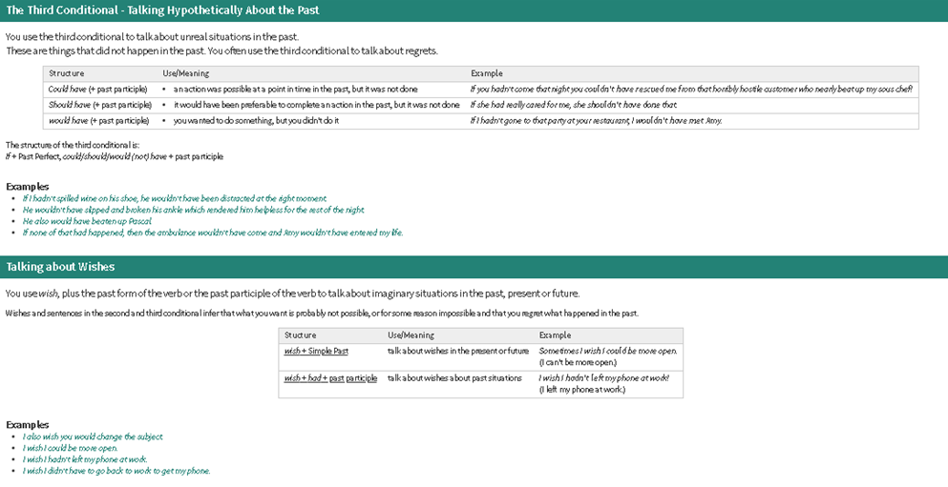
You must include the vocabulary, phrases and the following gramar content of the lesson 1-5

Slide 4
General Requiriment format (5pts) | Good (1) | Satisfactory (.5) | Poor (0)
The task fulfills all grammatical elements of unit content
The task fullfills functions and vocabulary (4 words min) of the unit content.
The task is clear sentences are well applied in context.
Ideas flow in the paragraph and clearly support the main idea.
There are not errors in spelling, capitalization or puncuation.
TOTAL

