Slide 1
PAST TENSE
Memorizing irregular verbs, tips, games and PRACTICE activities

Slide 2
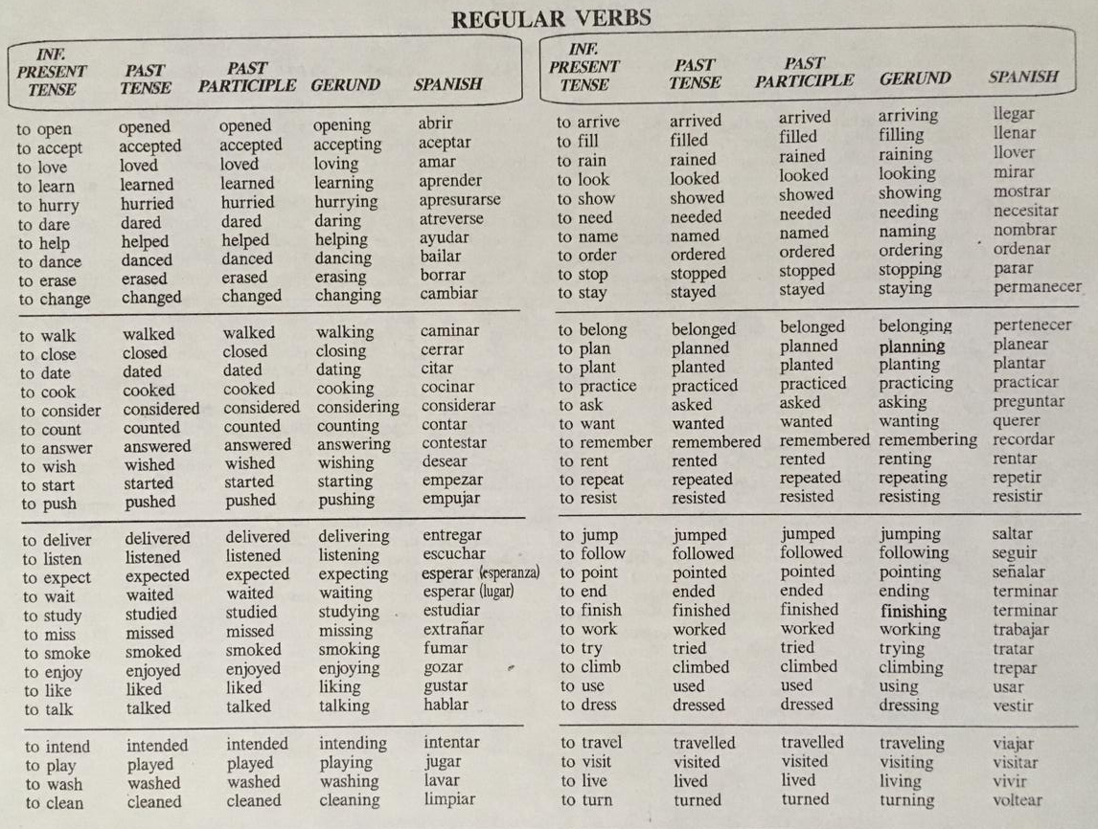
With most verbs, the past tense is formed by adding –ed:
Watch and learn about pronunciation of words ending in –ed
https://www.youtube.com/watch?v=Dsd0eFgU0m8
https://www.youtube.com/watch?v=YWuS7rfZlDQ

Slide 3

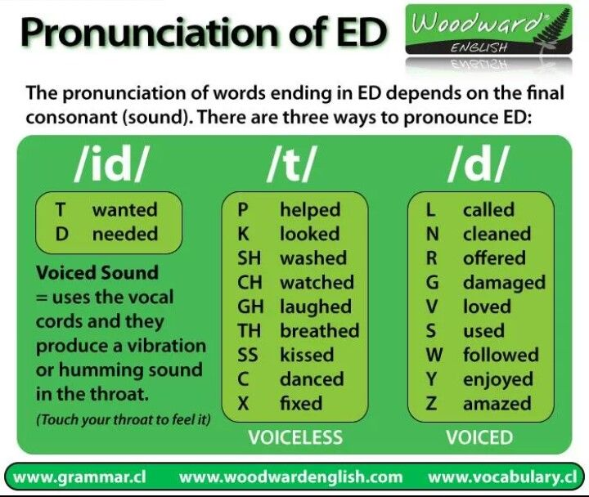
PRACTICE #1
Analyze the information in the green box. Then, add verbs to the chart from list of REGULAR verbs on slide 2. Finally, practice your pronunciation and record your voice as you say your list of verbs.
/id/ | /t/ | /d/
counted | stopped | described
ended | helped | banned
minded | talked | died
started | pushed | filed
cooked | laughed | judged

Slide 4
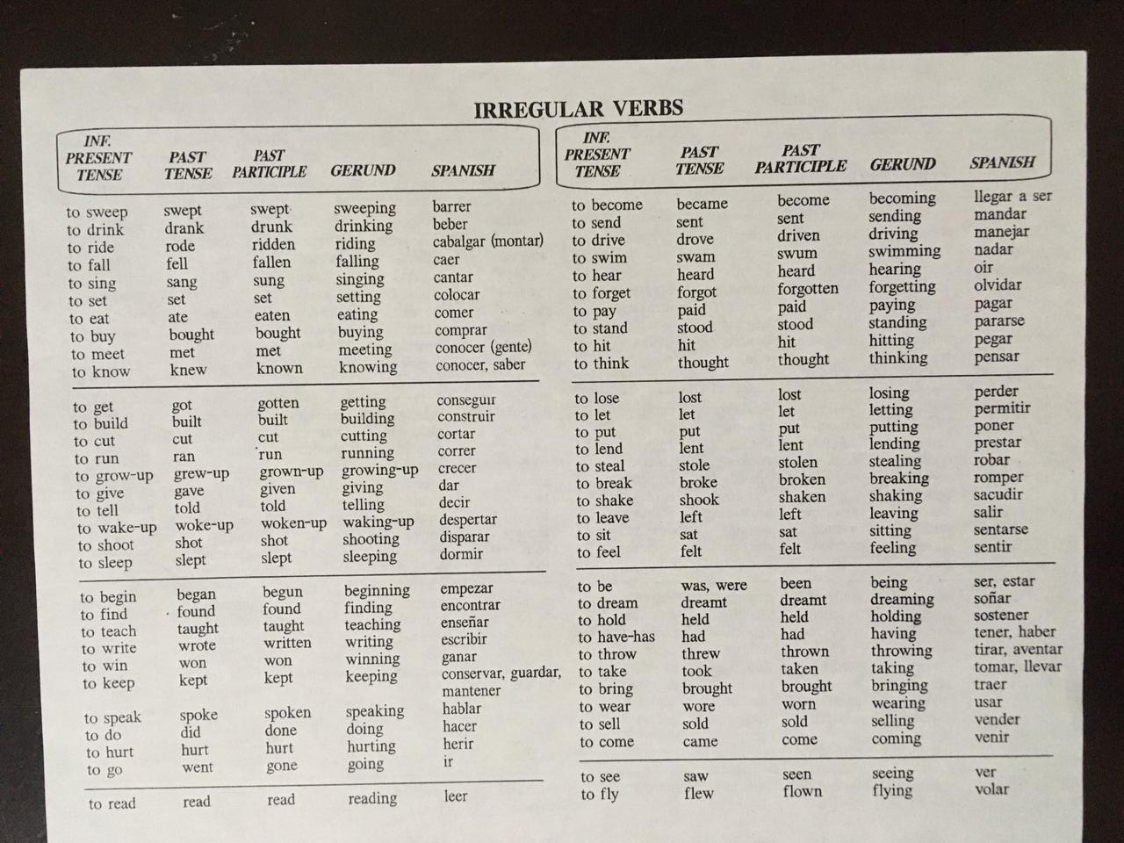
But there are a lot of irregular past tense forms in English:

Slide 5
Here are the most common irregular verbs in English:
be
begin
break
bring
buy
build
choose
come
cost
cut
do
draw
drink
drive
eat
fall
feel
find
fly
forget
get
give
go
grow-up
have/has
hear
hold
keep
know
leave
lead
let
lie
lose
make
mean
meet
pay
put
quit
read
ride
run
say
see
sell
send
set
sit
sleep
speak
spend
stand
steal
swim
take
teach
tell
think
understand
wear
win
write

Slide 6
Tip #1 (self-study)
See videos and practice your pronunciation.
Study 250+ Common Verbs in English in 25 Minutes
https://www.youtube.com/watch?v=VhvpOkEFFEk
Tip #2 (self-study)
There are a few games online that can make remembering the verbs fun and easy. The British Council has a quiz-like game, the MacMillan Dictionary has a verb wheel, and Quia has a game similar to Jeopardy. Take advantage of them:
https://learnenglish.britishcouncil.org/english-grammar-reference/irregular-verbs
https://www.macmillandictionary.com/us/verb_wheel/
https://www.quia.com/cb/8111.html
Tip #3 (self-study)
Do interactive exercises.
https://www.perfect-english-grammar.com/grammar-exercises.html
https://learnenglish.britishcouncil.org/english-grammar-reference/past-simple
https://www.englishclub.com/grammar/verb-tenses_past_quiz.htm

Slide 7
Tip #4
You can make irregular verbs easier for yourself in the future by just learning them right from the beginning. Every time you learn a new verb, learn its tenses as well.
Don’t just learn that to steal means to take something without permission. You should also learn that its simple past tense is stole and its past participle is stolen.
Live session activity
PRACTICE #2
Click on the link and complete the worksheet. Write the different tenses of the verbs under your list number.
https://drive.google.com/file/d/15YUKEwdqJoh0tYsQjTPdMrLj-MiOVShb/view?usp=sharing

Slide 8
Tip #5
Group common irregular verbs together
Irregular verbs don’t follow any rules, which is what makes them so hard to remember. But some irregular verbs follow a similar pattern. Instead of learning the verbs in alphabetical order, try putting them in similar groups.
How you group the verbs depends on whatever is easiest for you, but here are a few suggestions:
Verbs that remain the same in the present, past and past participle.
  Examples: cost and set.
Verbs that are the same in the past forms, but not the present.
  Examples: breed, bred and shoot, shot.
Verbs that end in -en in the past participle.
  Examples: speak, spoken and wake, woken.
Live session activity
PRACTICE #3 Look through the list of irregular verbs and find patterns.
https://drive.google.com/file/d/1hOw8JiQG19L3opzmz2b1R-kbpxU45WoD/view?usp=sharing

Slide 9
PRACTICE #4
Write these questions in your English notebook. Answer and give complete answers. Take pictures of your writing production and paste it on the next slide.
How did you spend yesterday? Where did you go? Did you have a good time?
Did you do anything special last weekend? What did you do? Was the weather OK? Who were you with?
Did you go anywhere on Friday night? Did you meet any friends? When did you go to bed?
What time did you get up last Sunday?
What was the best thing about your weekend? What would you like to do next weekend?
Where did you spend your last vacation? How long were you there? Who were you with? What did you do there? How was the weather? How was the food?

Slide 10

