Slide 1
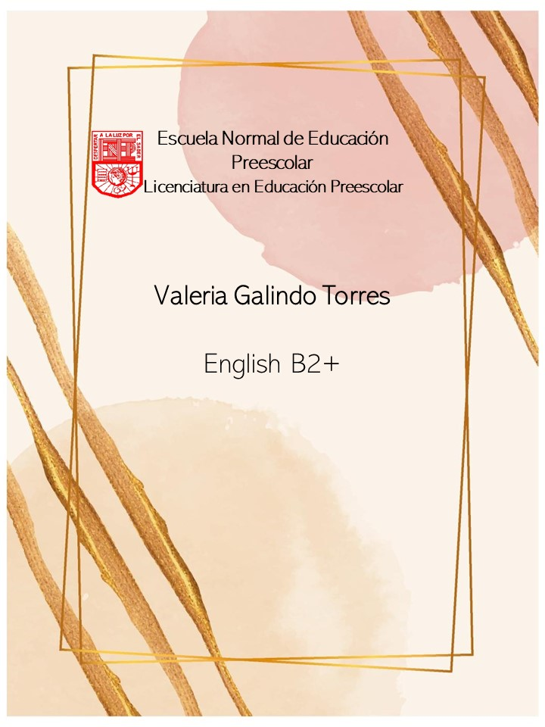
Writing Assignment
April 21, 2021

Slide 2
Writing/Speaking Assignment | Write a paragraph of 10 lines min. answering the following questions, Support your pharagraph with the grammar and vocabulary of Unit 9 lessons 6-10 Have you ever had or witnessed an accident? What did you do? How often are the accidents on the streets in your city? Are they usually major or minor accidents? Have you helped someone in need due to an accident? How did that make you feel?
Due date | April 20th
Your Paragraph here: (Font arial 10, margin 1 )
I personally and fortunately have never experienced any accident or seen one, however, someone I really appreciate have, my boyfriend. He was in a car accident right after dropping me off at my house and was very lucky to get out of the car as it burned down. When his dad called to tell me, I was completely astonished and speechless, it was horrible because he didn’t deserve it.
Unfortunately, accidents on the streets of my city happen literally daily and have no schedule, since they happen in the morning, during the day and even more at night.
The most common accidents are car accidents, ranging from small scratches or hits from one car to another to large accidents where unfortunately people lose their lives.
I have never helped someone who needs it due to an accident, but my boyfriend has done it while we are in the car together, usually it is small things like pushing a car or simply asking if they need any kind of help, and I just wait in the car. And I can fathom why he does it even more nowadays, and it is because when he had his accident only one person helped him.
Seeing these types of actions make me feel very happy and even make me realize that little actions could change someone’s life.

Slide 3
General Requiriment format (5pts) | Good (1) | Satisfactory (.5) | Poor (0)
The task fulfills all grammatical elements of unit content
The task fullfills functions and vocabulary (4 words min) of the unit content.
The task is clear sentences are well applied in context.
Ideas flow in the paragraph and clearly support the main idea.
There are not errors in spelling, capitalization or puncuation.
TOTAL

