Slide 1
ESCUELA NORMAL DE EDUCACIÓN PREESCOLAR
Licenciatura en educación preescolar
Materia: inglés B2 online
Profra.: Mayela Alejandra del Carmen Gaona García
EXTRA MATERIAL TO STUDY AND PRACTICE (ELL UNIT 8 LESSONS 1-6 THIRD CONDITIONAL REVIEW)
Alumna: Yazmin Tellez Fuentes N.L. 13
Sexto semestre Sección A
Saltillo, Coahuila
24 de marzo de 2021

Slide 2
Let´s talk about it!
Would you have had a better life if you had lived in another era ? Would your life have been better if you´d been born in another place? If you hadn´t born in the place you were born, where would you have born? If you hadn´t studied this career what other career would you have chosen? How would your life have been different if you´d chosen a different school? If you hadn´t lived in your current house where would you have lived?
If I had been born in another time period (era) I don't think it would have been better for me because I don't know what would I do without books or internet, I would have been grumpy all the time and bugging everyone. Besides in the past women didn't have the right to go to school and they only were at home and that's not something for me. However it would have been intriguing to see how was life in those moments.
On the other hand, I think that my life could've been lame if I'd been born in another place, because I would not have made the same decisions that took me into this moment of my life. Maybe if I was born in Canada or London I wouldn't have been a teacher or learn another language as I did in this life.
But, I will not have a wall up so if I hadn't born in Mexico maybe I could have born in South Korea, London, Italy because I think those places are amazing.
But, if I hadn't studied this career I would have studied "Idiomas" because I love to learn them and it might be interesting to speak more than two languages.
I think if I’d chosen a different school I’d be sad, because I wouldn’t have met the people that I consider are very important for my in this time of my life. They made my life easier and it’s better to talk about school with them.
Last but not least, I don’t know where would I have lived if I hadn’t live in my current house. I mean, maybe I’d be in Zaragoza or living with one of my uncles or aunts. I have never think about that, to be honest.

Slide 3
CLICK ON THE FOLLOWING LINK TO STUDY AND PRACTICE THE THIRD CONDITIONAL (THERE ARE THREE EXCERCISES YOU MUST COMPLETE)
https://learnenglishteens.britishcouncil.org/grammar/intermediate-grammar/third-conditional

Slide 4
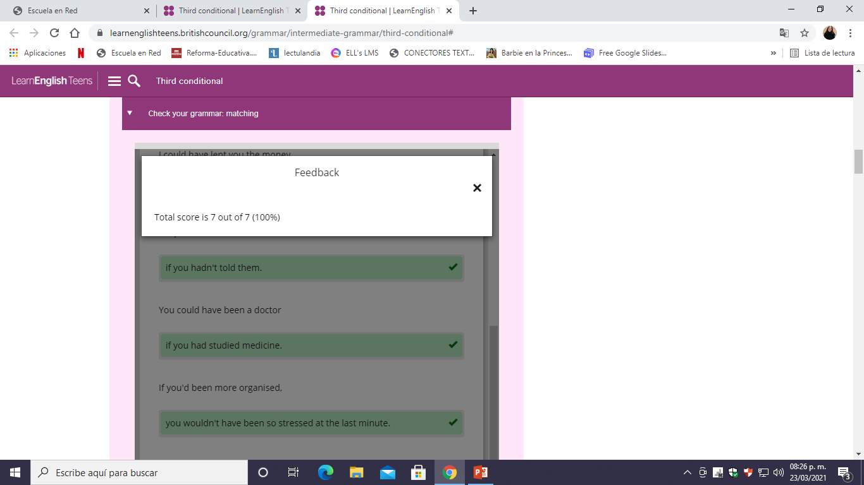

Slide 5
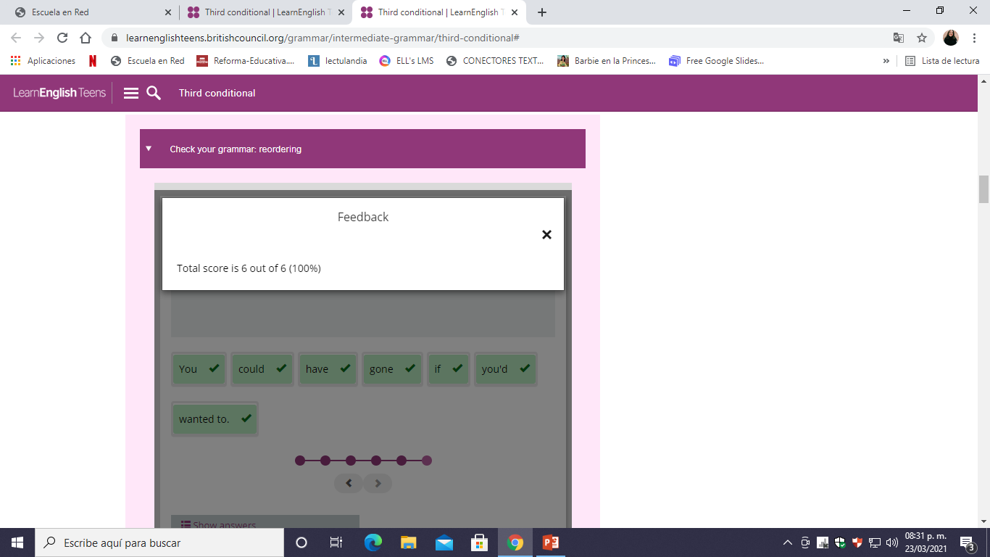

Slide 6
