Slide 1
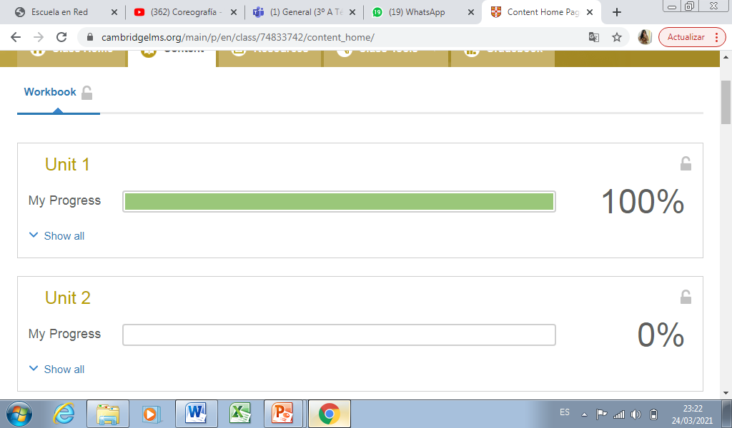
BRISEIDA GUADALUPE MEDRANO GALLEGOS

