Slide 1
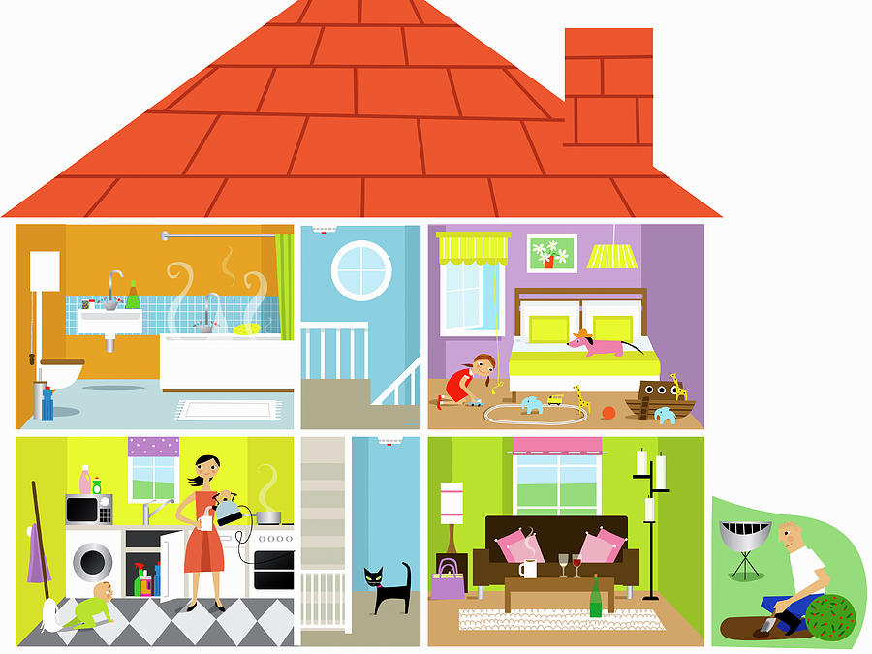
ESCUELA NORMAL DE EDUCACION PREESCOLAR
ENGLISH A1.2
TEACHER: MAYELA LAEJANDRA DEL CARMEN GAONA GARCIA
LEARNING EVIDENCE UNIT 7
MY DREAM HOUSE
Aim:
Give Ss practice in describing their house using there is- there are (+ and -,) to indicate what is on the room, use vocabulary and adjectives to describe each room.
Ss use simple present sentences (+ and - )to say what do they and their family do on each room.
Preparation:
Ss will elaborate a poster (floor plan or origami house)of their house.
Ss will elaborate a video showing their origami house describing the romos of their house using vocabulary of home, furniture and appliances.
Ss will say statements using there Is, there are in positive, negative sentences.
Ss talk about what they have and what they need possitive and negative statements.
Ss have to say also, what do they and their family do on each room of their house. Using sim-ple present sentences ( +,- and ?)
Materials:
Poster paper; pictures, colored pencils
Plan
In a video Ss show their origami house describing the rooms of their house using the elements of the rubric

Slide 2
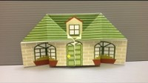
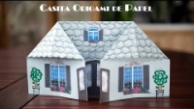
Watch the following video to elaborate yor origami house
english:
https://www.youtube.com/watch?v=OZioO5aeHhY
Spanish:
https://www.youtube.com/watch?v=kQuBWaokJ5o
Show your origami house in a video and talk about it
Eg. I live with my parents(family, friend, etc..) in a house (apartment, etc) There are 5 rooms in my house, the kitchen the living room, etc…, there are chairs in the kitchen, there is a bed in the bedroom, I need a T:V in my bedroom… etc…
Insert your video here.

Slide 3
ESCUELA NORMAL DE EDUCACION PREESCOLAR
ENGLISH A1.2
TEACHER: MAYELA LAEJANDRA DEL CARMEN GAONA GARCIA
LEARNING EVIDENCE RUBRICS
General requirement format (+25pts) | Points | Total pts.
Vocabulary of rooms and furniture from the unit 7 (at least15 words) | 15
Use of statements with have and need (3possitive) Use of statements with have and need (3 negative) Use grammar structures in sentences.. of there is, there are(3possitive) Use grammar structures in sentences.. of there is no, there isn´t a, there aren´t any, there are no. (3 negative) Use of questions in simple present use of auxiliary do and does (at least 3) | 15
Total: | 30
General requirement format (+5 pts) | Good (1) | Average (.5) | Weak (0)
Does the student correctly apply in context the new functions and grammar from the module?
Does the student correctly apply in context the vocabulary from the module?
Does the student express himself or herself clearly and fluently?
The task is creative.
The task fulfill all the elements of the required format
Total:

