Slide 1

Wish You Were Here!
Escuela Normal de Educación Preescolar
English A.2
Teacher: BEATRIZ EUGENIA VALDES RODRIGUEZ
Students: Sofia V. Gaona Montoya
Natalia Guevara García
Mariana E. Martínez Marín
Valeria K. Zamarripa Garza

Slide 2
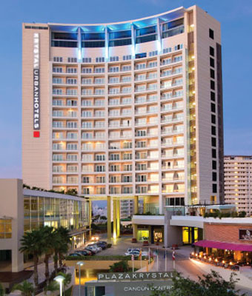
Where you gonna go? Where can you stay?
Hi everyone, we are finally in Cancún, I hope you’re here with us. By the way, if you decide to come, I recomended to you some places to stay. The Kriystal Hotel is the best hotel to stay.
This luxurious hotel, overlooking the Caribbean Sea, is right on the beach, in front of the Cancun convention center and 23 km from Cancun International Airport.

Slide 3
Where can you eat and what?
01
02
03
04
Hotel
Planet Hollywood
Johnny Rockets
Plaza la isla
Hotel Buffet
If you want to feel like a famous, this is the place to feel it.
Hamburguers with milks shake, here, it’s the best combination
You can eat anything you can imagine.

Slide 4

What is the weather like?
The weather on the Yucatan isn't nearly as predictable but rest assured it will get hot and it will be sunny for some part of your stay, this weather man predicts with a 30% accuracy +- 20% 19 times out of 20.

Slide 5
What can you do there?
Just relax
TOURIST
Go to parks
Stay at the hotel just to relax
Cancun is a place where there are many places to visit and learn about the culture
*Xcaret
*Xplor
*Xelhá
*Tulum
*Chichen itzá

Slide 6
Prices for 6 nights/7 days stay
For 7 days and 6 days, you have to pay 845 dollars

Slide 7
Who is going to go with you?
I´m here with my mom, my dad, and my little brother

Slide 8

What transport did you use?
We arrive here in airplane. It was the first time tan I traveled in an airplane, I really like it.

Slide 9
What are your next vacations?
Disneyland
The wizarding world of Harry Potter
I would like to go to:

Slide 10
Category | Score 5 | Score 4 | Score 3 | Score 2
Required elements | Goes over and above all required elements stated in the instructions | Includes all of the required elements stated in the instructions | Missing one or more of the required elements. | Several required elements are missing from the project
Overall effectiveness and completion of task | Project is organized and presents material captivating for viewer | Project is somewhat organized and complete and holds attention of viewer | Project is disorganized and incomplete at times and is somewhat able to hold attention of viewer | Project is incomplete and not easy to follow
Creativity | Exceptionally unique and clever in showing deep understanding | Thoughtfully and uniquely presented; showing understanding | A few original touches enhance the project to show some understanding of the material | Shows little originality and creativity and/or effort in understanding the material
Neatness and attractiveness | Exceptionally attractive and neat in design and layout | Attractive and neat in design and layout | Acceptably attractive but may be messy at times and/or show lack of organization | Distractingly messy or very poorly designed
Grammar | No grammatical or mechanical mistakes | 2 or 3 grammatical mistakes which are not distracting | 4 to 6 grammatical mistakes which are distracting | More than 6 grammar or mechanical mistakes which are very distracting
Understanding of content | Shows a sophisticated understanding of the themes | Shows an understanding of the themes | Displays a somewhat limited understanding of the themes and may have few misinterpretations | Does not show an understanding of the themes. Has quite a few misinterpretations.
Oral presentation | Exceeds expectations in fluency, pronunciation and comprehensibility | Meets expectations in fluency, pronunciation and comprehensibility | Approaches expectations in fluency, pronunciation and comprehensibility | Does not meet expectations in fluency, pronunciation and comprehensibility.
Total 35 pts

