Slide 2
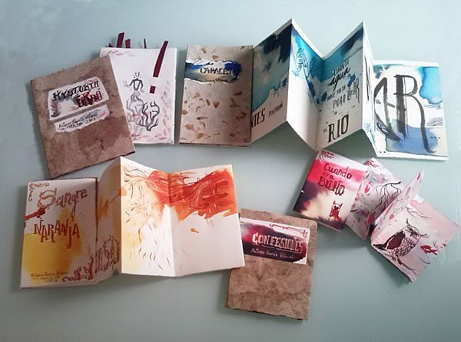
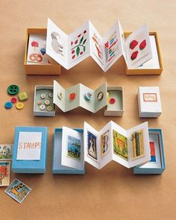
Video del Libro de artista.
https://drive.google.com/file/d/1SjLi8sDEyL1NmJYlnv2ozWmNx2qOYPmm/view?usp=sharing

Slide 3
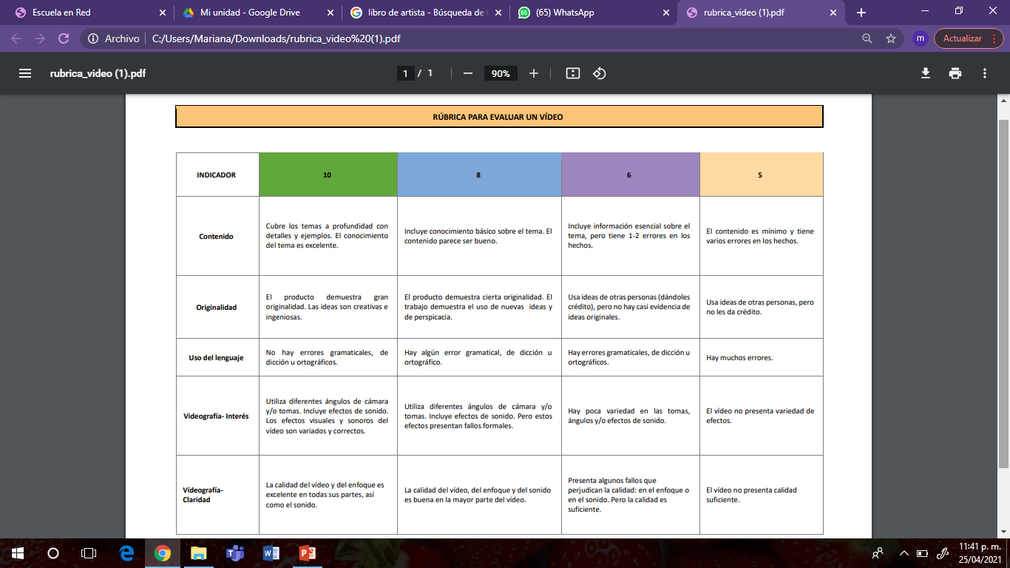
Rubrica

