Slide 1
ESCUELA NORMAL DE EDUCACION PREESCOLAR
March – July 2021
ENLGISH COURES B2+
Proficient Users of English
TEACHER MAYELA ALEJANDRA DEL C. GAONA GARCIA
RUBRICS FOR ACTIVITY 1 UNIT 2

Slide 2
Writing/Speaking Assignment | Elaborate a poster in Canva, include images and audio with your speech (300 words min) giving answer to the following questions. Support your answer with grammar, vocabulary and expressions of unit 10 lessons 1-5 Do you like to think about the future? Can you imagine what your life will be like in thirty years? What will have changed in your life? What will you be doing by this time in thirty years? What types of technology will have changed or dissappeared by then? What will your city be like by then? Note: Your activity must be done in canva.com I suggest to subscribe for free, explore and practice to elaborate a good product. It is a very friendly app in which your ideas are posible.
Due date | May 5th
Your presentation here:
https://drive.google.com/drive/folders/1wprcFEeh6W7Iwcdc6Qnk1cqpjpFuAIr7?usp=sharing
This is the link for my poster and my video speech.
I include the written speech in the page below.
Note: you can also share your presentation by e-mail with the teacher at: mayelaalejandradelcarmen.gaona@docentecoahuila.gob.mx or galejandra@hotmail.com
Before sharing, make sure the sound with your voice and the presentation with your design run perfectly

Slide 3
ANSWERS
Do you like to think about the future?
Can you imagine what your life will be like in thirty years?
What will have changed in your life?
What will you be doing by this time in thirty years?
What types of technology will have changed or dissappeared by then? What will your city be like by then?
To be honest I don’t. It makes me kind of anxious because of all the uncertainty, I have a lot of doubts about it, especially because I hesitate when it comes down to what I want to do for the rest of my life, there are so many things I like and I would love to do with a higher level of knowledge but maybe 10 years from now we won’t be able to because of the state of the earth.
I definitely can’t, I seriously hope a lot of our habits will have changed because we can’t continue draining earth like this. On the other side, I also would like to see all the technological changes there’ll be, maybe even teleportation.
I hope by the time I will be living on my own, owning a stable job and a house. Having studied another career and one or two more languages and I can add better habits from the ones I know now, like recycling and separating the trash.
I have no clue. Like I said before, there are so many things I would like to try, I love the education field but I also would like to try the arts field but maybe earth will be unrecognizable by that time. The idea of having for water and resources is really scary.
I don’t think my city will continue to exist, it will probably have morphed into Saltillo. Maybe everything that involves the creation of paper will seize to exist, like notebooks, books, newspaper, in order to preserve trees, but maybe technology by that time would have found an easier way to purify ocean water so we can keep living in the way we know but keeping in mind what are we leaving to future generations.

Slide 4
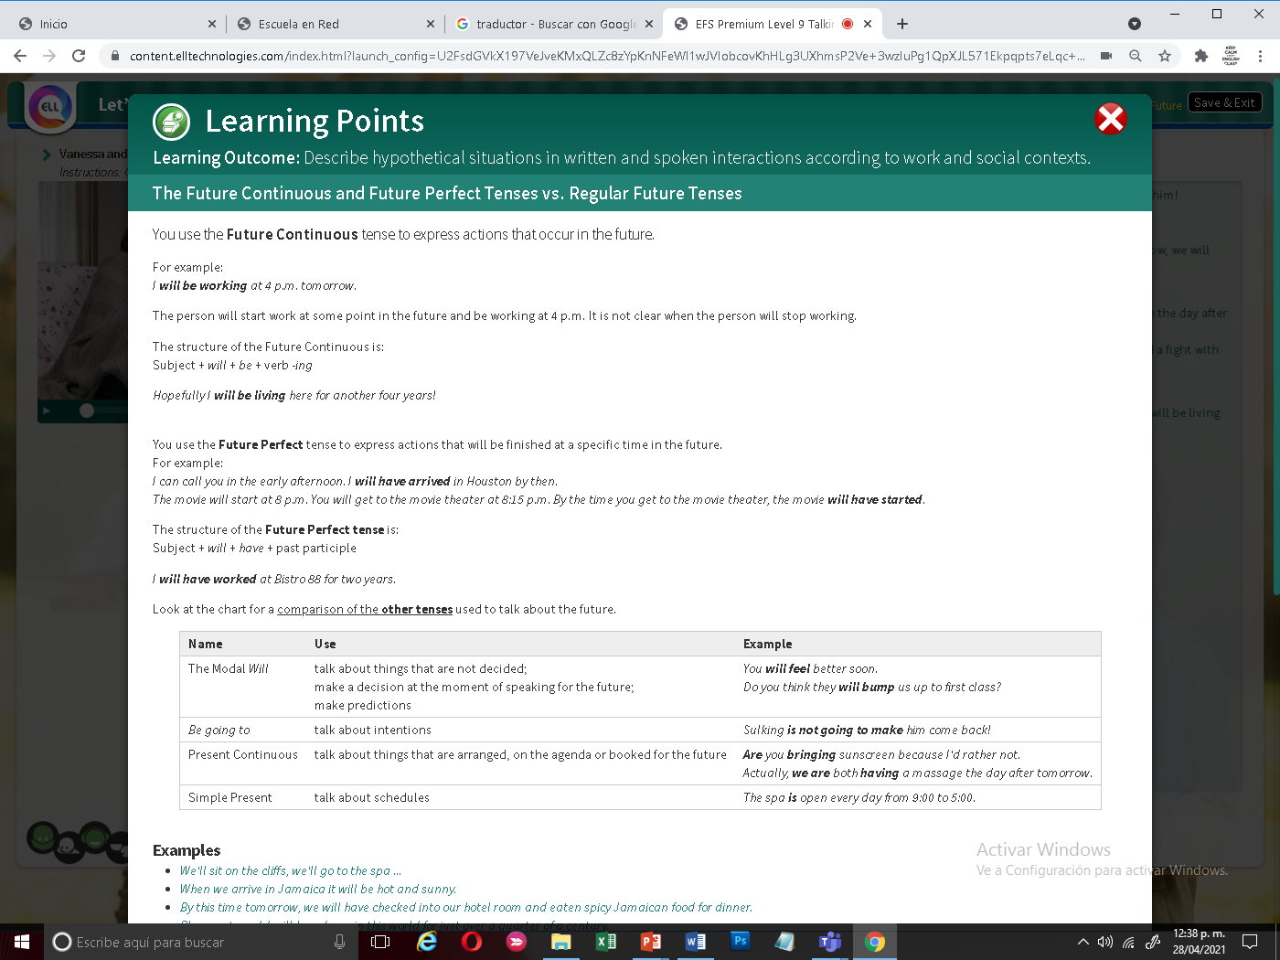
You must include the vocabulary, phrases and the following gramar content of the lesson 1-5

Slide 5
General Requiriment format (5pts) | Good (1) | Satisfactory (.5) | Poor (0)
The task fulfills all grammatical elements of unit content
The task fullfills functions and vocabulary (4 words min) of the unit content.
Communicates efectivly and clearly the ideas in the speech.
Ideas flow in the speech and clearly support the main idea.
The presentation is creative and elaborated in Canva
TOTAL

