Slide 1


Escuela Normal de Educación Preescolar
Licenciatura en Educación Preescolar
Ciclo escolar 2020-202
Curso: English B2
Nombre del titular: Miss Mayela Alejandra del C. Gaona García.
Segundo semestre Sección C
Alumna
Samantha de León Huitrón Ramos

Slide 2
Writing/Speaking Assignment | Elaborate a poster in Canva, include images and audio with your speech (300 words min) giving answer to the following questions. Support your answer with grammar, vocabulary and expressions of unit 10 lessons 1-5 Do you like to think about the future? Can you imagine what your life will be like in thirty years? What will have changed in your life? What will you be doing by this time in thirty years? What types of technology will have changed or dissappeared by then? What will your city be like by then? Note: Your activity must be done in canva.com I suggest to subscribe for free, explore and practice to elaborate a good product. It is a very friendly app in which your ideas are posible.
Due date | May 5th
Your presentation here: (share your link here)
https://www.canva.com/design/DAEe8bsHvNs/share/preview?token=aHZ_OWIJEaDMYpTMLgyq1g&role=EDITOR&utm_content=DAEe8bsHvNs&utm_campaign=designshare&utm_medium=link&utm_source=sharebutton
Note: you can also share your presentation by e-mail with the teacher at: mayelaalejandradelcarmen.gaona@docentecoahuila.gob.mx or galejandra@hotmail.com
Before sharing, make sure the sound with your voice and the presentation with your design run perfectly

Slide 3
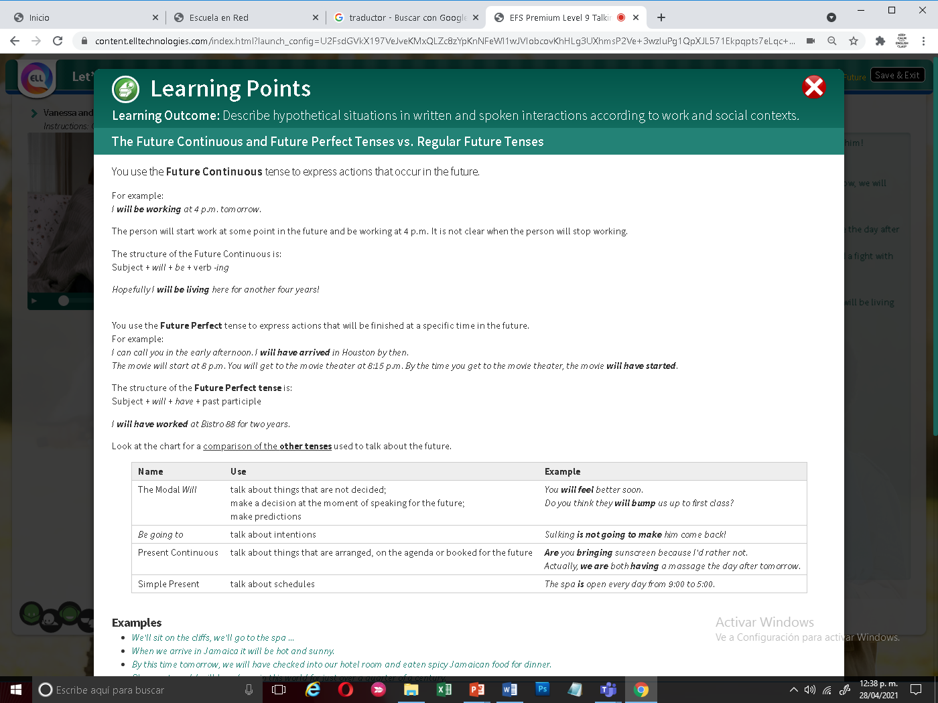
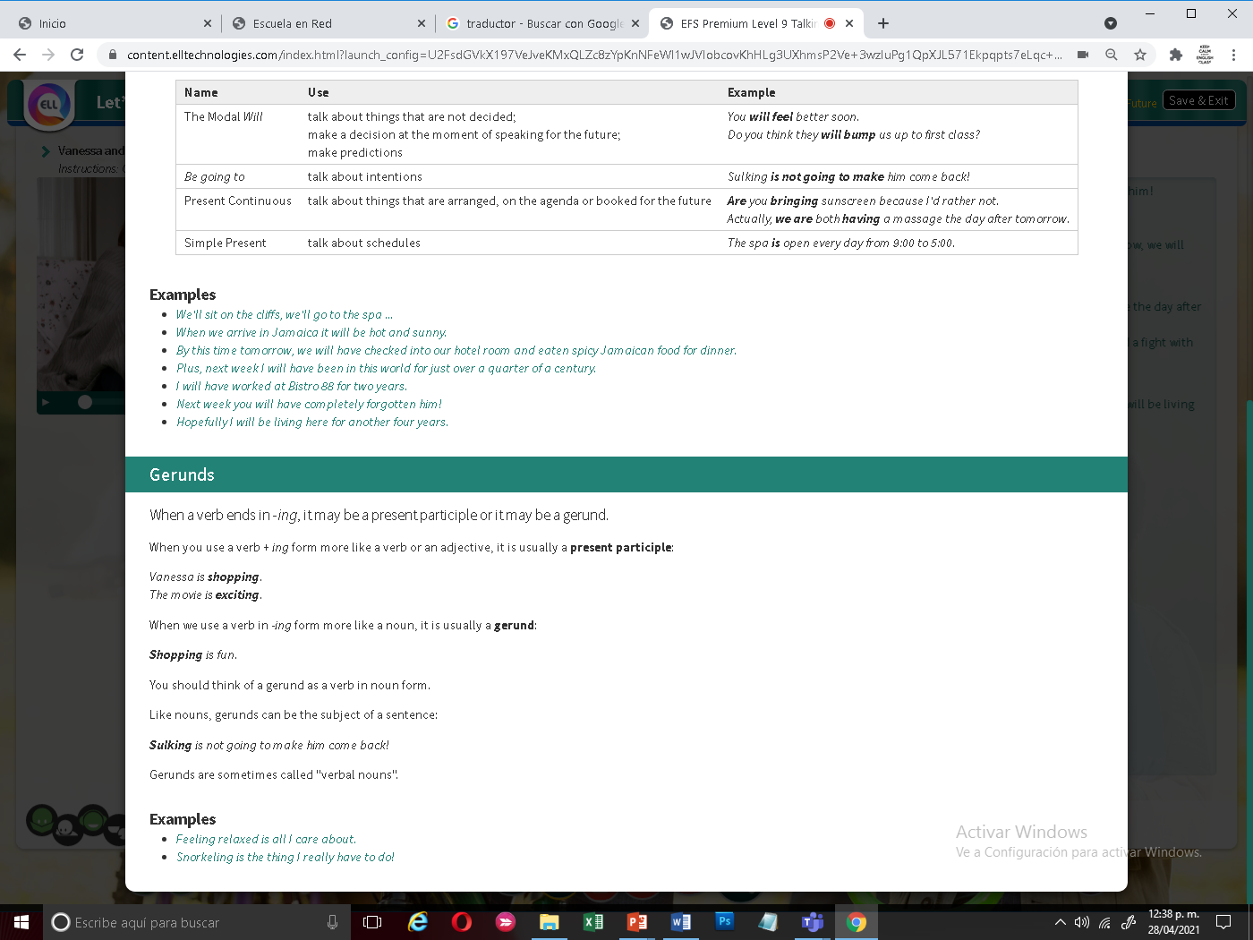
You must include the vocabulary, phrases and the following gramar content of the lesson 1-5

Slide 4
General Requiriment format (5pts) | Good (1) | Satisfactory (.5) | Poor (0)
The task fulfills all grammatical elements of unit content
The task fullfills functions and vocabulary (4 words min) of the unit content.
Communicates efectivly and clearly the ideas in the speech.
Ideas flow in the speech and clearly support the main idea.
The presentation is creative and elaborated in Canva
TOTAL

