Slide 1
ESCUELA NORMAL DE EDUCACIÓN PREESCOLAR
Licenciatura en educación preescolar
Materia: inglés B2 online
Profra.: Mayela Alejandra del Carmen Gaona García
TASK 2 UNIT 2
Alumna: Yazmin Tellez Fuentes N.L. 13
Sexto semestre Sección A
Saltillo, Coahuila
20 de mayo de 2021

Slide 2
Writing/Speaking Assignment | Elaborate an infographic in Canva. Include images and audio with your speech (300 words min) giving information of the life of a famous person from the past that you admire Use the grammar, vocabulary and expressions of unit 11 lessons 1-11 Note: Your activity must be done in canva.com I suggest to subscribe for free, explore and practice to elaborate a good product. It is a very friendly app in which your ideas are posible.
Due date | May 19th
Your infographic here: (share your link here)
https://www.canva.com/design/DAEe-rwR6Eg/ohGt0G6waX3E2MYeu1BBew/watch?utm_content=DAEe-rwR6Eg&utm_campaign=designshare&utm_medium=link&utm_source=sharebutton
Note: you can also share your presentation by e-mail with the teacher at: mayelaalejandradelcarmen.gaona@docentecoahuila.gob.mx or galejandra@hotmail.com
Before sharing, make sure the sound with your voice and the presentation with your design run perfectly

Slide 3
You must include the vocabulary, phrases and the following gramar content of the lesson 1-11

Slide 4
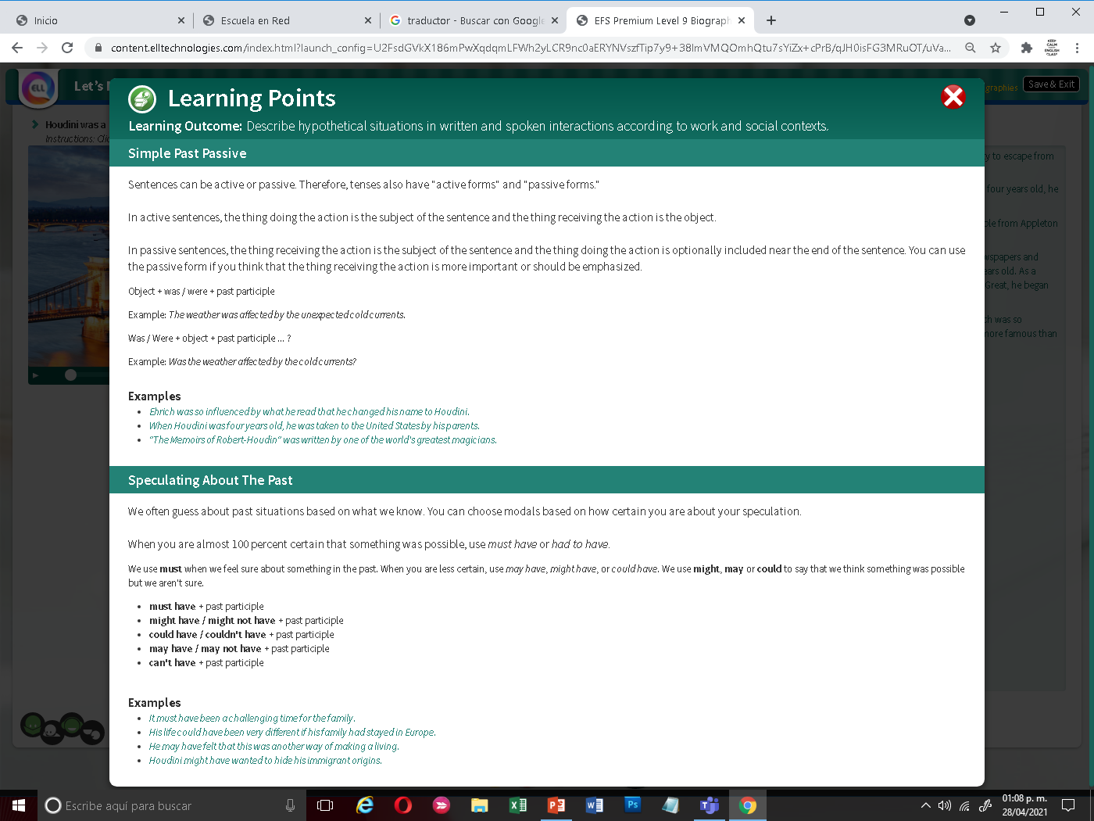

Slide 5
General Requiriment format (5pts) | Good (1) | Satisfactory (.5) | Poor (0)
The task fulfills all grammatical elements of unit content
The task fullfills functions and vocabulary (4 words min) of the unit content.
Communicates efectivly and clearly the ideas in the speech.
Ideas flow in the speech and clearly support the main idea.
The presentation is creative and elaborated in Canva
TOTAL

