Slide 1
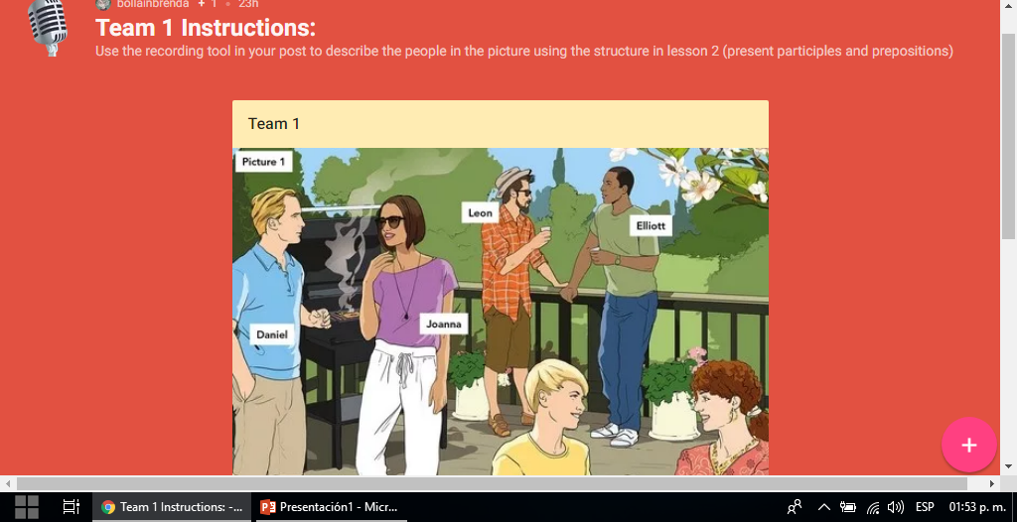
UNIT 2-WHT DOES SHE LOOK LIKE_UNIT PROJECT -PADLET
DANNA RANGEL

Slide 2
