Slide 1
UNIT 2
WHT DOES SHE LOOK LIKE
UNIT PROJECT –PADLET
Student: Brenda Saidaly De la Rosa Rivera

Slide 2
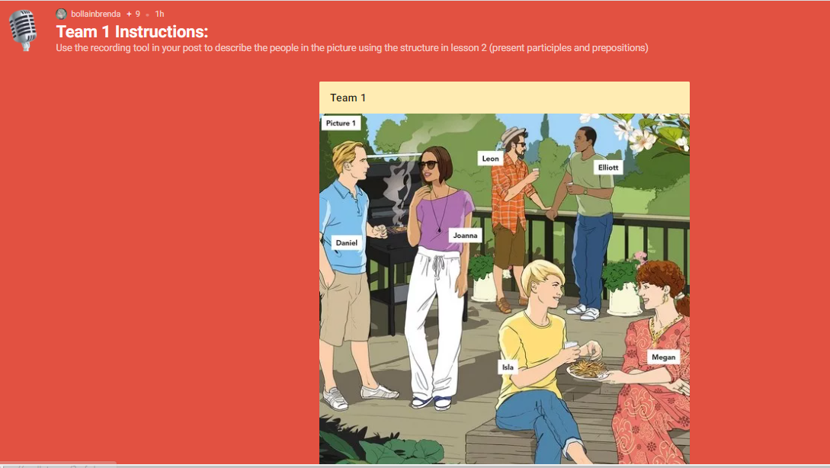

Slide 3
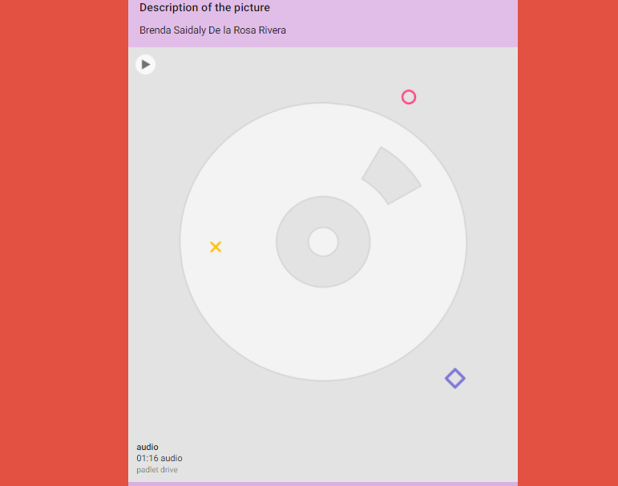

Slide 4
GRADING CRITERIA | Excellent | Good | Needs improvement
content: 6 descriptions using the structure -present participles and prepositions | 2.5 | 2 | 1.5
accuracy | 2.5 | 2 | 1.5
pronunciation & Intonation | 2.5 | 2 | 1.5
vocabulary | 2.5 | 2 | 1.5

