Slide 1
Unit 2 WHT DOES SHE LOOK LIKE- UNIT PROJECT
01
02
Adriana Rodriguez Hernandez
03
04

Slide 2
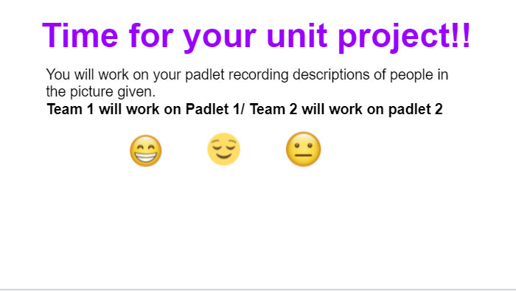
Instructions
01
02
03
04

Slide 3
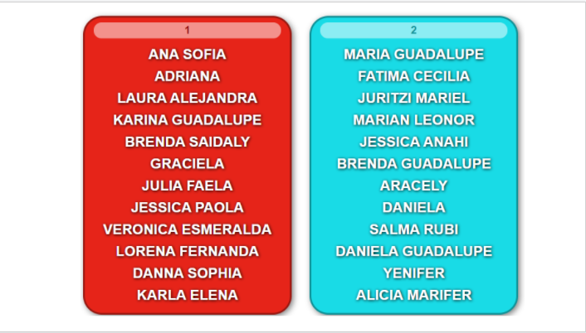
01
02
03
04

Slide 4
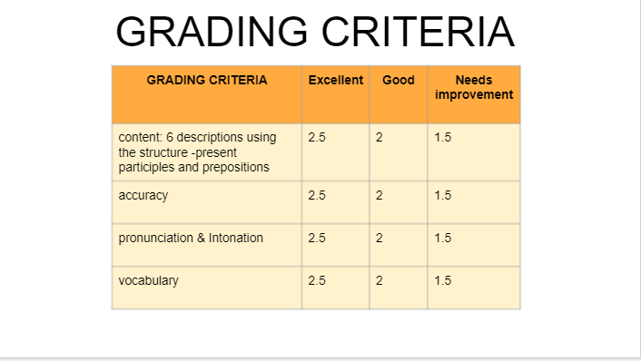
01
02
03
04

Slide 5
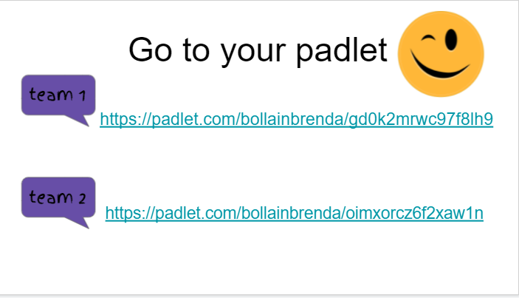
01
02
03
04

Slide 6
Padlet!
01
02
03
04

Slide 7
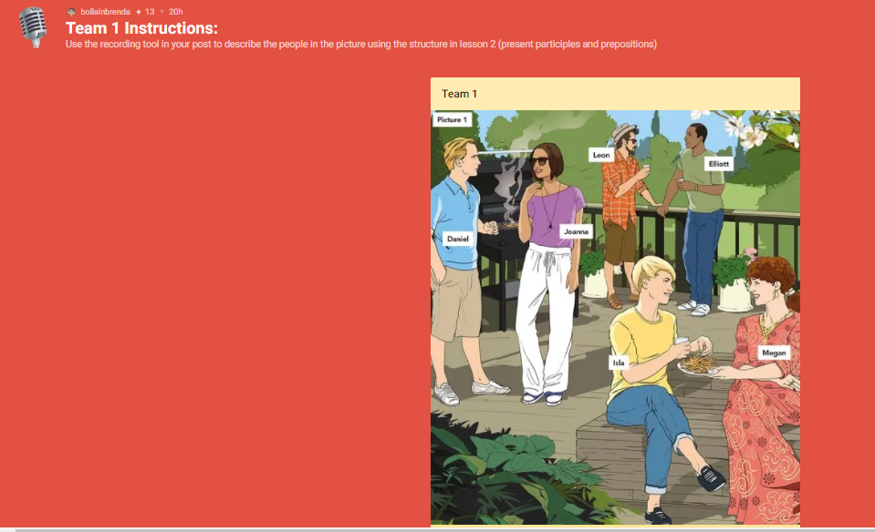
01
02
03
04

Slide 8
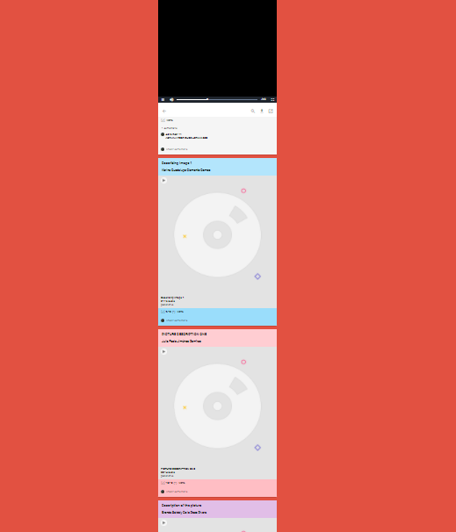
01
02
03
04

