Slide 1
Escuela Normal de Educación Preescolar
Unit 2-WHT Does she look like_unit project-padlet
Lorena Fernanda Olivo Maldonado
Ingles A2.2 1
4 semestre
Teacher: Brenda Bollain y Goytia De La Peña
Mayo 2021, Saltillo, Coahuila

Slide 2
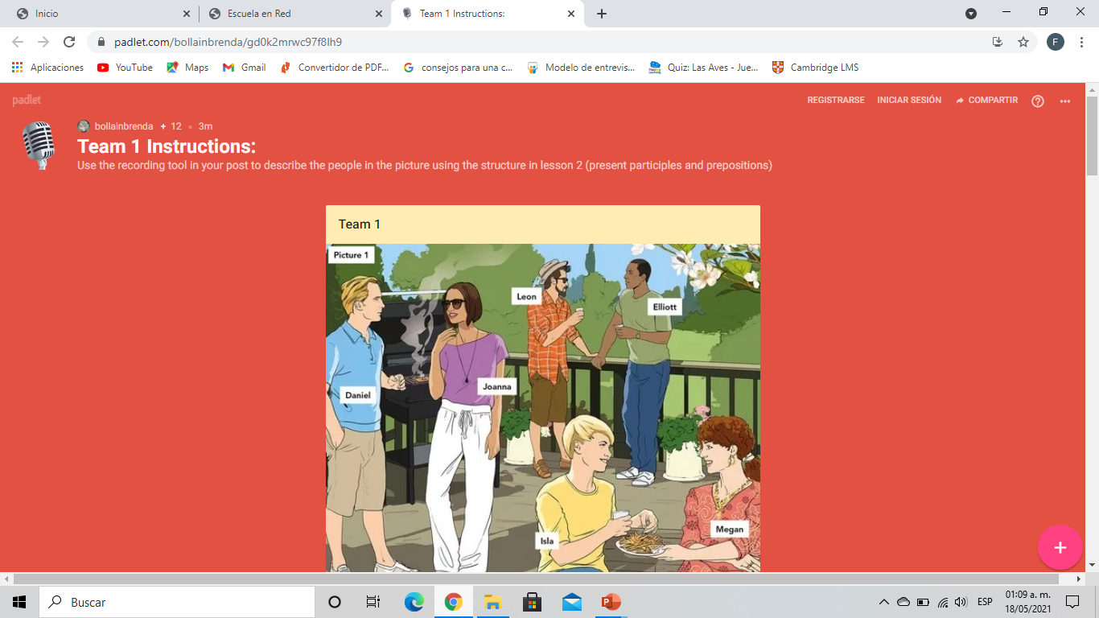

Slide 3
