Slide 1
Evidence
Veronica Esmeralda González Mata

Slide 2
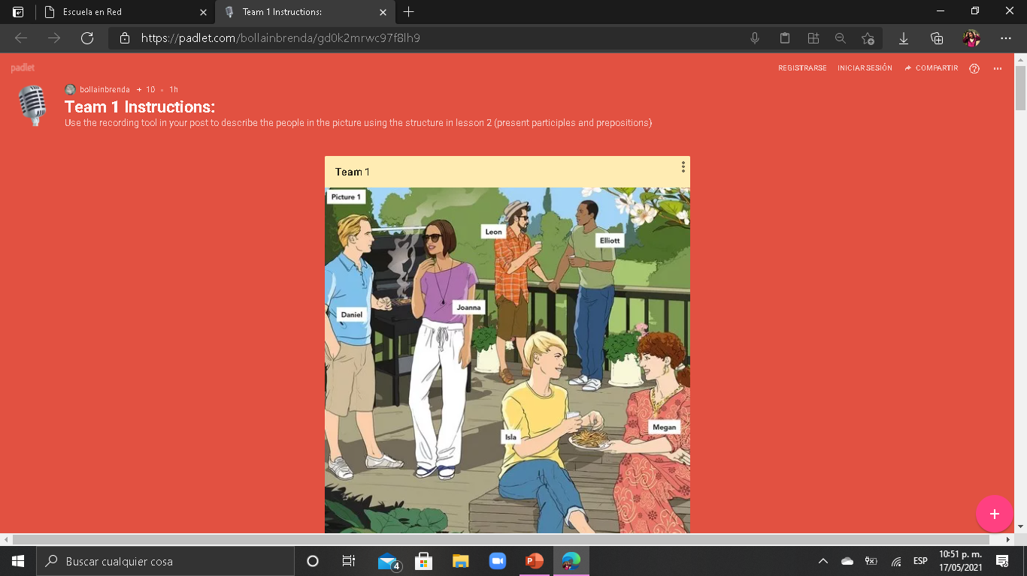

Slide 3
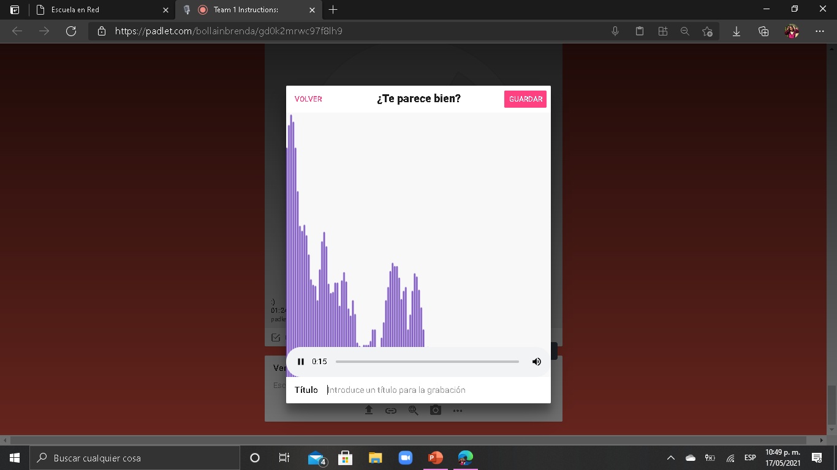

Slide 4
