Slide 1
UNIT 2 -WHT DOES SHE LOOK LIKE_UNIT PROJECT -PADLET
Jessica Anahí Ochoa Ramos.

Slide 3
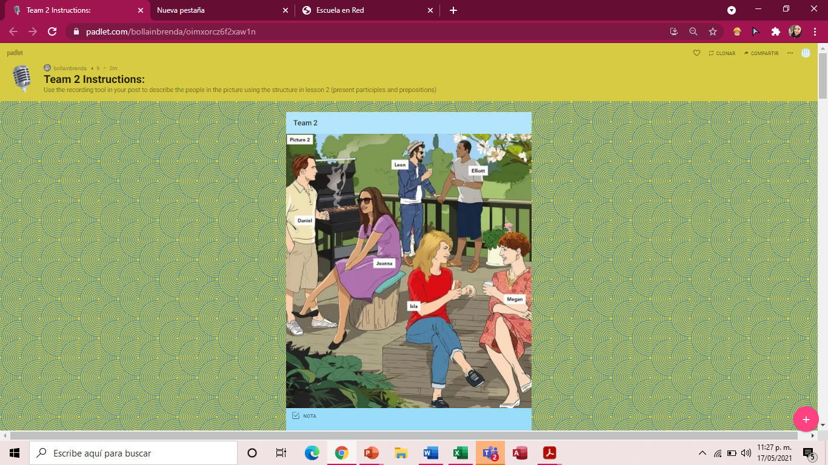

Slide 4
