Slide 1
Unit 2- PROJECT -PADLET
Evidence.
Graciela de la garza barboza.

Slide 2
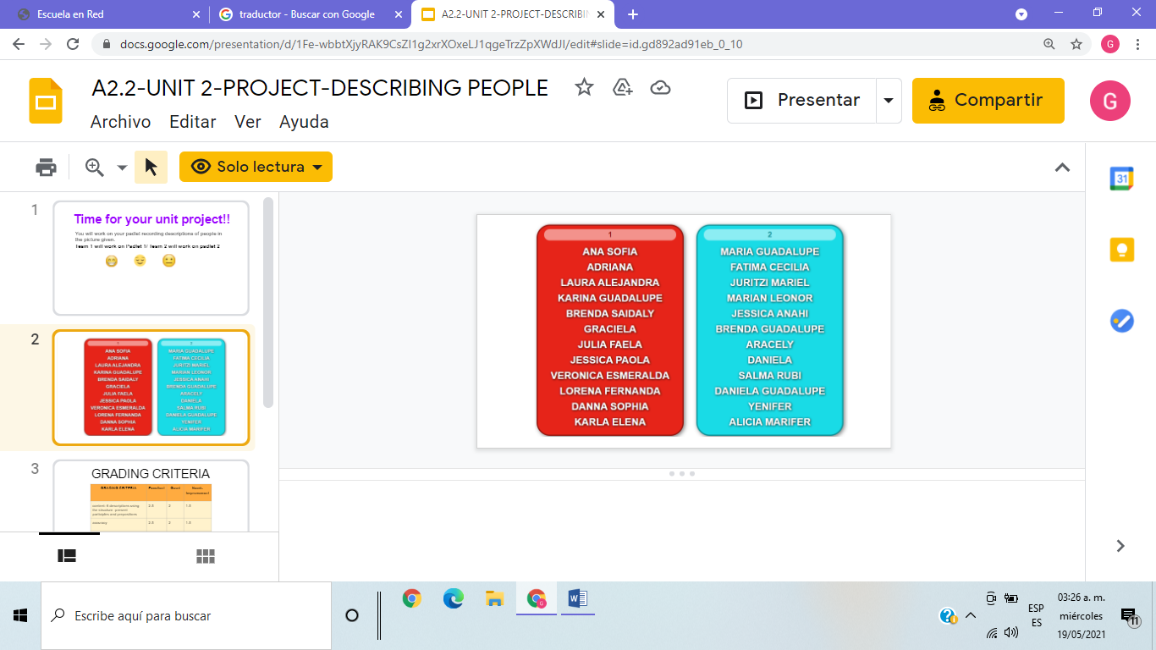

Slide 3
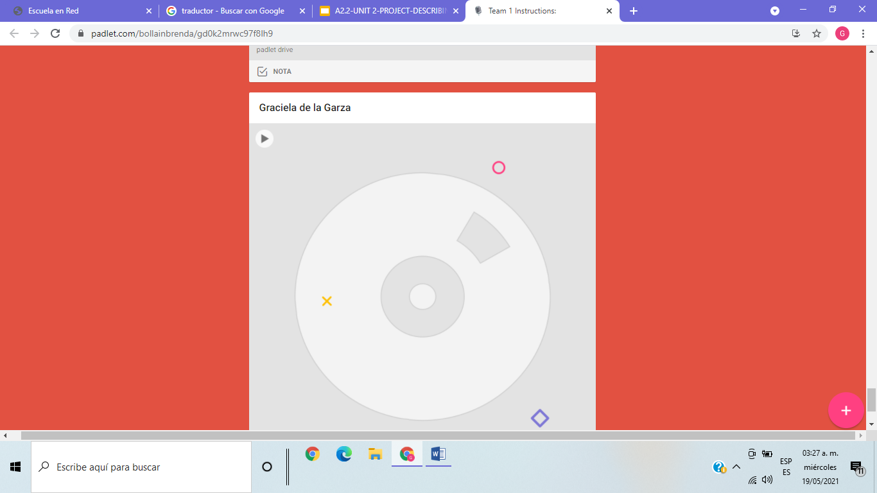

Slide 4
GRADING CRITERIA | Excellent | Good | Needs improvement
content: 6 descriptions using the structure -present participles and prepositions | 2.5 | 2 | 1.5
accuracy | 2.5 | 2 | 1.5
pronunciation & Intonation | 2.5 | 2 | 1.5
vocabulary | 2.5 | 2 | 1.5

