Slide 1
Name: Maria Guadalupe Morales Mendoza
UNIT 2-WHT DOES SHE LOOK LIKE_UNIT PROJECT -PADLET

Slide 2
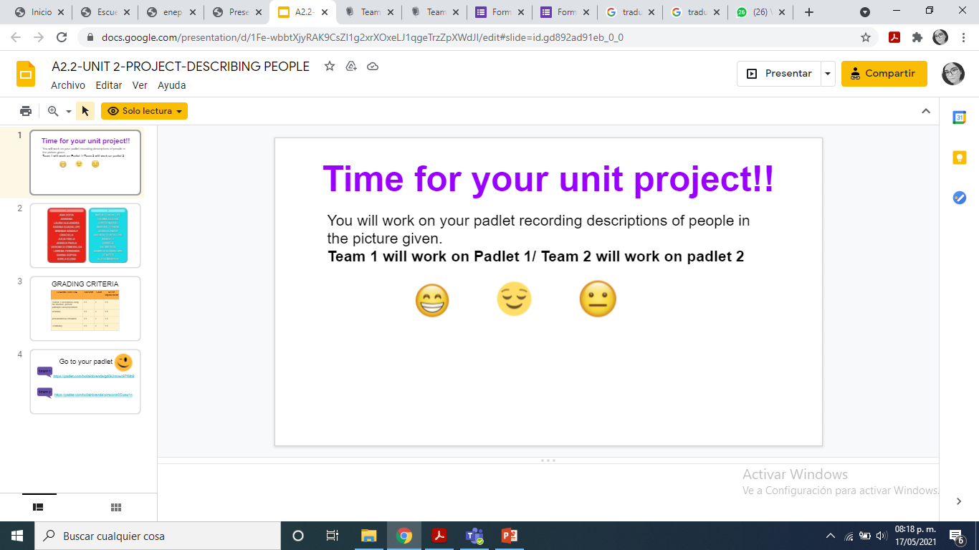

Slide 3
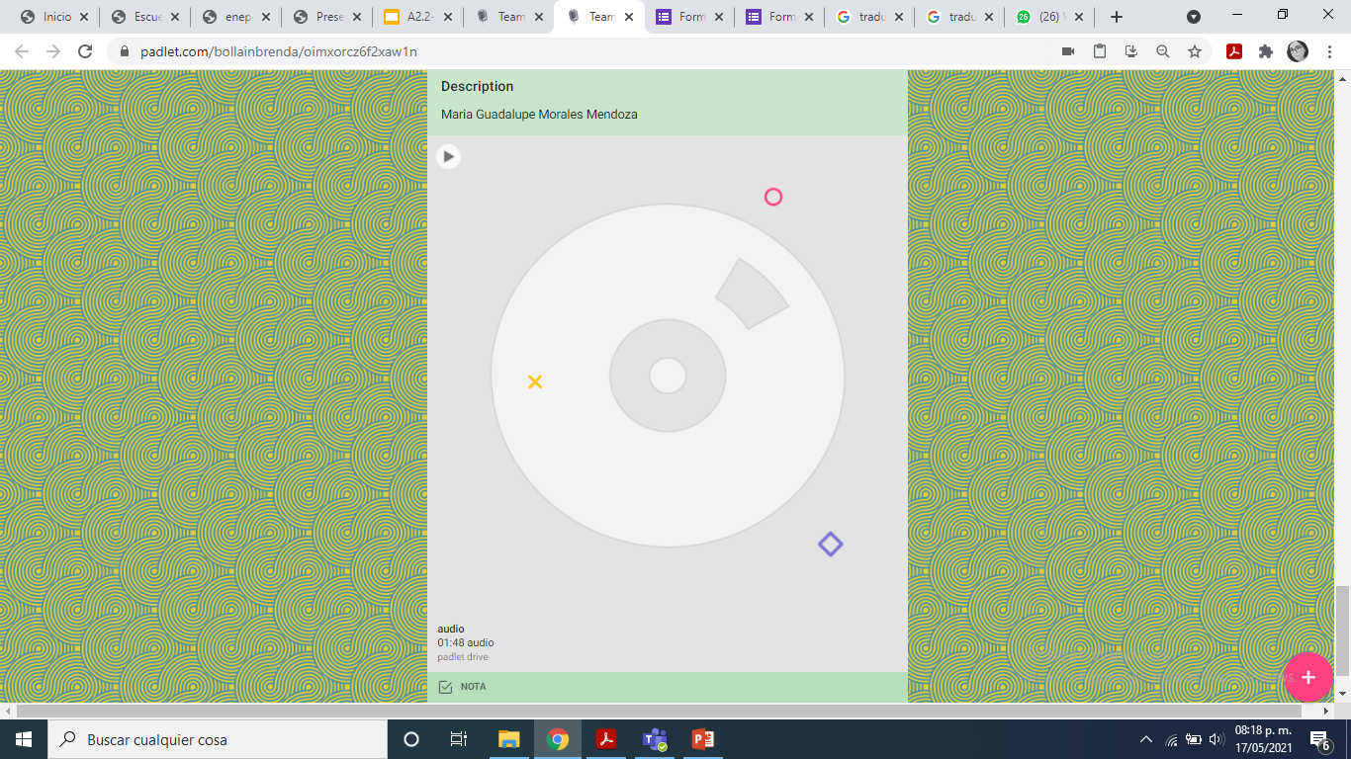

Slide 4
