Slide 1
Evidence
Escuela normal de preescolar
Alumna: salma rubi jiménez uribe
Inglés a2.1

Slide 2
Time for your unit project!!
You will work on your padlet recording descriptions of people in the picture given.
Team 1 will work on Padlet 1/ Team 2 will work on padlet 2

Slide 3
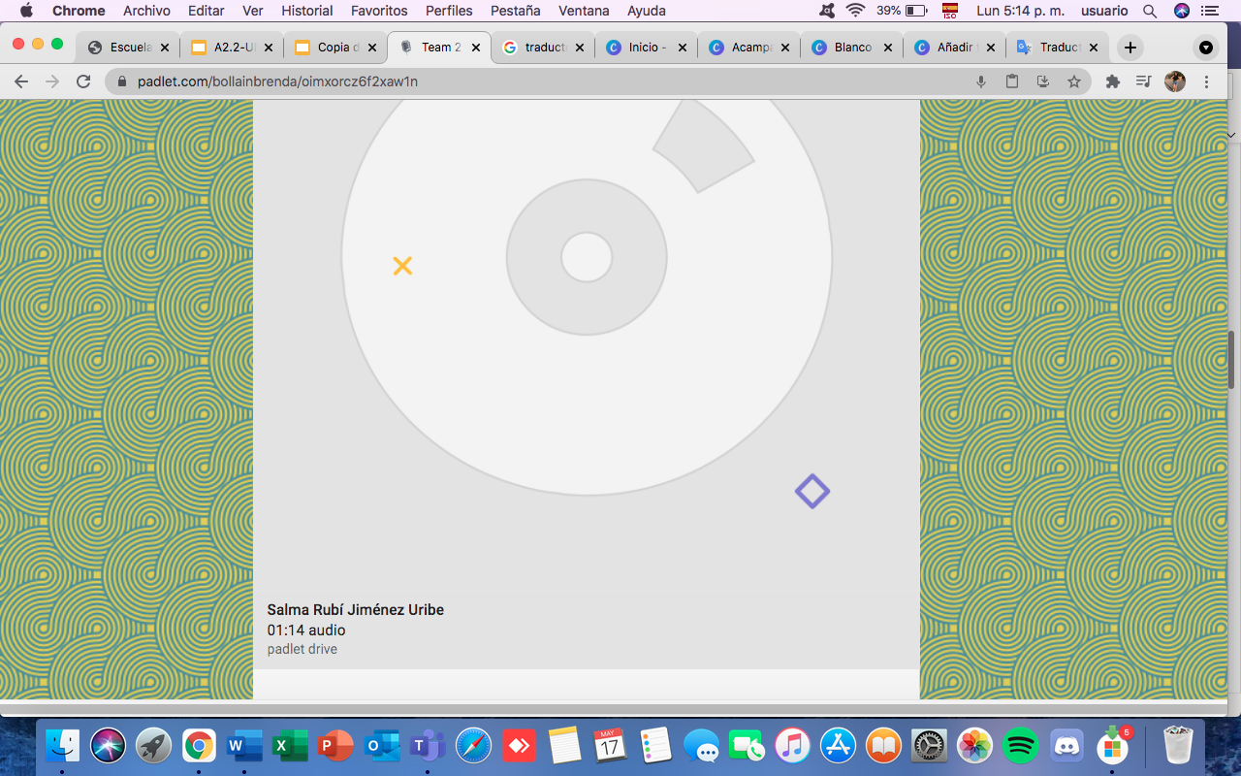

Slide 4
GRADING CRITERIA
GRADING CRITERIA | Excellent | Good | Needs improvement
content: 6 descriptions using the structure -present participles and prepositions | 2.5 | 2 | 1.5
accuracy | 2.5 | 2 | 1.5
pronunciation & Intonation | 2.5 | 2 | 1.5
vocabulary | 2.5 | 2 | 1.5

