Slide 1
I wish I could...
UNIT 2
Practice activities

Slide 2
Dear students,
In this virtual classroom you will find
a useful tutorial to understand the use of wish in the present
some exercises to reinforce the structure
a beautiful song that will serve as spring for your unit project
and the guideline to develop your speaking tasks (unit project)
Have fun & learn!

Slide 3
Go to your tutorial here :
https://eslgold.com/grammar/present_wishes/
Remember to take a screenshot to leave evidence

Slide 4
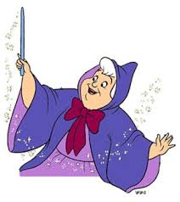
Go to some practice exercises:
Don’t forget to take a screenshot of the activity
http://www.5minuteenglish.com/apr21.htm

Slide 5
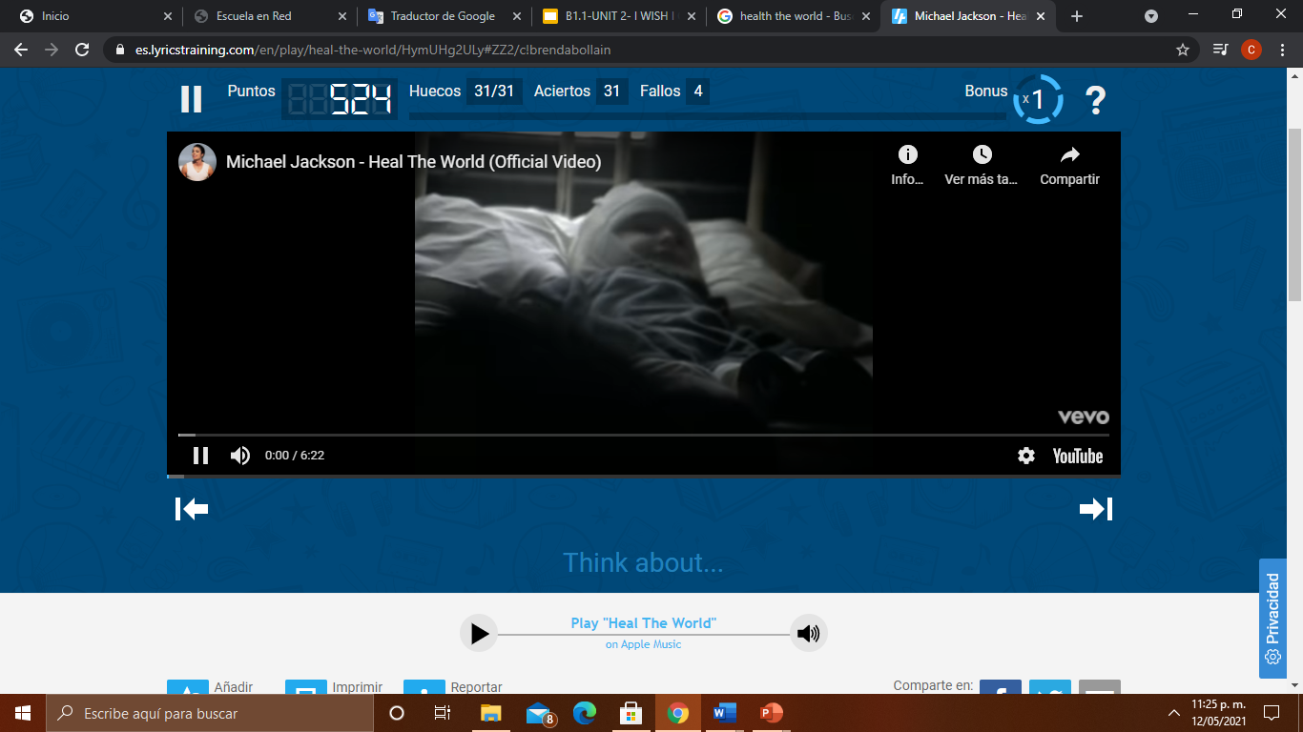
Go to the song here:
Take a screenshot of your score
and keep it as evidence for Escuela en red.
https://es.lyricstraining.com/en/play/heal-the-world/HymUHg2ULy#ZZ2/c!brendabollain

Slide 6
PASTE YOUR EVIDENCE HERE:
https://docs.google.com/presentation/d/15GvvDKK4VvDL-QEF7Fr54HfT4uJJH2qqrzEy-v5ebbg/edit?usp=sharing
Your three screenshots of the previous activities.

