Slide 1
Escuela Normal De Educación Preescolar
Licenciatura en Educación Preescolar
English B1.1
Teacher:
Brenda Bollain Y Goytia De La Peña
Student:
Alexa Carrizales Ramírez
Grado 3
Saltillo, Coahuila May 2021

Slide 2
TIME FOR YOUR SPEAKING PROJECT
Student: Alexa Carrizales Ramírez
UNIT 2
“MAKING CHANGES”
I wish I could..

Slide 3
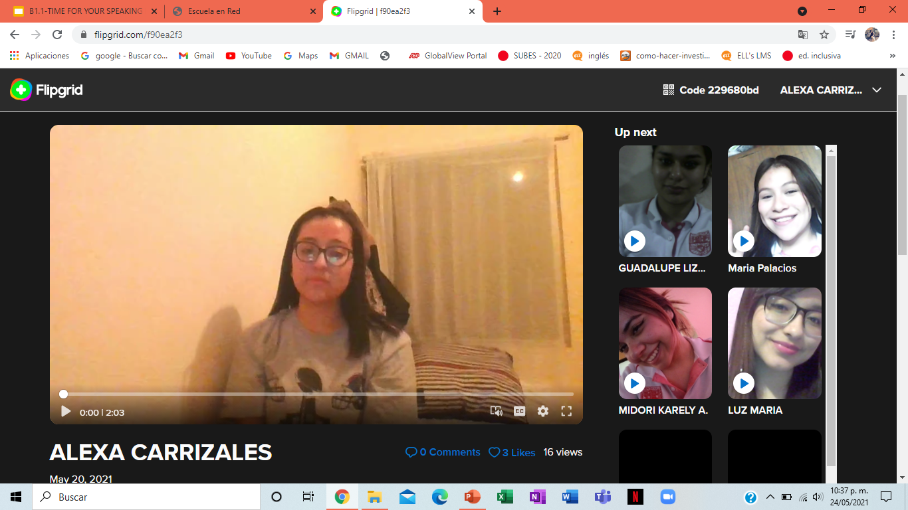

Slide 4
GRADING CRITERIA
criteria | excellent | Good | needs improvement
content | The content includes 3/3 statements 3 pts | The content includes only 2/ 3 2.5 pts | The content includes only 1 statement 2 pts
organization | The information is presented in a clear and organized way. It is delivered in a logical order 3 pts | The information is presented in a somewhat clear and organized way, as well as the logical order of ideas. 2.5 pts | The information lacks organization, and the ideas are not clearly stated and organized in a logical way. 2 pts
Language & delivery of speech | Language is used correctly and creatively, words varied and easy to follow. Good fluency Includes grammar structures seen in the unit 3 pts | Most language is clear, easy to follow and understand. Most of the words are well pronounced. Voice is often clear and there is evidence of some grammar structures seen in the unit 2.5 pts | Language is unclear and hard to understand. Lots of grammar, vocabulary and pronunciation mistakes. Lack of fluency. Poor evidence of grammar structures seen in the unit. 2 pts.
participation | 2/2 responses to others’ participation 1 pt. | ½ responses to other’s participation .5 pts | 0/2 responses to their classmates’ participation 0 pts

