Slide 1
ESCUELA NORMAL DE EDUCACION PREESCOLAR
Licenciatura en Educación Preescolar
Ciclo 2020-2021
“Evidencia”
Asignatura: Ingles
Titular: BRENDA BOLLAIN Y GOYTIA DE LA PEÑA
Alumna: Melissa Martinez Aldaco
Saltillo, Coahuila. 25-05-2021

Slide 2
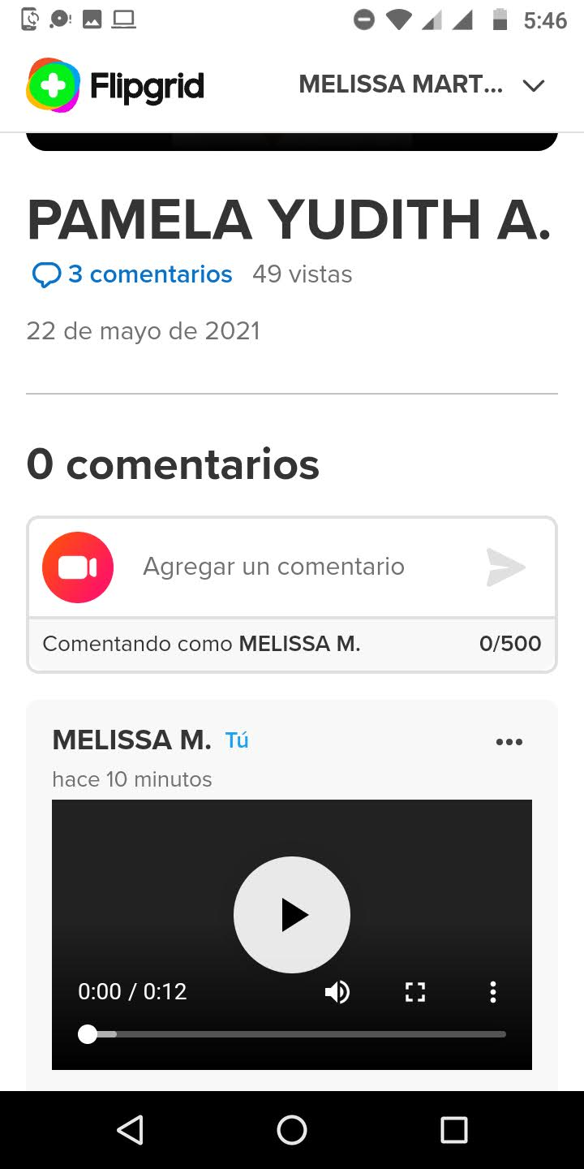
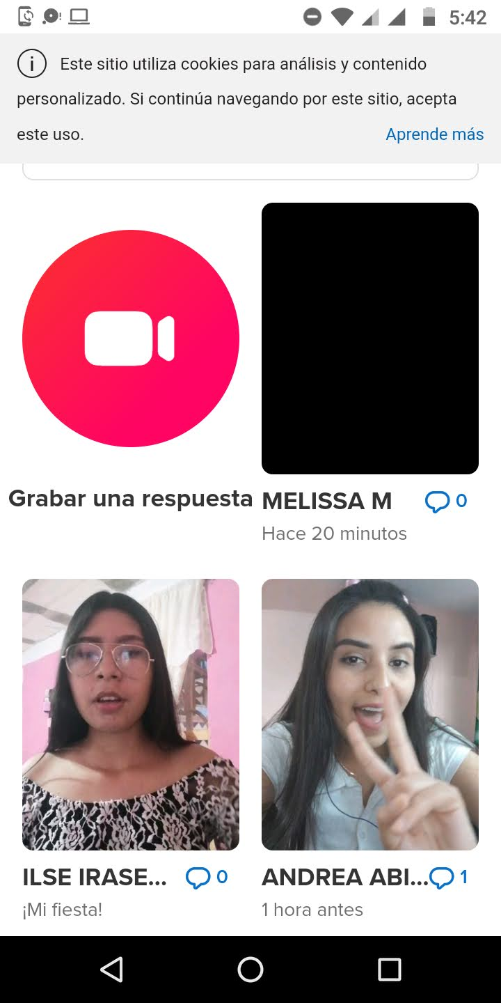
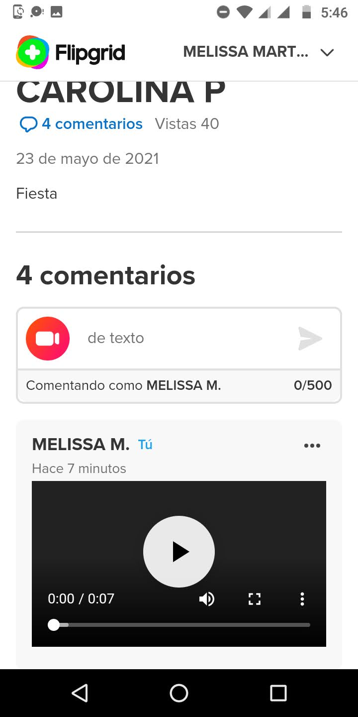

Slide 3
Grading criteria
criteria | Excellent | Good | Needs improvement
content | The content includes 4/4 statements with suggestions about food 3 pts | The content includes only 3/ 4 statements with suggestions about food 2.5 pts | The content includes less than 3 /4 statements 2 pts
organization | The information is presented in a clear and organized way. 3 pts | The information is presented in a somewhat clear and organized way, 2.5 pts | The information lacks organization and the ideas are not clear 2 pts
Language & delivery of speech | Language is used correctly and creatively, words varied and easy to follow. Good fluency Includes grammar structures seen in the unit 3 pts | Most language is clear, easy to follow and understand. Most of the words are well pronounced. Voice is often clear and there is evidence of some grammar structures seen in the unit 2.5 pts | Language is unclear and hard to understand. Lots of grammar, vocabulary and pronunciation mistakes. Lack of fluency. Poor evidence of grammar structures seen in the unit. 2 pts.
participation | 2/2 responses to others’ participation 1 pt. | 1/ 2 responses to other’s participation .5 pts | 0/2 responses to their classmates’ participation 0 pts

