Slide 1
ESCUELA NORMAL DE EDUCACION PREESCOLAR
ENGLISH A1.2
TEACHER: MAYELA LAEJANDRA DEL CARMEN GAONA GARCIA
LEARNING EVIDENCE UNIT 8
Kathia Anahí Castañuela Salas
Jatziry Wendolyne Guillen Cabello
WHAT DO YOU DO?
Aim: Give Ss practice using simple present questions with shorts answers and Wh-questions which include the vocabulary for jobs. Ss will also be able to describe job.
Preparation: Students make an interview to a partner about his/her job
Materials: video of the recorded interview
Plan
PAIR WORK Students elicit a job to talk about it, here are some examples. (you can use some other examples of jobs in the vocabulary given you can wear costumes to characterize your job)
A PREPARE With your partner record an interview make questions about your jobs (student 1 and student 2 take turns to make and answer the questions). You can use the following questions. (Include questions of personal information when start the interview as what´s your name? how old are you? where do you live? )
Do you have a job?
What do you do?
Where do you work?
Do you work in an office, outdoors or home?
Do you work with a team?
Do you use a computer?
Do you use English?
Do you wear a uniform?
How do you like your job?
What is it like?
Is your job interesting (stressful, difficult, easy, boring)?
What time do you start and finish work?
What do you do after work?
B PRESENT Upload your video in this presentation and include the link of your video.

Slide 2
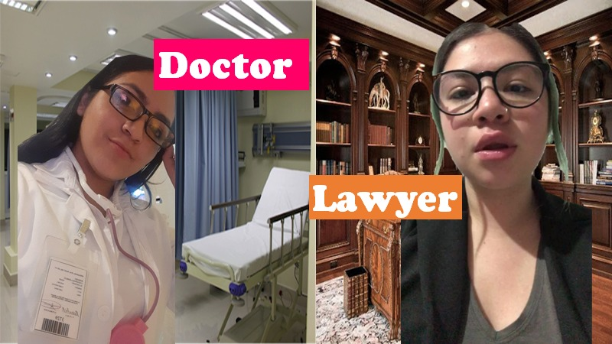
Insert here your video:
(make sure it Works perfectly before you upload your project)
https://youtu.be/C8n1FZIYYf0

Slide 3
ESCUELA NORMAL DE EDUCACION PREESCOLAR
ENGLISH A1.2
TEACHER: MAYELA LAEJANDRA DEL CARMEN GAONA GARCIA
LEARNING EVIDENCE RUBRICS
General requirement format (+25pts) | Points | Total pts.
Vocabulary of jobs and workplaces unit 8 Use of adjectives to describe the job (+5) | 5
Use of simple present (+, -) sentences and questions (10) | 10
Creativity in the presentation of the video (I suggest to wear costumes to characterize your job) | 5
Total: | 20
General requirement format (+5 pts) | Good (1) | Average (.5) | Weak (0)
Does the student correctly apply in context the new functions and grammar from the module?
Does the student correctly apply in context the vocabulary from the module?
Does the student express himself or herself clearly and fluently?
The task is creative.
The task fulfill all the elements of the required format
Total:

