Slide 1

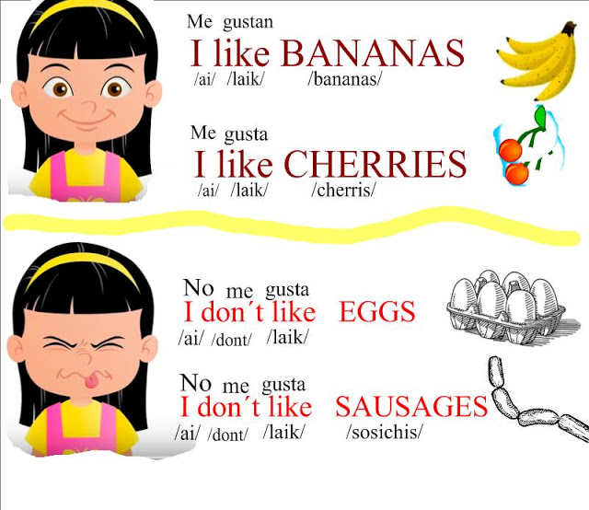
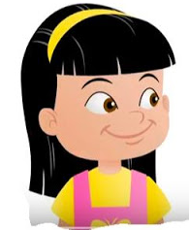
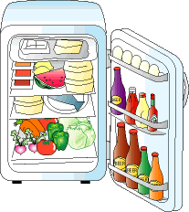
ESCUELA NORMAL DE EDUCACION PREESCOLAR
ENGLISH A1.2
TEACHER: MAYELA LAEJANDRA DEL CARMEN GAONA GARCIA
LEARNING EVIDENCE UNIT 9
WHAT IS IN MY REFRIGERATOR
Aim: Give Ss practice of the unit 9 content
Preparation: Students talk about their eating habits
Materials: A video in which they talk about their personal eating habits
Plan
INDIVIDUAL WORK Students talk about their eating habits, they use expressions as like and don´t like, they use adverbs of frequency to talk about their habits and the vocabulary of unit 9. Students mention what is in his/her refrigerator they use countable and uncountable nouns. Students can follow the next example to make their own practice.
I like fruit, blueberries and apples are my favorites
I don´t like onions and tomatoes in my salad.
I usually have fish or chicken for lunch.
There are some eggs,
I need some chiken.
There are some carrots, onions and a lettuce. I don´t have any milk in my refrigetator
PREPARE individual work record your self talking about what you like and dislike in food. Also mention what are your eating habits (use adverbs of frequency always, often, sometimes, hardly ever, never) Use as much food vocabulary of the unit as you can.
Go to your refrigerator and mention what is in it, use countable and uncountable nouns (a, an, some, any) to give some affirmative and negative sentences. Say what you have, what you need, include also expressions as there is and there are.
PRESENT Upload your video in this presentation and include the link of your video

Slide 2
Insert here your video:
(make sure it Works perfectly before you upload your project)
https://youtu.be/fgElNDg3mfw

Slide 3
ESCUELA NORMAL DE EDUCACION PREESCOLAR
ENGLISH A1.2
TEACHER: MAYELA LAEJANDRA DEL CARMEN GAONA GARCIA
LEARNING EVIDENCE RUBRICS
General requirement format (+25pts) | Points | Total pts.
Vocabulary of food unit 9 (13 words at least) Use of like and don´t like expression. (2) | 15
Use of simple present sentences adverbs of frequency (+4) Use of countable and uncountable nouns (6) (I have, I need, there is, there are) | 10
Creativity in the presentation of the video | 5
Total: | 30
General requirement format (+5 pts) | Good (1) | Average (.5) | Weak (0)
Does the student correctly apply in context the new functions and grammar from the module?
Does the student correctly apply in context the vocabulary from the module?
Does the student express himself or herself clearly and fluently?
The task is creative.
The task fulfill all the elements of the required format
Total:

