Slide 1
Escuela Normal de Educación Preescolar
Licenciatura en educación preescolar
Ciclo escolar 2020 – 2021
INGLES A1.2
2° semestre
MAESTRO: Máyela Alejandra del Carmen Gaona García
María de los Ángeles Guevara Ramírez #11
Cambridge plataform
COURSE COMPETENCES
The students will develop their ability to use English in personal and social communications, to develop relationships, complete transactions and meet every day needs.
The students will increase their engagement with cultural and intercultural activities in English, in order to develop a better understanding of their own culture as well as other cultures around the world
The students will develop their ability to teach in a school environment where English is an important aspect of the school approach. Schools are expected to use English increasingly for various teaching and learning activities, and future teachers need to be confident in using English in the school environment
Saltillo, Coahuila
29/05/2021

Slide 2
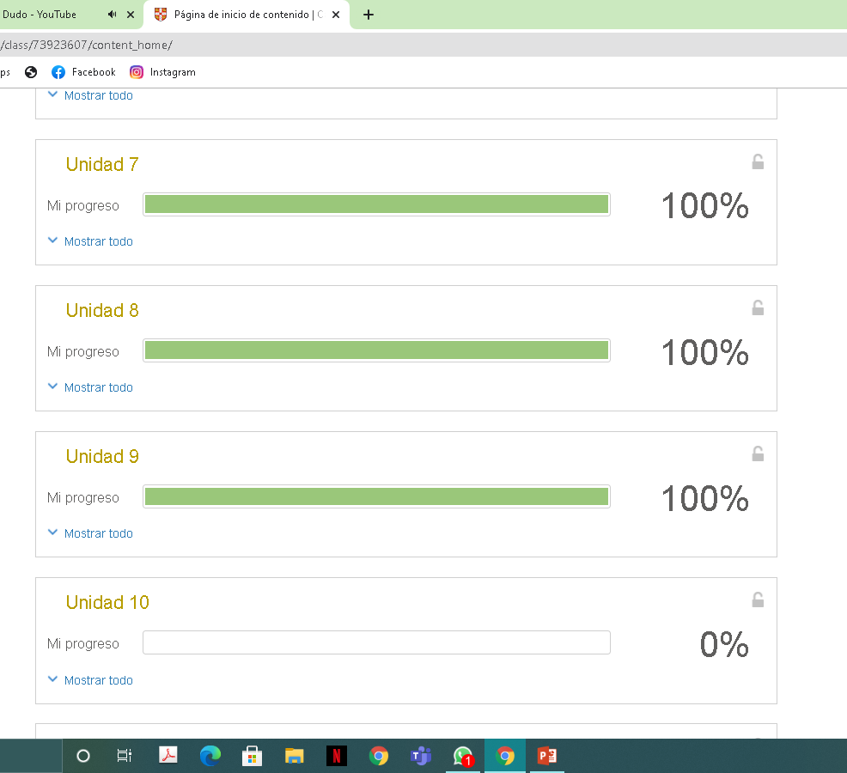

Slide 3
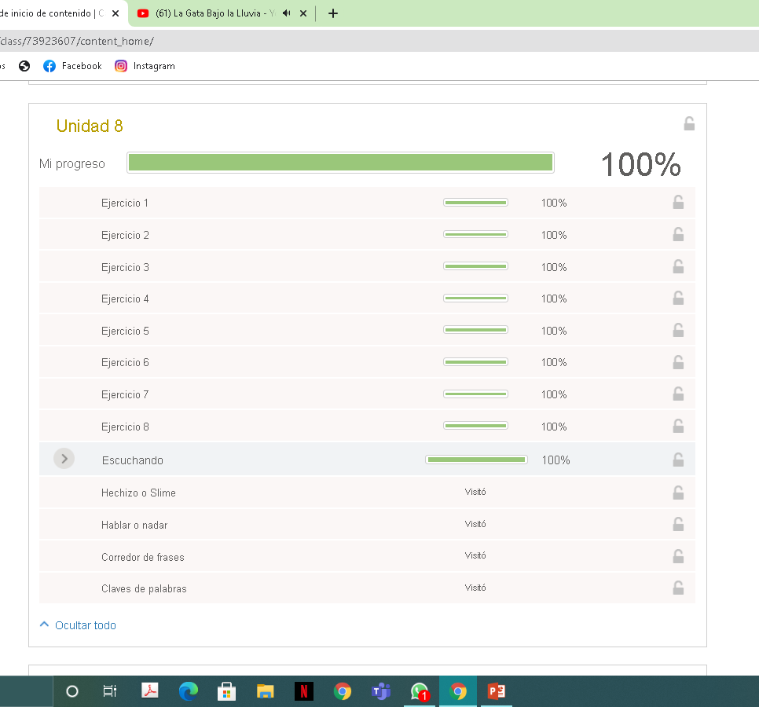

Slide 4
