Slide 1
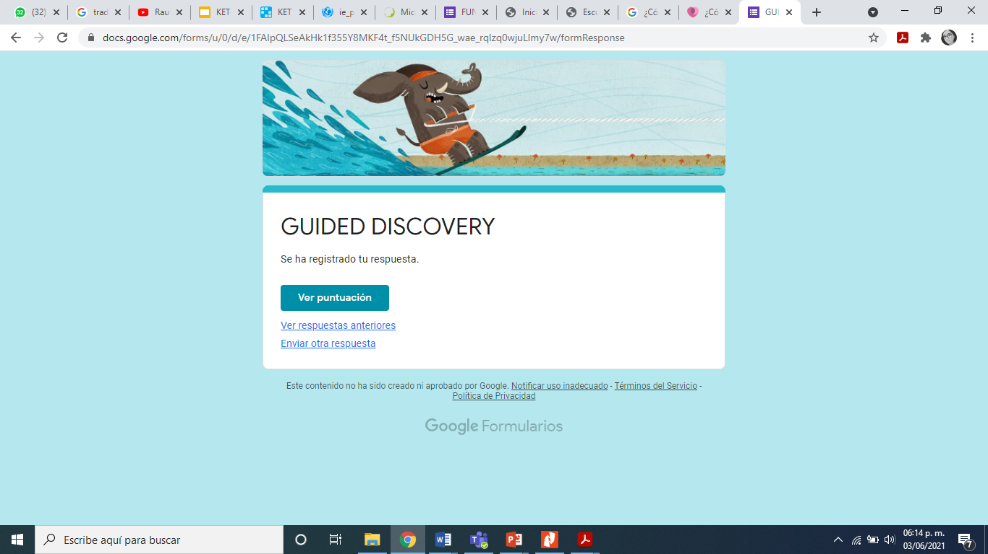
Maria Guadalupe Morales Mendoza

