Slide 1
MARIAN LEONOR CEPEDA LEOS

Slide 2
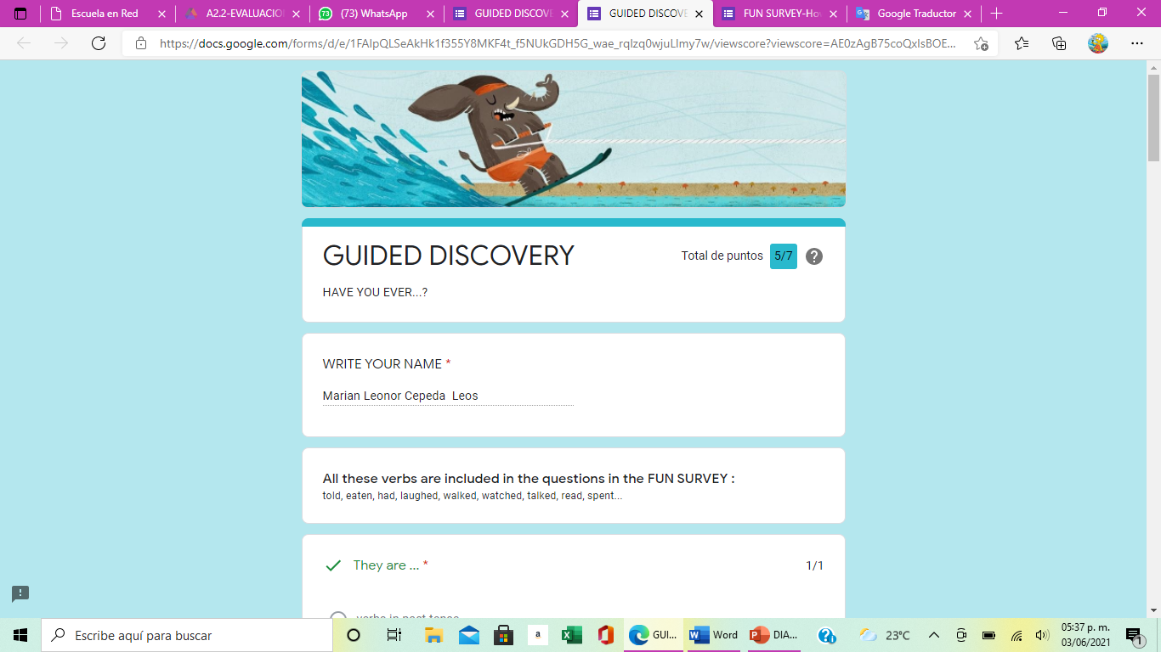

Slide 3
