Slide 1
Escuela Normal de Educación Preescolar
Licenciatura en Educación Preescolar.
Project: WHAT DO I LOOK LIKE?
UNIT 9 WHAT DOES SHE LOOK LIKE?
https://voca.ro/12Pzt1yVVfjs
Teacher: Beatriz Eugenia Valdés Rodríguez
Subject: English A2.1 4
Student: Evelin Medina Ramírez
Friday May 21st 2021

Slide 2
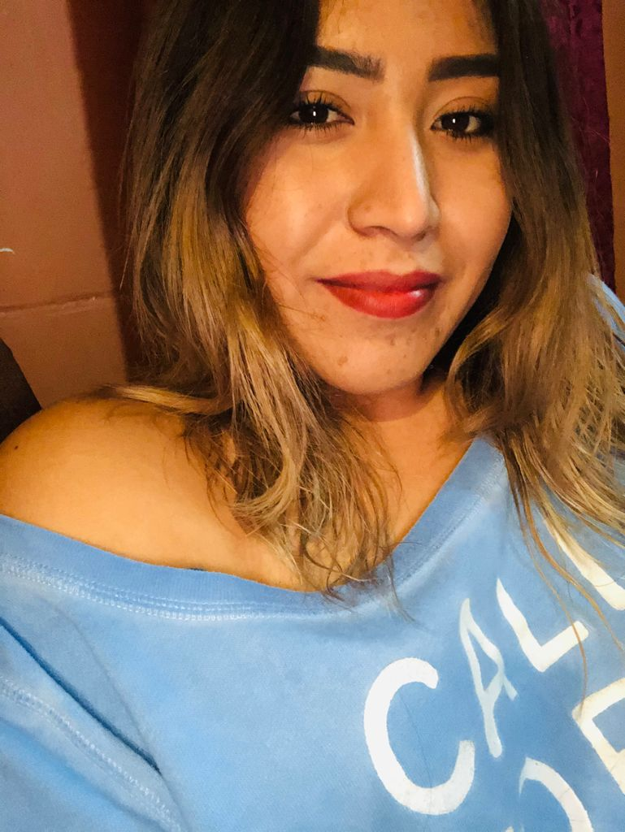
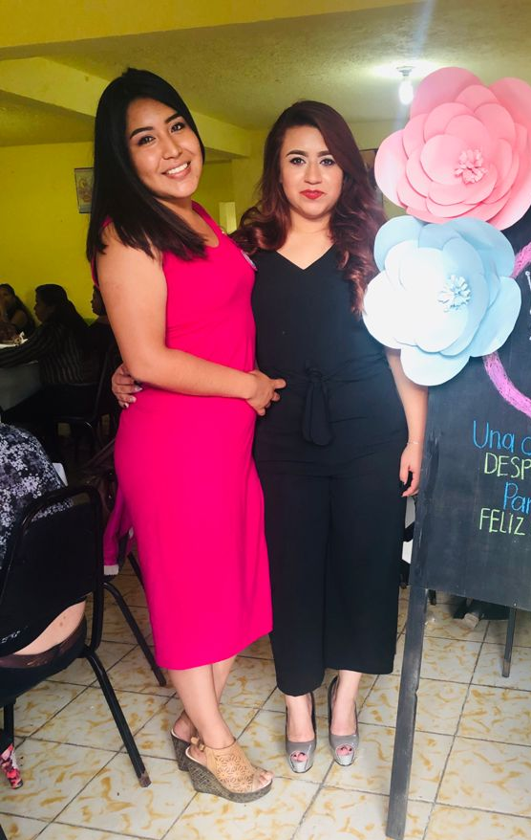
HOW DO I LOOK LIKE?
Hello! My name is Evelin I’m 24 years old, I´m going to describe you how I look like.. So I am medium build and tall, my face has a square shape, I have small and Brown eyes and they have a wide set shape, my hair is Brown and it’s short, sometimes I have frizzy hair. I love my lips because sometimes it look like puffy, also I have turned up nose. I have one mole in my face near my lips also some spots from my acné.
https://voca.ro/12Pzt1yVVfjs

Slide 3
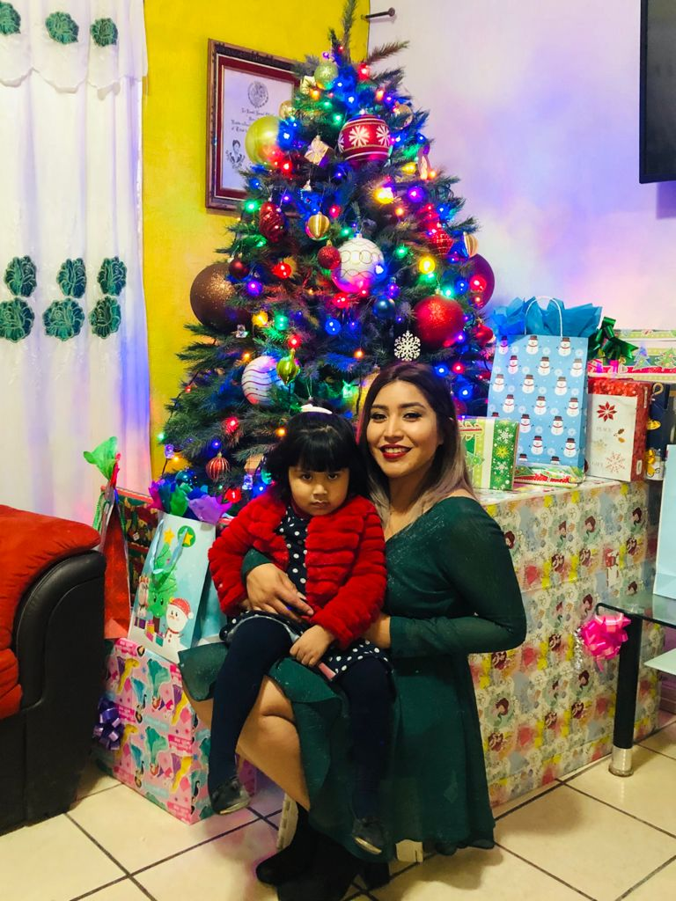
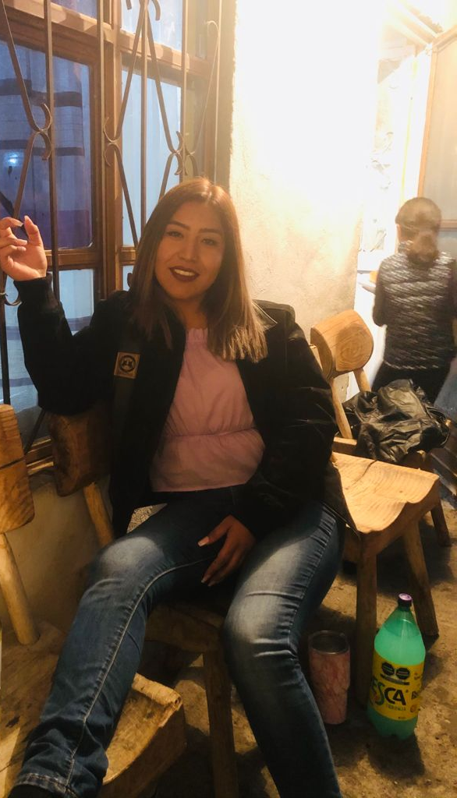
I use to wear basic clothes, I think that I have two styles, one of them is like streetwear because Monday to Thursday I like to wear jeans, t-shirts, sneakers, sweaters and (ON) Friday, Saturday and Sunday is more casual because I like wearing (A) dress it could be short or long, skirts, jewelry and I love (TO) wear high heels.
Clothing style .

Slide 4
I don’t have a lot of hobbies because I don’t have enough time, all week I have to work so when I can have free time is on Sunday and I like to watch movies with my daughter although I know all princess movies,(.) aAnother activitie that I like to do with hear is go(ING) to the park, I enjoy see(ING) her (HAVING) fun.
Hobbies

Slide 5
This unit I liked because I could learn new types of how I can describe people, say all characterictics and diferents styles.
Reflection

Slide 6
rubric
Category | Score 5 | Score 4 | Score 3 | Score 2
Required elements | Goes over and above all required elements stated in the instructions | Includes all of the required elements stated in the instructions | Missing one or more of the required elements. | Several required elements are missing from the project
Overall effectiveness and completion of task | Project is organized and presents material captivating for viewer | Project is somewhat organized and complete and holds attention of viewer | Project is disorganized and incomplete at times and is somewhat able to hold attention of viewer | Project is incomplete and not easy to follow
Creativity | Exceptionally unique and clever in showing deep understanding | Thoughtfully and uniquely presented; showing understanding | A few original touches enhance the project to show some understanding of the material | Shows little originality and creativity and/or effort in understanding the material
Neatness and attractiveness | Exceptionally attractive and neat in design and layout | Attractive and neat in design and layout | Acceptably attractive but may be messy at times and/or show lack of organization | Distractingly messy or very poorly designed
Grammar | No grammatical or mechanical mistakes | 2 or 3 grammatical mistakes which are not distracting | 4 to 6 grammatical mistakes which are distracting | More than 6 grammar or mechanical mistakes which are very distracting
Understanding of content | Shows a sophisticated understanding of the themes | Shows an understanding of the themes | Displays a somewhat limited understanding of the themes and may have few misinterpretations | Does not show an understanding of the themes. Has quite a few misinterpretations.
Oral presentation Vocaroo app | Exceeds expectations in fluency, pronunciation, comprehensibility, inflection and intonation | Meets expectations in fluency, pronunciation, comprehensibility, inflection and intonation | Approaches expectations in fluency, pronunciation and comprehensibility | Does not meet expectations in fluency, pronunciation and comprehensibility.
Total 35 pts

