Slide 1
Escuela Normal de Educación Preescolar English A2.1 Teacher: Beatriz Eugenia Valdés Rodríguez Sara Gabriela Vargas Rangel UNIT. 9 What does she look like? Project name. WHAT DO I LOOK LIKE? Saltillo Coahuila may 2020

Slide 2
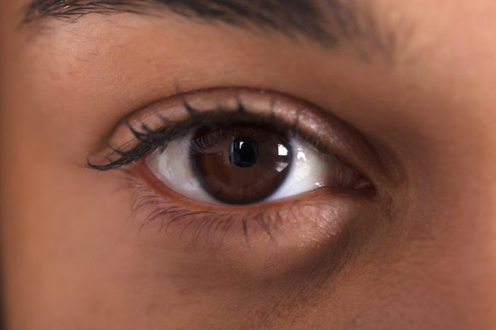
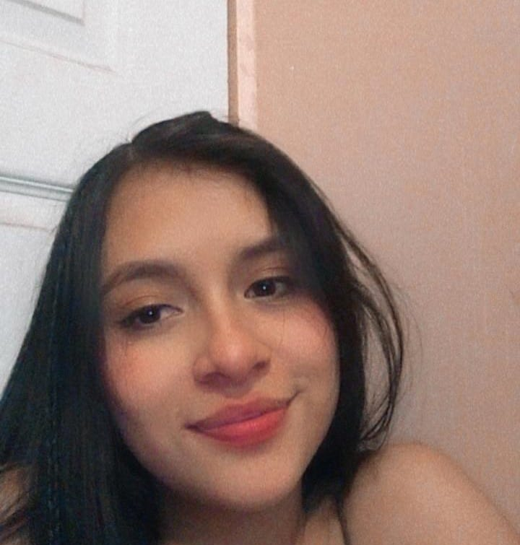
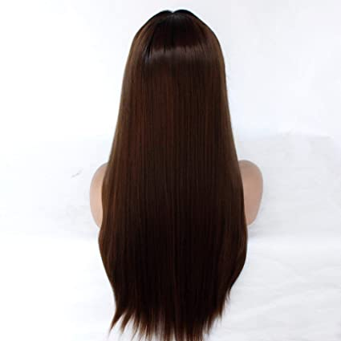
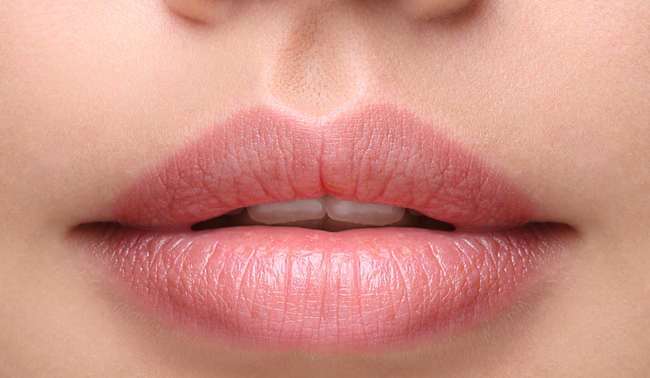
Hello friends! Today I´m going to talk to you about myself. I am a young of 18 years old, I’m of medium height and thin, I have an oval face, pearly skin, my eyes are brown, small and oval, I have sparse eyebrows, my hair is long and straight dark brown, I have small moles on my face, sharp lips, my nose is flat and I have small ears

Slide 3
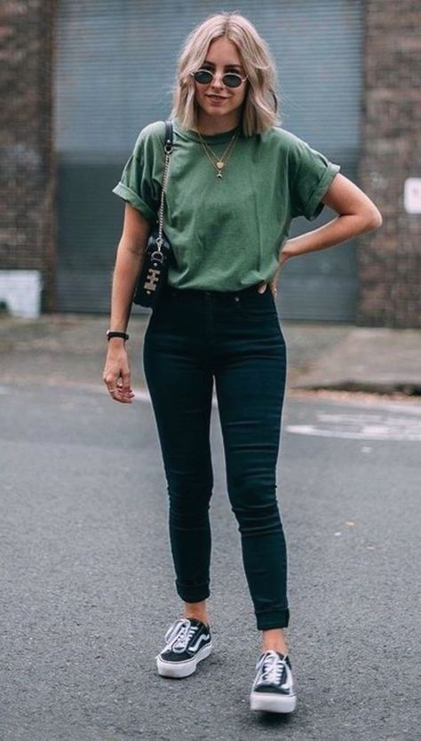
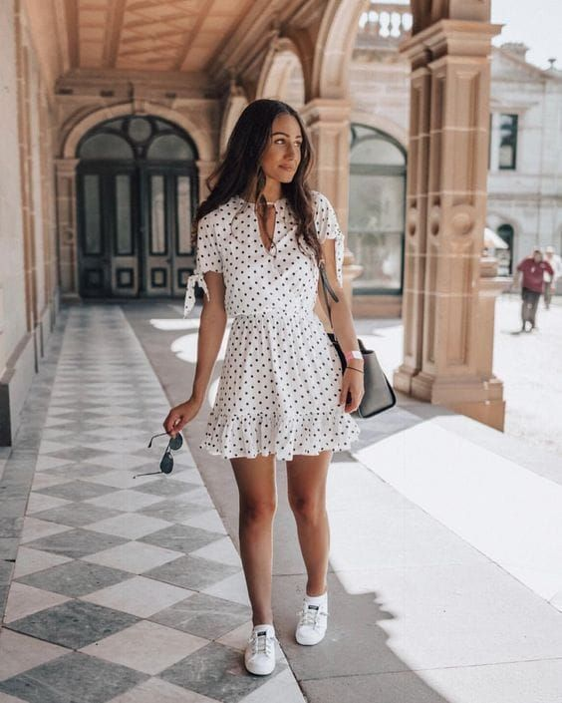
My style of dressing is casual, most of the time I wear jeans and shirts of different colors, I wear sneakers, I like this style because it’s comfortable and can be used on any occasion. sometimes I like to wear casual dresses but I don't wear them much as I am very thin. When I have special events I wear formal dresses to look good, I don't like to wear heels so when I wear dresses I wear sneakers or sandals.

Slide 4
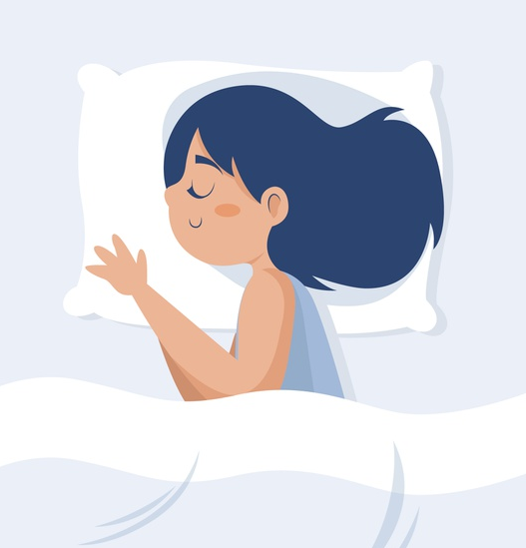
I would finally like to tell you about my favorite hobbies. I really like to sing, so I do it all the time, sometimes I sing in the youth group of my church. I like to watch movies with my family so we go to the movies very often, but because of the pandemic we hardly go anymore, now we watch movies at home while eating popcorn. I also like to watch series so in my free time I watch them. I like to sleep a lot and when I have the opportunity I sleep as much as I can. I like camping, so when I can I go camping with my friends. Another thing I love to do is eat, my favorite food is fried chicken, I eat it when I can.

Slide 5
Individual reflection
In this unit I was able to learn about physical appearances and descriptions, how to describe hair, height, age, special characteristics, among other things. I learned to describe people and ask questions about appearances, I also learned modifiers with present participle and prepositions and how to use them. I liked that I was able to learn many new words and how to use them
<div><iframe width="300" height="60" src="https://vocaroo.com/embed/19GTcQGGdzTd?autoplay=0" frameborder="0" allow="autoplay"></iframe><br><a href="https://voca.ro/19GTcQGGdzTd" title="Grabadora de voz de Vocaroo" target="_blank">Ver en Vocaroo &gt;&gt;</a></div>

Slide 6
Category | Score 5 | Score 4 | Score 3 | Score 2
Required elements | Goes over and above all required elements stated in the instructions | Includes all of the required elements stated in the instructions | Missing one or more of the required elements. | Several required elements are missing from the project
Overall effectiveness and completion of task | Project is organized and presents material captivating for viewer | Project is somewhat organized and complete and holds attention of viewer | Project is disorganized and incomplete at times and is somewhat able to hold attention of viewer | Project is incomplete and not easy to follow
Creativity | Exceptionally unique and clever in showing deep understanding | Thoughtfully and uniquely presented; showing understanding | A few original touches enhance the project to show some understanding of the material | Shows little originality and creativity and/or effort in understanding the material
Neatness and attractiveness | Exceptionally attractive and neat in design and layout | Attractive and neat in design and layout | Acceptably attractive but may be messy at times and/or show lack of organization | Distractingly messy or very poorly designed
Grammar | No grammatical or mechanical mistakes | 2 or 3 grammatical mistakes which are not distracting | 4 to 6 grammatical mistakes which are distracting | More than 6 grammar or mechanical mistakes which are very distracting
Understanding of content | Shows a sophisticated understanding of the themes | Shows an understanding of the themes | Displays a somewhat limited understanding of the themes and may have few misinterpretations | Does not show an understanding of the themes. Has quite a few misinterpretations.
Oral presentation Vocaroo app | Exceeds expectations in fluency, pronunciation, comprehensibility, inflection and intonation | Meets expectations in fluency, pronunciation, comprehensibility, inflection and intonation | Approaches expectations in fluency, pronunciation and comprehensibility | Does not meet expectations in fluency, pronunciation and comprehensibility.
Total 35 pts

