Slide 1
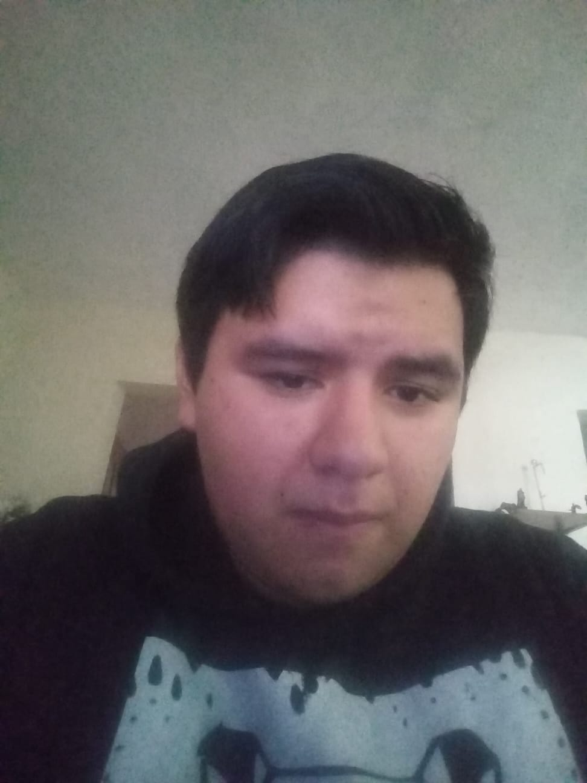
Escuela Normal de Preescolar
English
Unit 9 - What does she look like?
Project: WHAT DO I LOOK LIKE?
Teacher: Beatriz Eugenia Valdés Rodríguez
Student: Leonardo Torres Valdés #14
Saltillo, Coahuila May 21, 2021

Slide 2
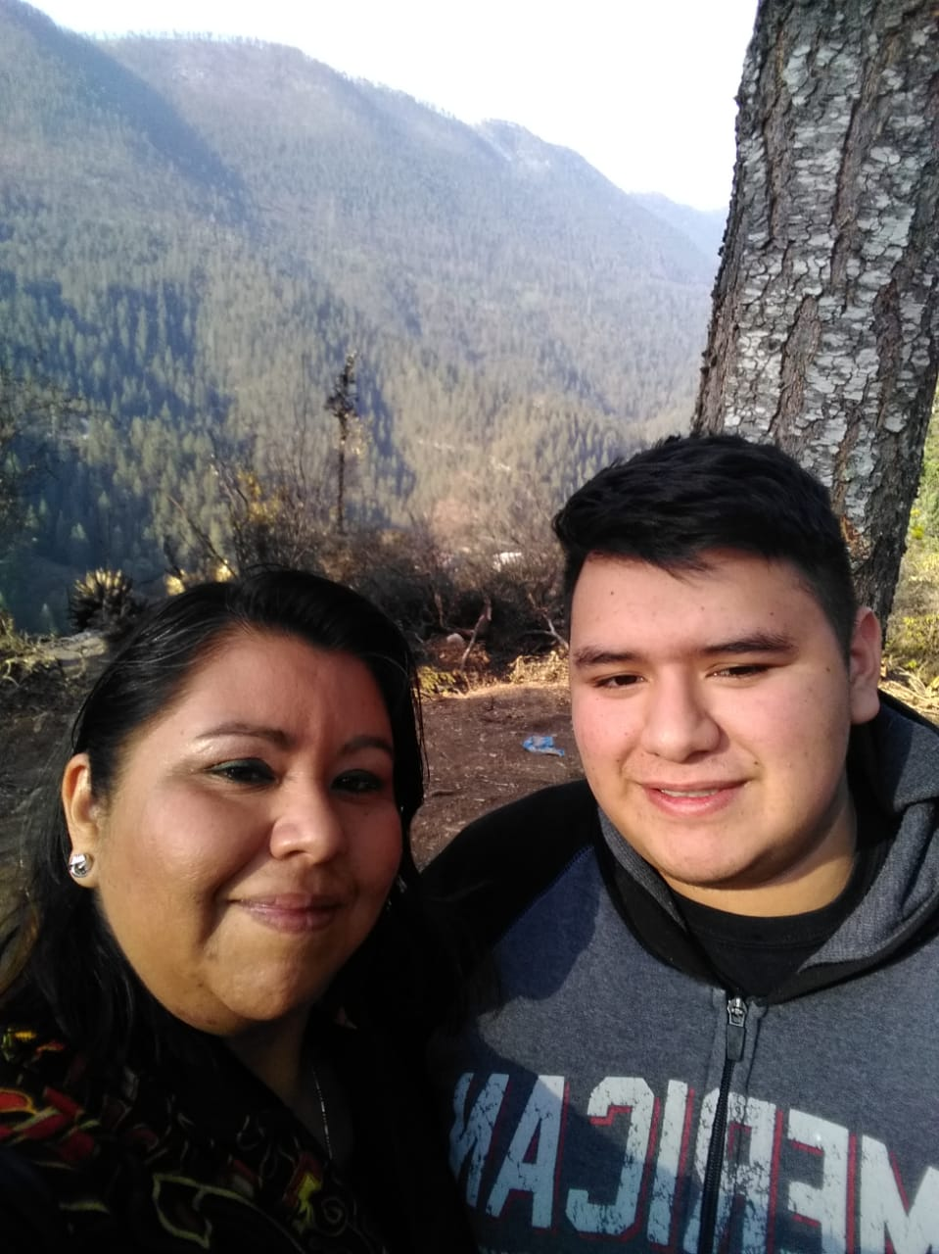
My Physical Description
Hello everyone, today I am going to tell you a little about myself about how I am and what I like, initially I am a person of average height, I am young since I am 17 years old, I have short black hair, I am a bit overweight, I am good looking, I am funny, I really like helping people, I am very respectful and I have few freckles.
https://voca.ro/1U61g3u0GNhV

Slide 3
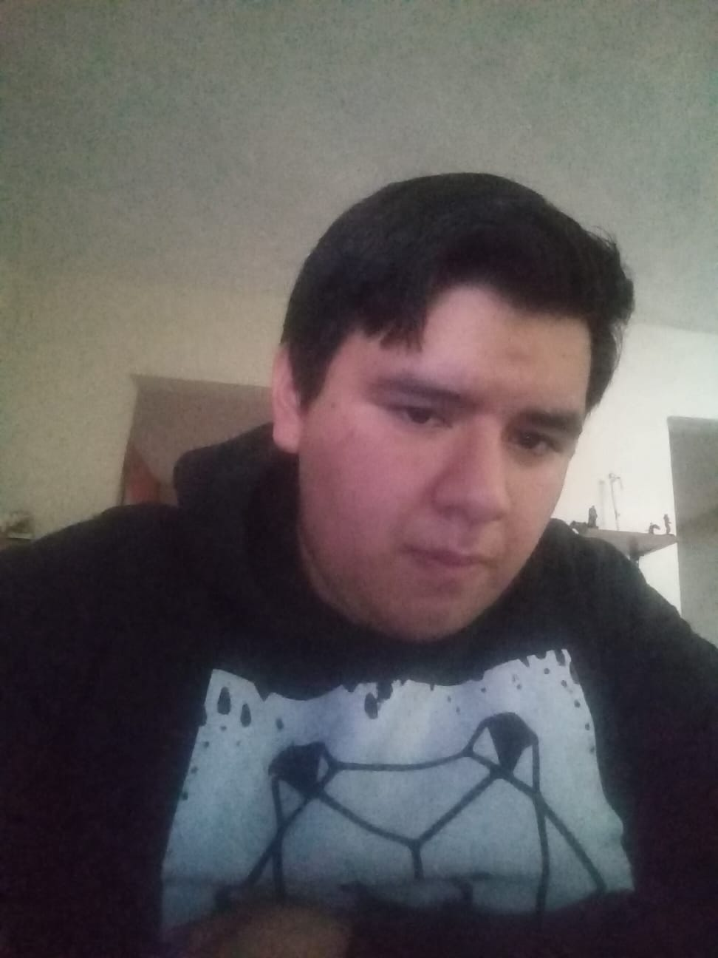
My Description of my Clothing Style
I always used to wear pants, a t-shirt and a sweatshirt since high school and I like it because I feel very comfortable wearing it, on special occasions I wear dress pants, a shirt and if it gets cold a jacket (.) I like (IT) because I (look) go Pretty presentable for the occasion without the need to wear a suit and I feel comfortable being like this.
https://voca.ro/1mnzMayCaRDP

Slide 4
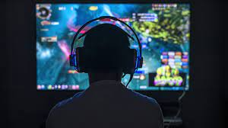
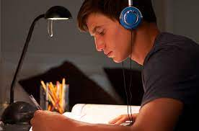
My Description of my Hobby or Hobbies Favorites
My hobbies are playing video games, I only get to do them at night or on weekends and listen to music that I get to do all day every day almost from the beginning of classes until I finish doing homework, personally I feel that Of the 2 the one I like to do the most is listen(ING) to music apart from singing it, although honestly I'm better playing video games with my friends or by myself. I really like playing video games mainly with my friends since it is a way in which we can communicate in these times and listening to music I like a lot because it is a way in which I can do my homework or other things with noise so that it is not all quiet.
https://voca.ro/1h7DttzYjCyt

Slide 5
Learned in this Unit and Project
What I learned in this unit was how to be able to describe a person or myself, to improve when describing the clothes that I wear or that of other people, I learned to have the correct way to ask any personal details of a person such as age, height, among others. In the project I was able to perfect the things that I was taught in the course of the unit and I realized that I am better at describing my way of dressing and my hobbies than myself.
https://voca.ro/1iw2LUWF776H

Slide 6
Category | Score 5 | Score 4 | Score 3 | Score 2
Required elements | Goes over and above all required elements stated in the instructions | Includes all of the required elements stated in the instructions | Missing one or more of the required elements. | Several required elements are missing from the project
Overall effectiveness and completion of task | Project is organized and presents material captivating for viewer | Project is somewhat organized and complete and holds attention of viewer | Project is disorganized and incomplete at times and is somewhat able to hold attention of viewer | Project is incomplete and not easy to follow
Creativity | Exceptionally unique and clever in showing deep understanding | Thoughtfully and uniquely presented; showing understanding | A few original touches enhance the project to show some understanding of the material | Shows little originality and creativity and/or effort in understanding the material
Neatness and attractiveness | Exceptionally attractive and neat in design and layout | Attractive and neat in design and layout | Acceptably attractive but may be messy at times and/or show lack of organization | Distractingly messy or very poorly designed
Grammar | No grammatical or mechanical mistakes | 2 or 3 grammatical mistakes which are not distracting | 4 to 6 grammatical mistakes which are distracting | More than 6 grammar or mechanical mistakes which are very distracting
Understanding of content | Shows a sophisticated understanding of the themes | Shows an understanding of the themes | Displays a somewhat limited understanding of the themes and may have few misinterpretations | Does not show an understanding of the themes. Has quite a few misinterpretations.
Oral presentation Vocaroo app | Exceeds expectations in fluency, pronunciation, comprehensibility, inflection and intonation | Meets expectations in fluency, pronunciation, comprehensibility, inflection and intonation | Approaches expectations in fluency, pronunciation and comprehensibility | Does not meet expectations in fluency, pronunciation and comprehensibility.
Total 35 pts

