Slide 1
Escuela Normal de Educación Preescolar. English A2.1 4 What do I look like? Miss. Beatriz Eugenia Valdes Rodriguez Gabriela Vargas May 21, Saltillo Coah. https://voca.ro/1ngjdRLOM3Lb

Slide 2
01
02
MY PHYSICAL DESCRIPTION
MY CLOTHING STYLE
03
04
MY HOBBIES
REFLECTION

Slide 3
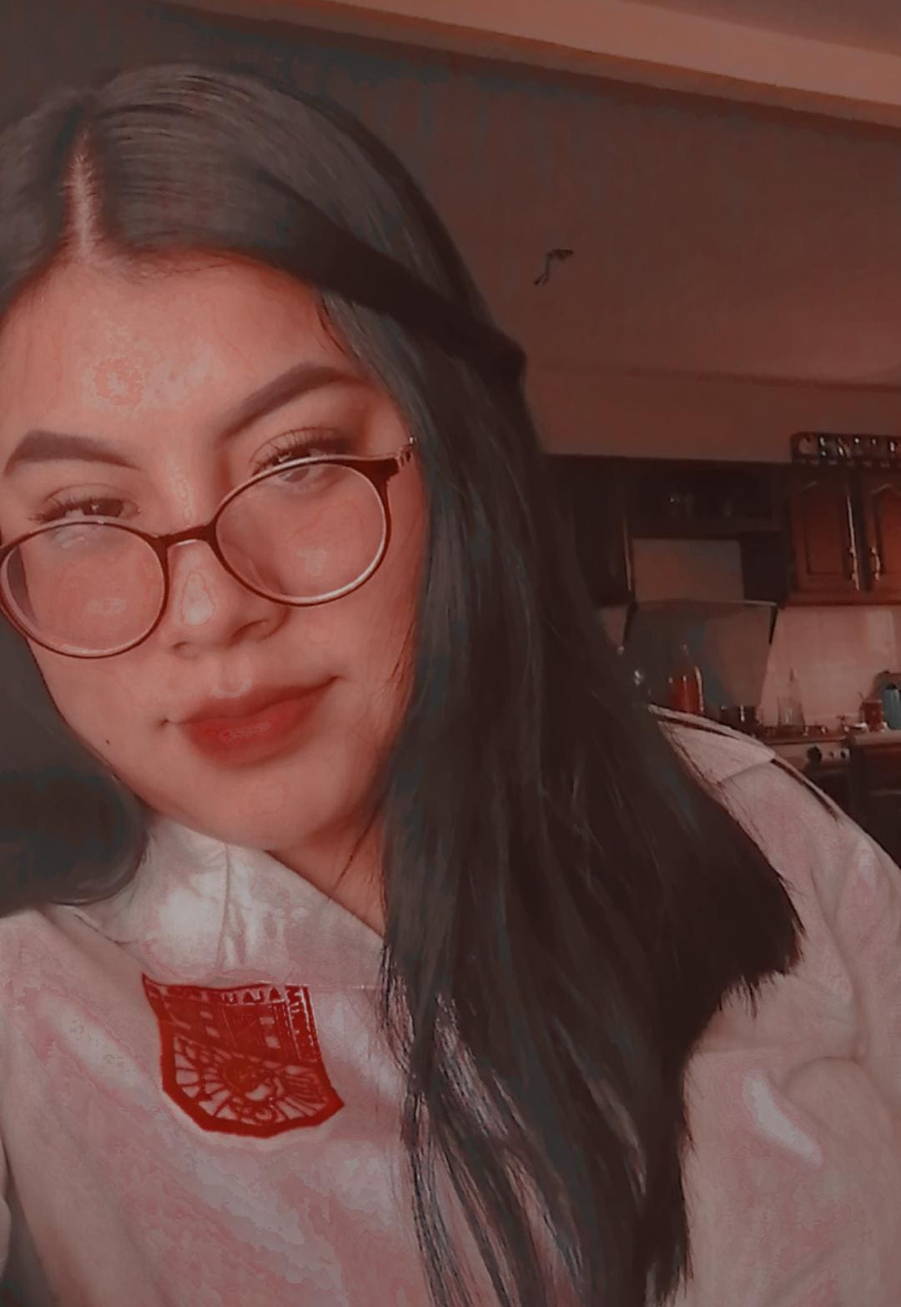
01 MY PHYSICAL DESCRIPTION
I am a young person, I am 18 years old, my height is medium, I am 1 meter 58
I have straight black hair, it's a little short because I cut it
The color of my eyes is very dark, like black, my eyebrows are dark and my eyelashes are long, I wear glasses,
My lips are normal, not thin or full I have a mole near my mouth, my face is round or oval, I have many cheeks

Slide 4
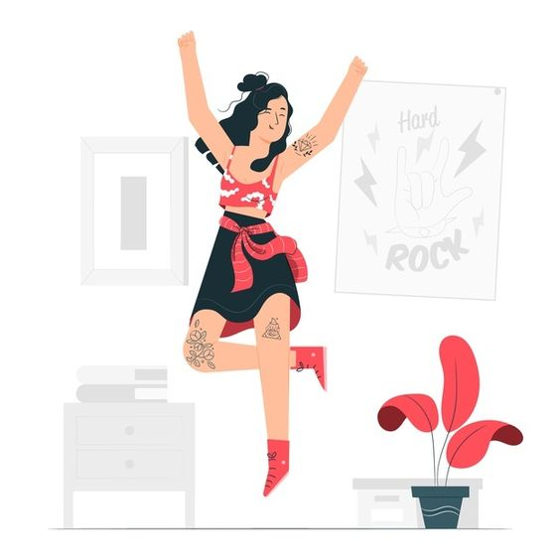
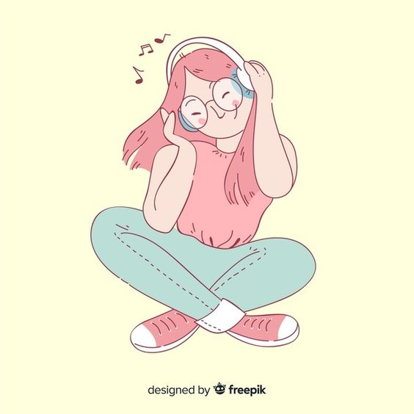
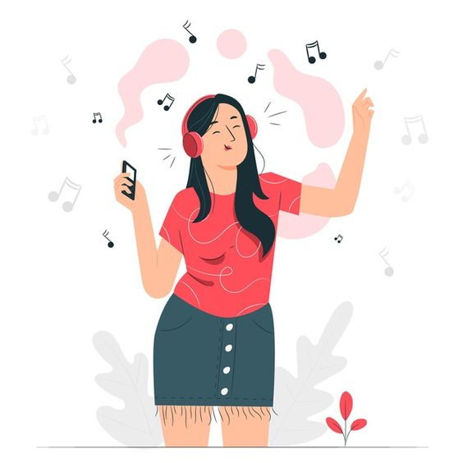
03 MY HOBBIES
What I enjoy doing the most is listening to music, singing it and dancing it, but only for fun because I don't do it formally. When I do homework, when I exercise, to clean or wash the dishes, before I sleep, I always listen to music, it depends on my mood, but it always makes me feel better.
Another of my hobbies is learning to cook, seeing new recipes and trying to make them is very entertaining for me.

Slide 5
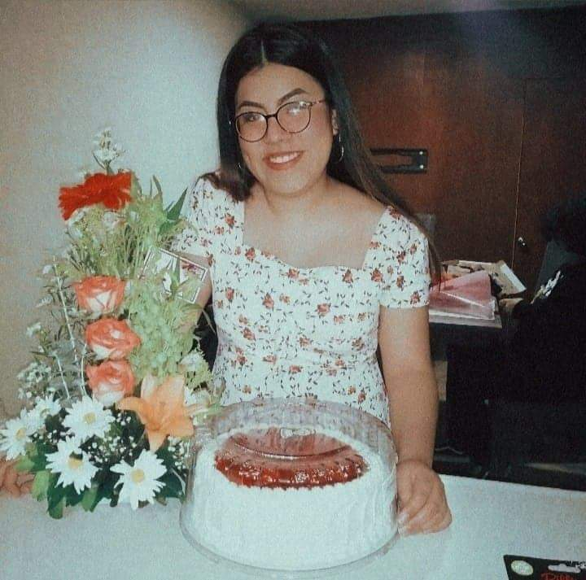
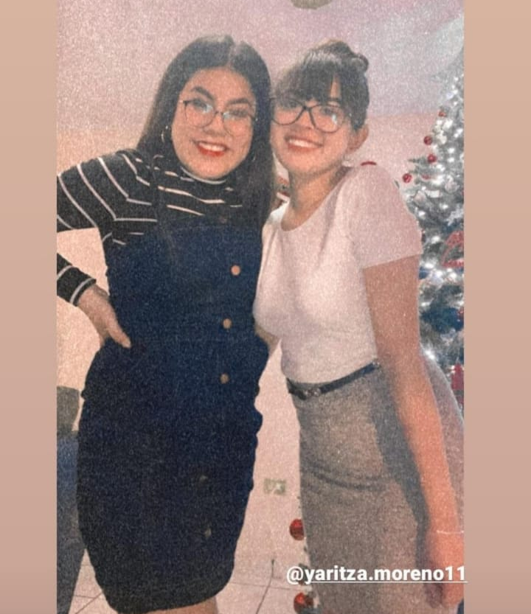
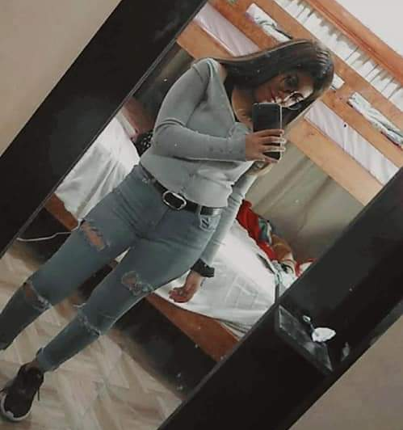
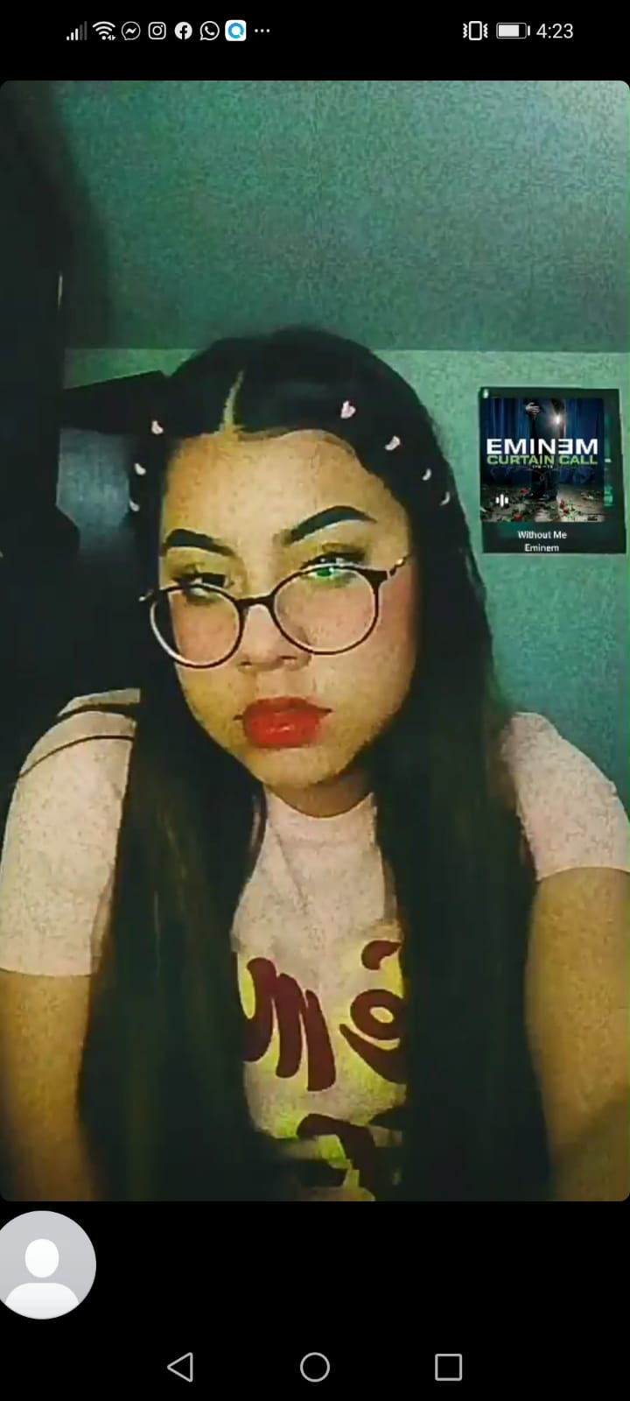
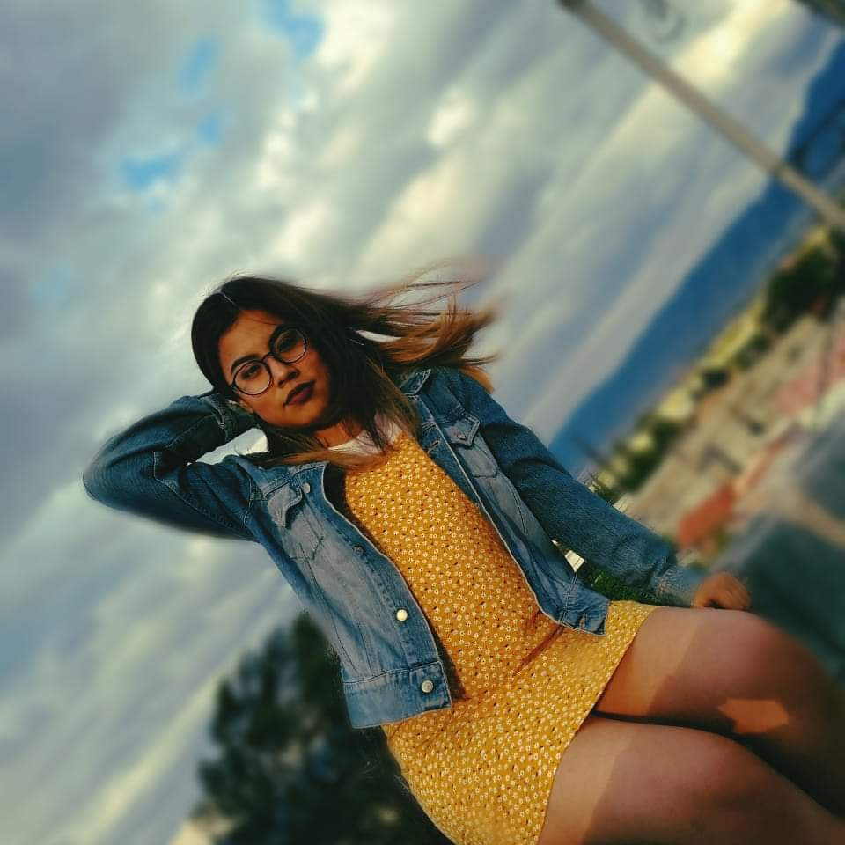
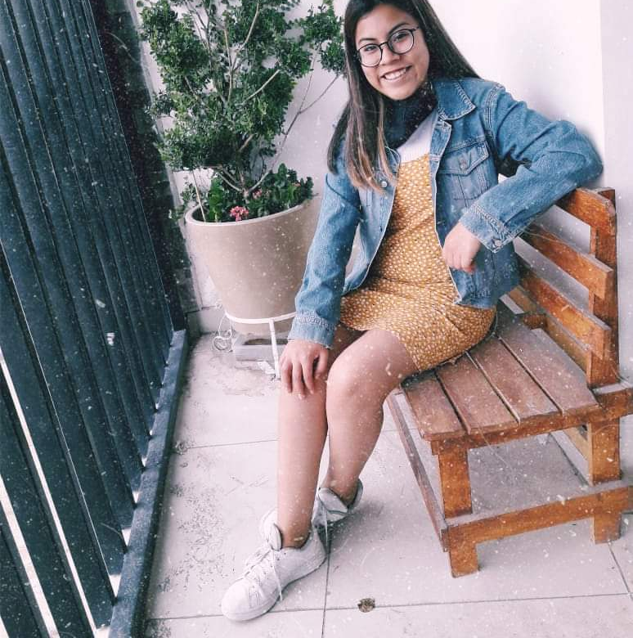
02 MY CLOTHING STYLE
On normal days I like to wear jeans that are comfortable, a basic blouse and hair accessories, I also really like simple or small earrings, I would also like to wear skirts but I hardly have any
I wear a lot of denim jackets because they combine with many things, almost always white or black tennis shoes.
For special occasions I really enjoy wearing dresses and putting on a little more makeup than usual, depending on where I am going to go, if it is casual or formal etc.

Slide 6
04 Reflection
During this unit I learned about adjectives to describe people about their physical appearance, eyes, mouth, hair, height, etc. also about different clothing styles I like to meet people who are different from me and learn from them and what I liked about this unit is that although we know that we are all different, we have something in common, that we are human and we must respect each other no matter what. In the grammar part I learned to ask questions and answer them with the present participle and the prepositions

Slide 7
RUBRIC
Category | Score 5 | Score 4 | Score 3 | Score 2
Required elements | Goes over and above all required elements stated in the instructions | Includes all of the required elements stated in the instructions | Missing one or more of the required elements. | Several required elements are missing from the project
Overall effectiveness and completion of task | Project is organized and presents material captivating for viewer | Project is somewhat organized and complete and holds attention of viewer | Project is disorganized and incomplete at times and is somewhat able to hold attention of viewer | Project is incomplete and not easy to follow
Creativity | Exceptionally unique and clever in showing deep understanding | Thoughtfully and uniquely presented; showing understanding | A few original touches enhance the project to show some understanding of the material | Shows little originality and creativity and/or effort in understanding the material
Neatness and attractiveness | Exceptionally attractive and neat in design and layout | Attractive and neat in design and layout | Acceptably attractive but may be messy at times and/or show lack of organization | Distractingly messy or very poorly designed
Grammar | No grammatical or mechanical mistakes | 2 or 3 grammatical mistakes which are not distracting | 4 to 6 grammatical mistakes which are distracting | More than 6 grammar or mechanical mistakes which are very distracting
Understanding of content | Shows a sophisticated understanding of the themes | Shows an understanding of the themes | Displays a somewhat limited understanding of the themes and may have few misinterpretations | Does not show an understanding of the themes. Has quite a few misinterpretations.
Oral presentation Vocaroo app | Exceeds expectations in fluency, pronunciation, comprehensibility, inflection and intonation | Meets expectations in fluency, pronunciation, comprehensibility, inflection and intonation | Approaches expectations in fluency, pronunciation and comprehensibility | Does not meet expectations in fluency, pronunciation and comprehensibility.
Total 35 pts

