Slide 1

Normal Preschool
Student:
Corina Beltrán García
Teacher:
Brenda Bollain y Goytia de la Peña
English B1.1
LET’S PREPARE FOR YOUR FINAL PROJECT!

Slide 2
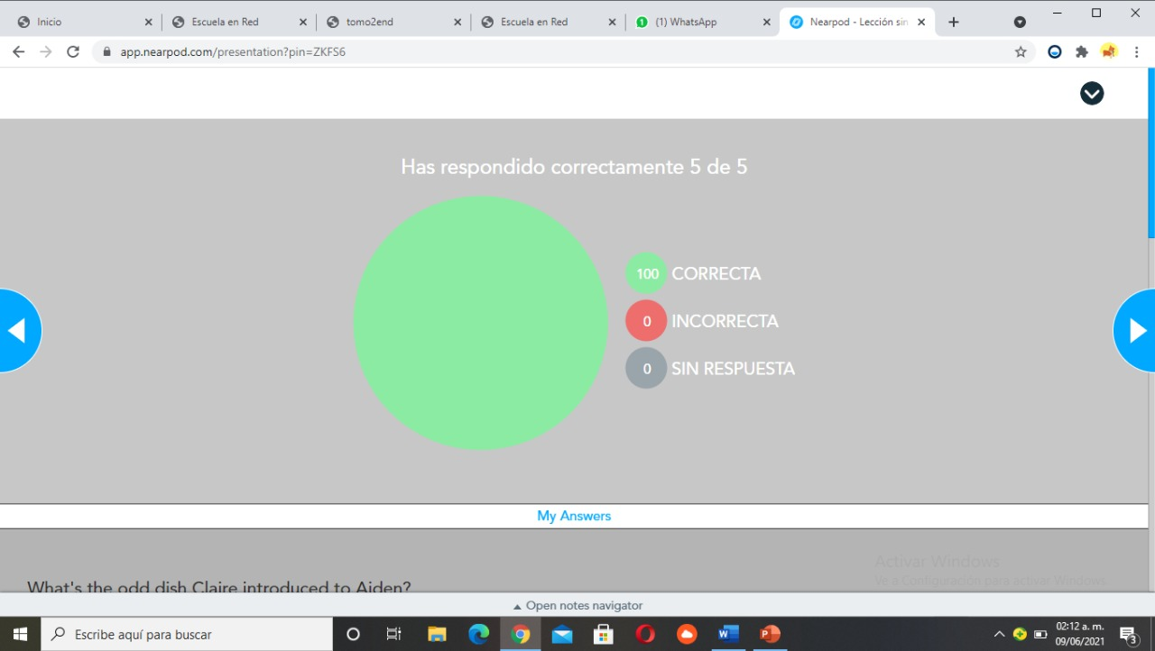
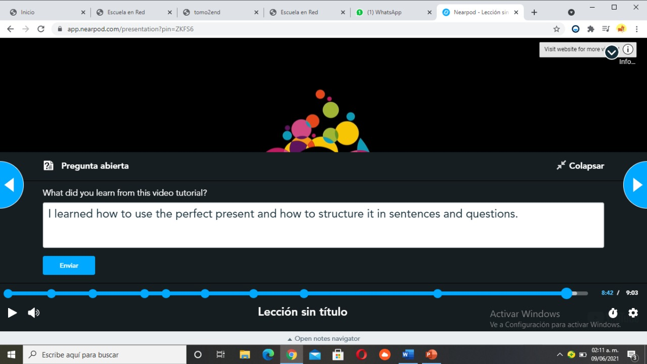
join.nearpod.com

Slide 3
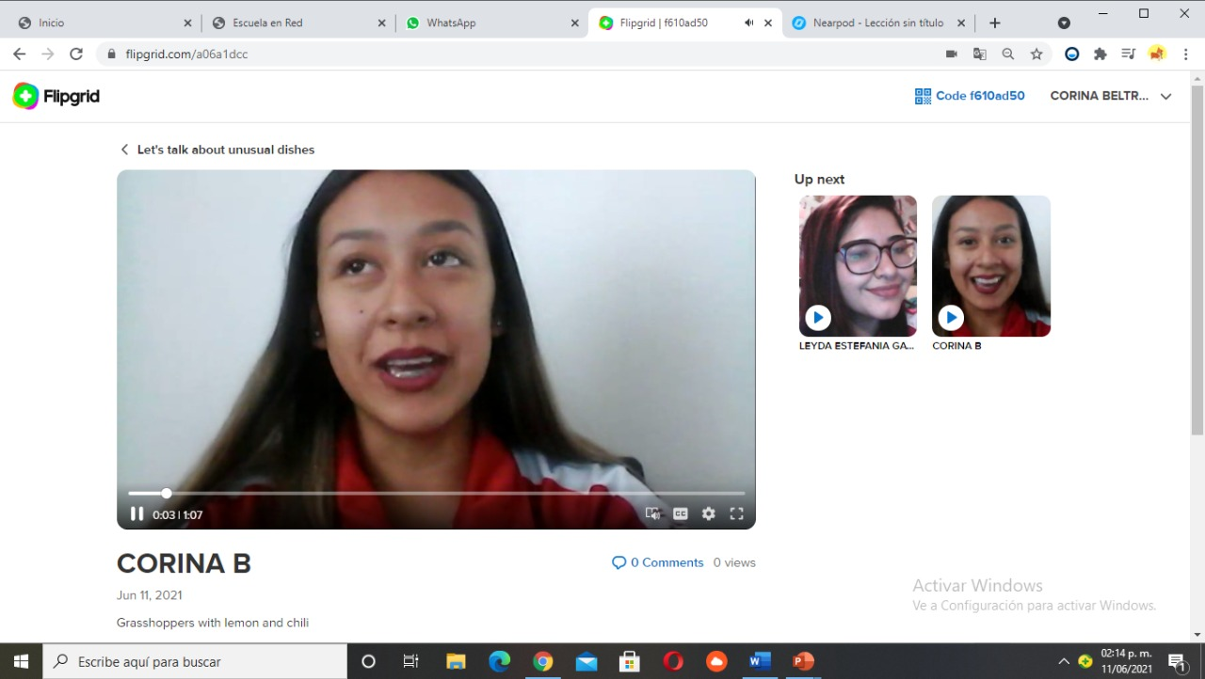
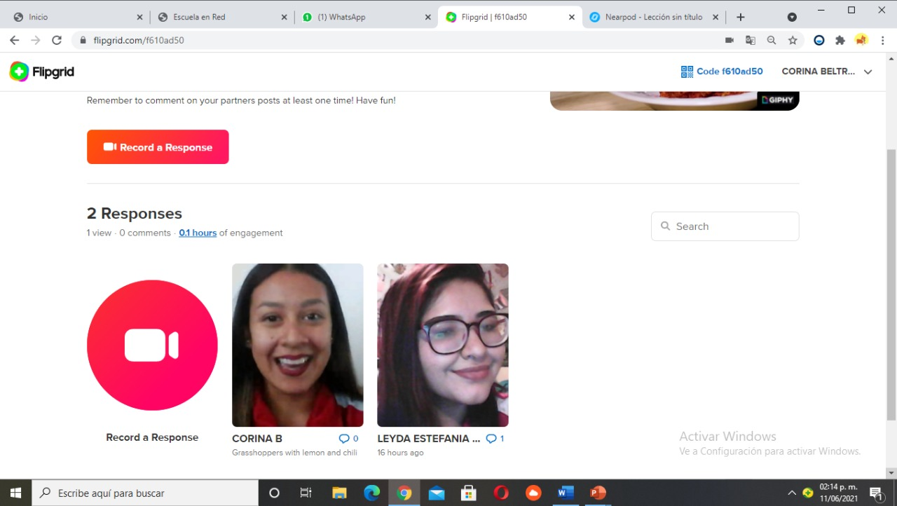
Flipgrid

Slide 4
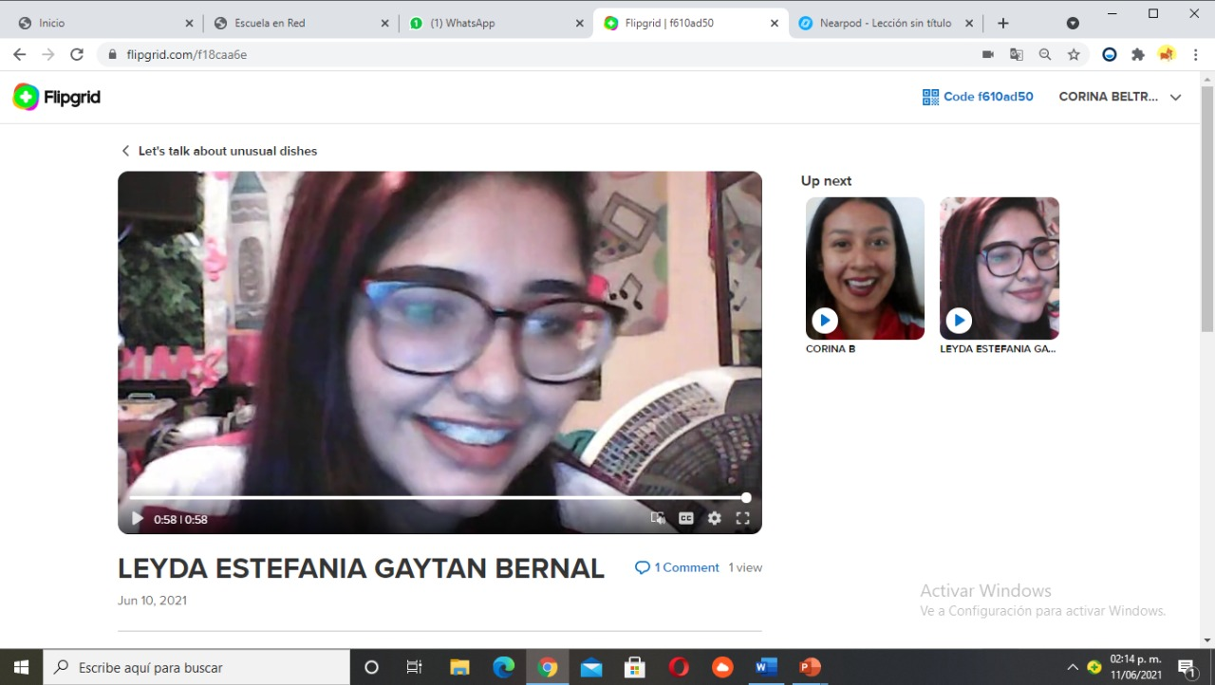
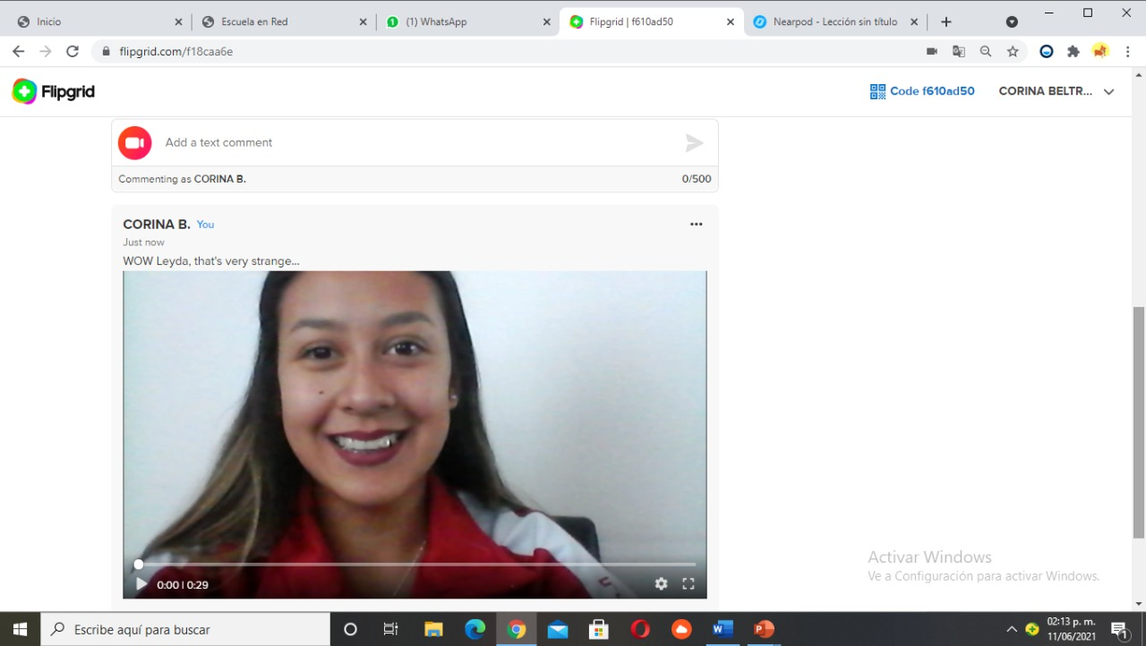
Comment Flipgrid

Slide 5
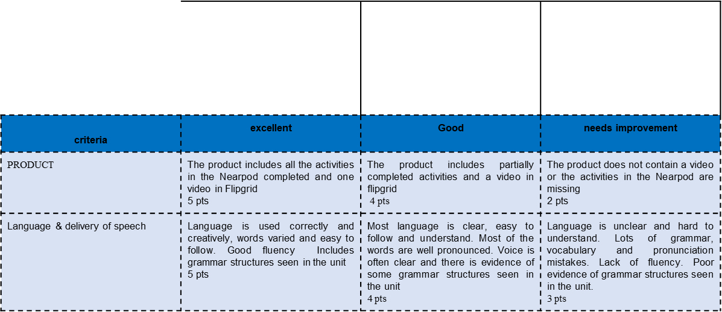
Nearpod activities completed, flipgrid video, and at least 1 response to a partner's posts= 20% of project evaluation
Not done =0% of your project evaluation.

