Slide 1
Escuela Normal de Educación Preescolar
Licenciatura en Educación Preescolar
Ciclo escolar 2020-2021
Subject: English
Student: Luz María Velásquez Mata
FINAL PROJECT
June 10, 2021

Slide 2
Nearpod
*I forgot to catch the second part

Slide 3
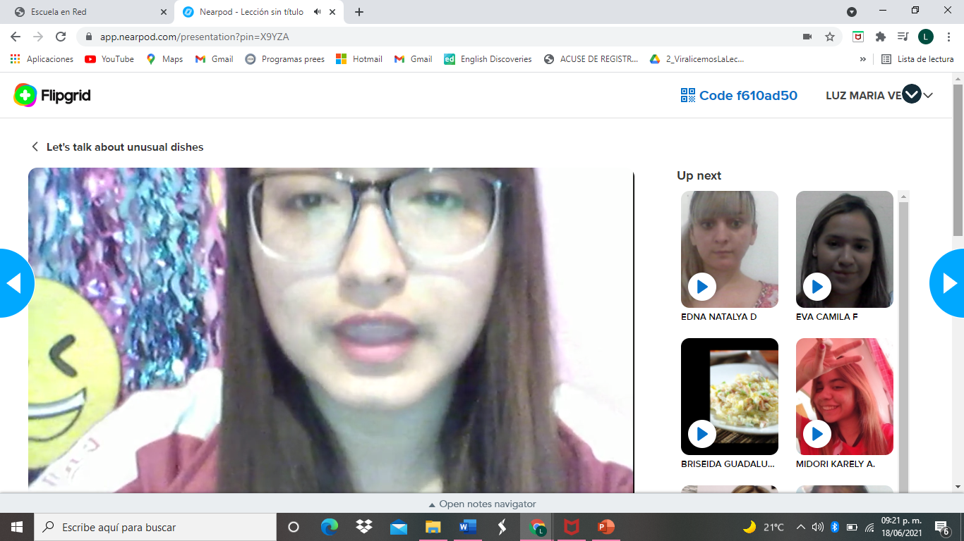
Flipgrid

