Slide 1
NORMAL SCHOOL OF PRESCHOOL EDUCATION
School cycle 2021-2021
FINAL PROYECT
STUDENT: Eva Camila Fong González
COURSE: Ingles B1.11
TEACHER: Brenda Bollain Y Goytia De La Peña
SALTILLO, COAHUILA JUNE 18, 2020

Slide 2
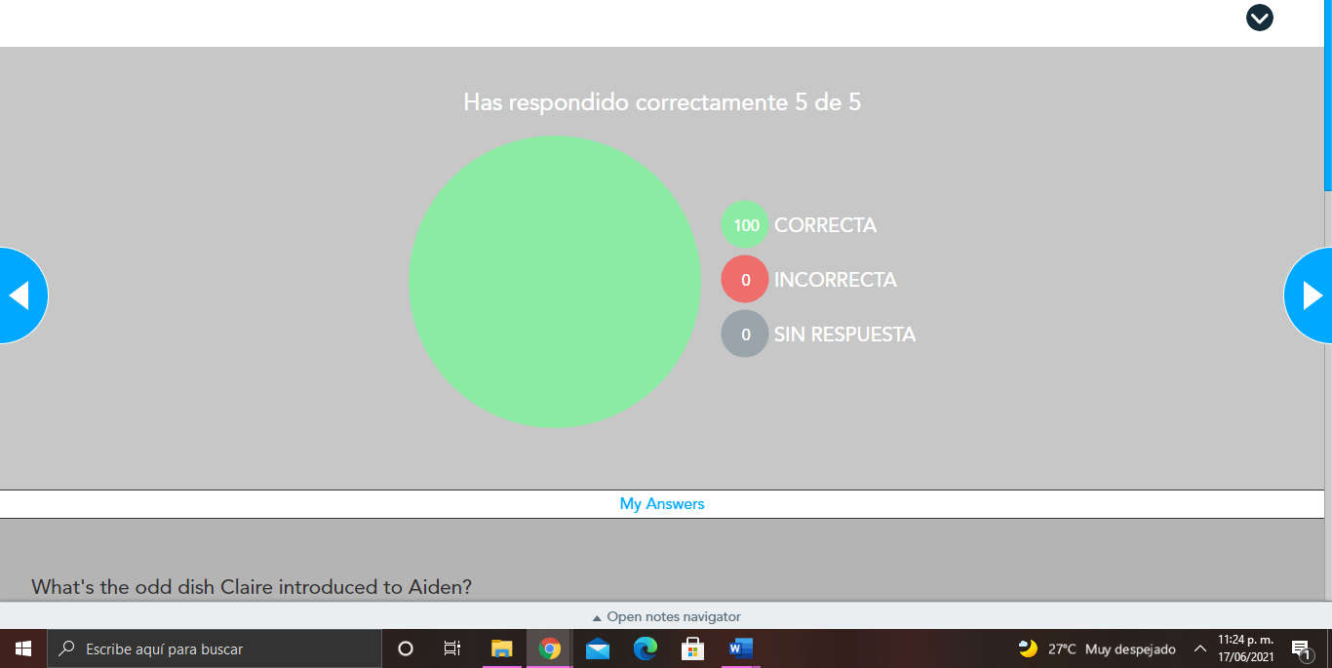
Nearpod activities

Slide 3
Evaluation Criteria
Nearpod activities completed, flipgrid video, and at least 1 response to a partner's posts= 20% of project evaluation

