Slide 1
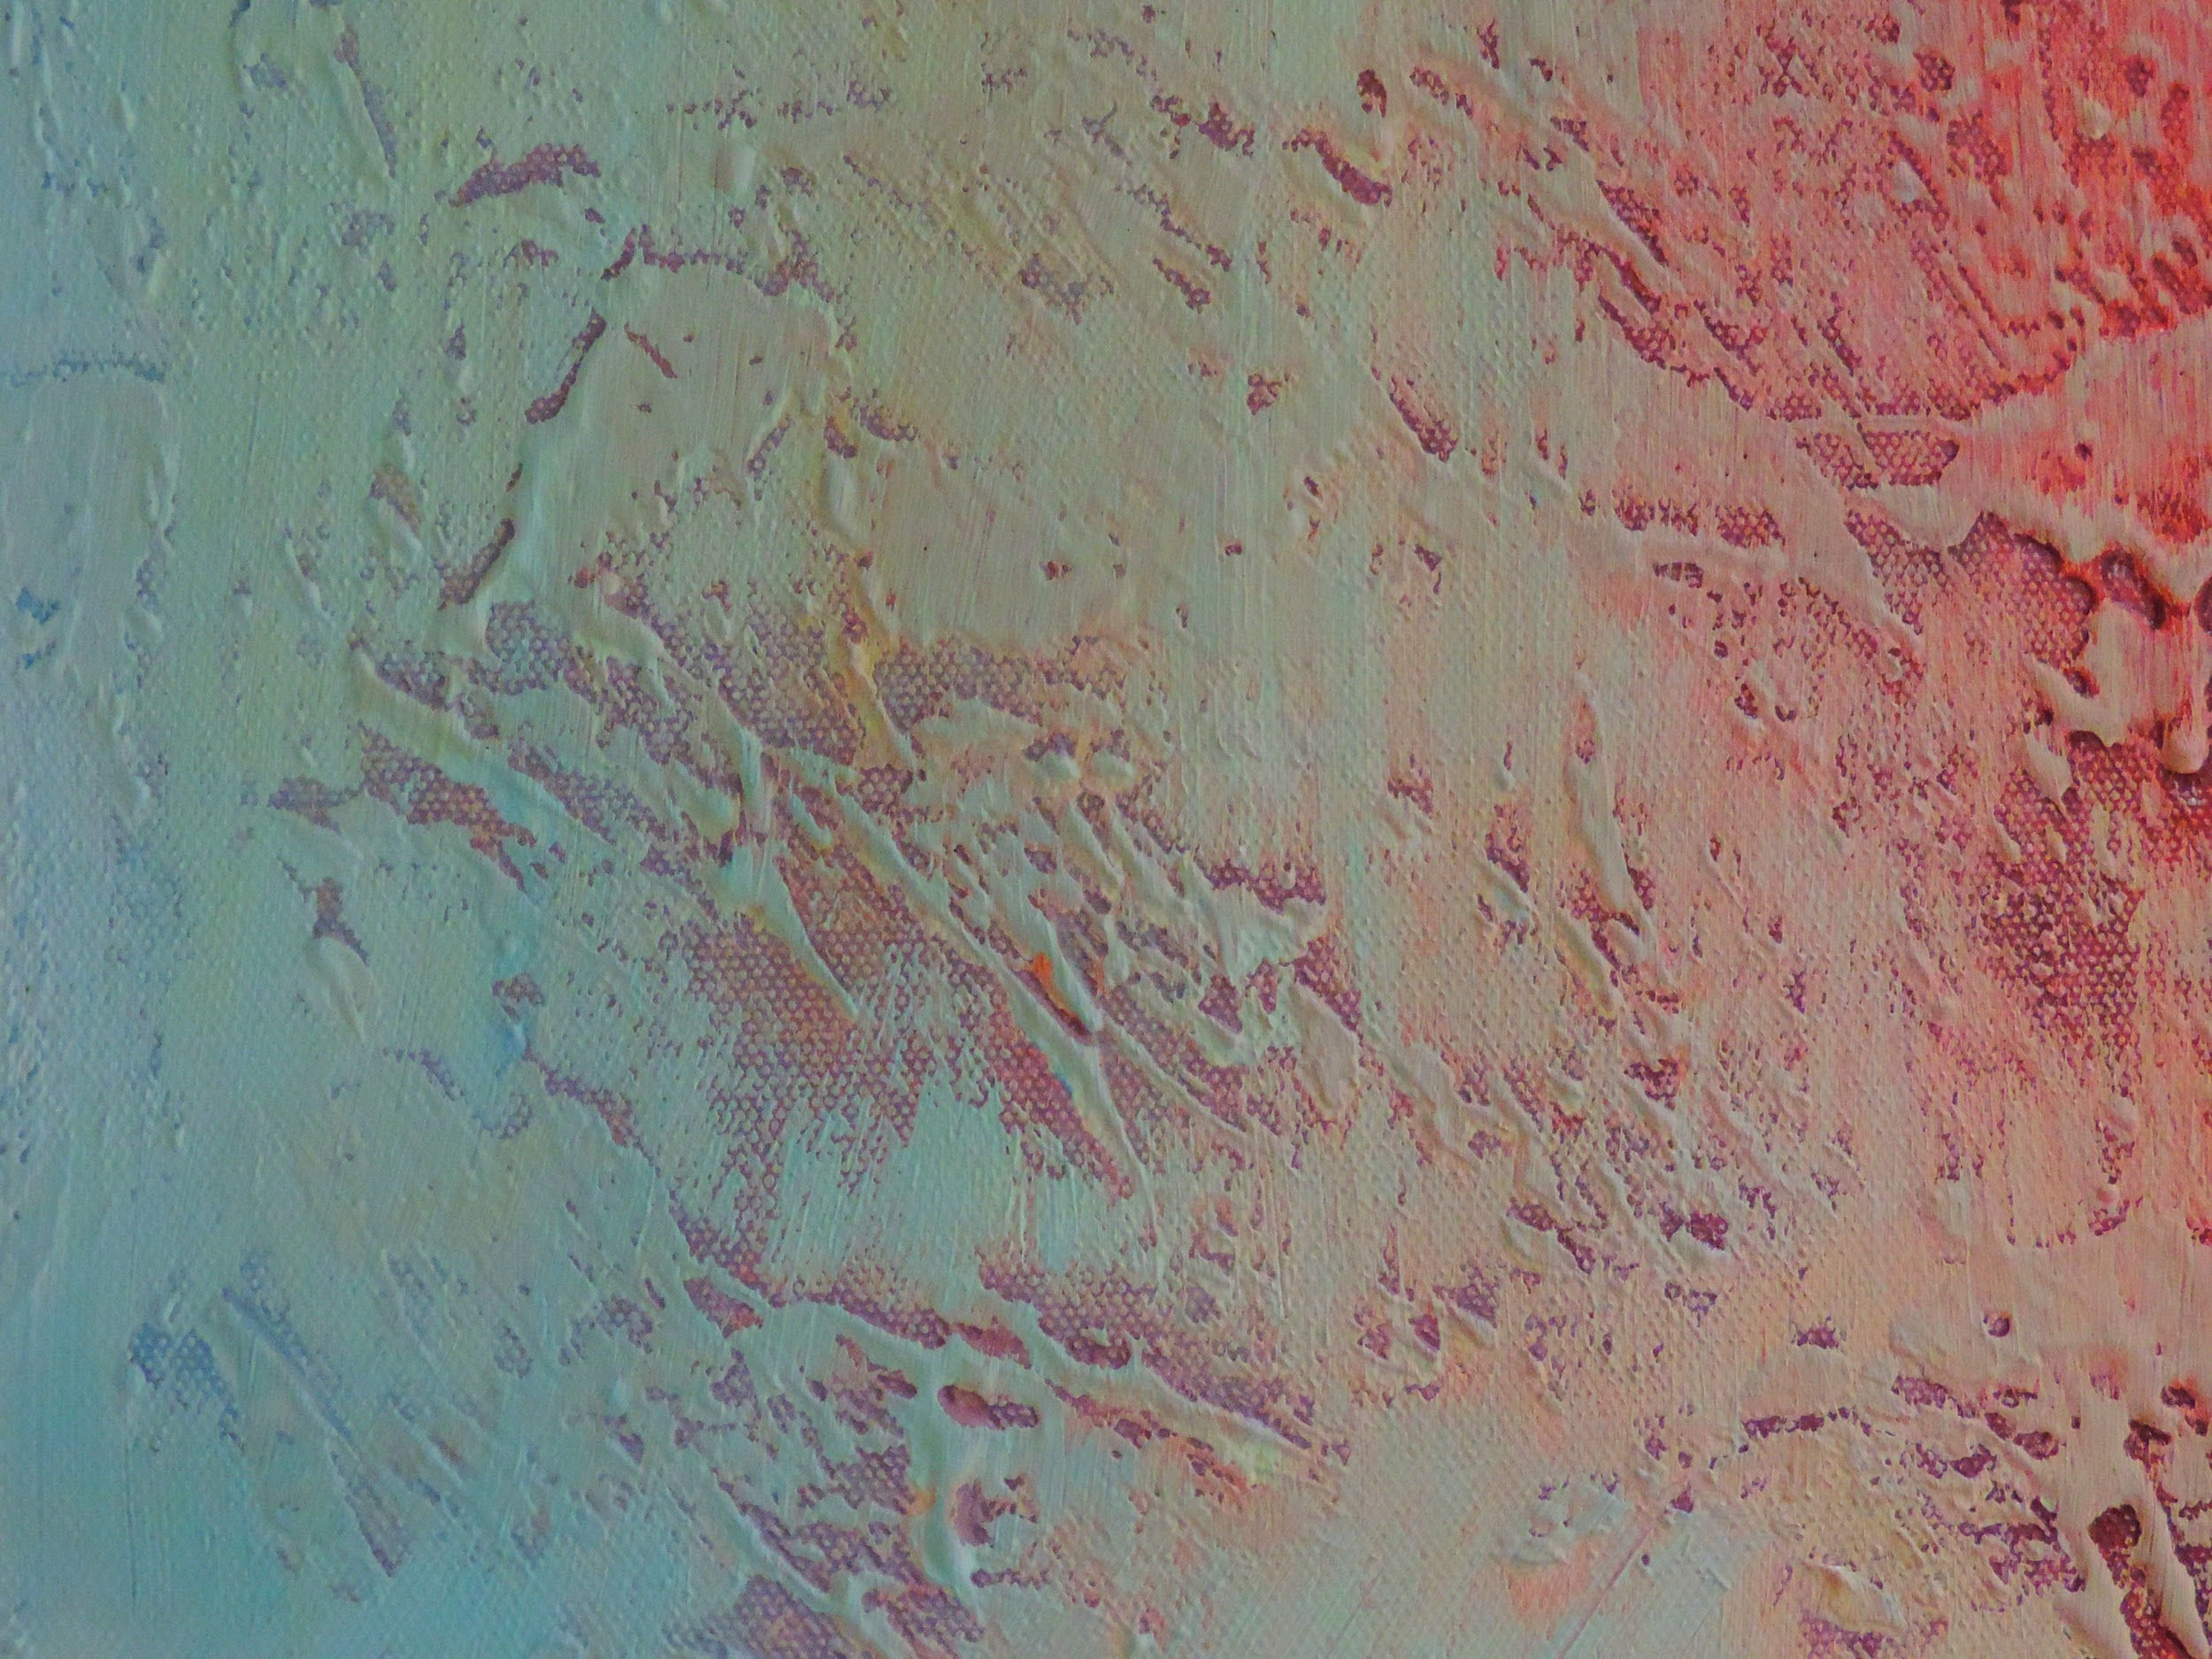
DANNA SOPHIA RANGEL IBARRA
UNIT 3 FINAL PROJECT

Slide 2
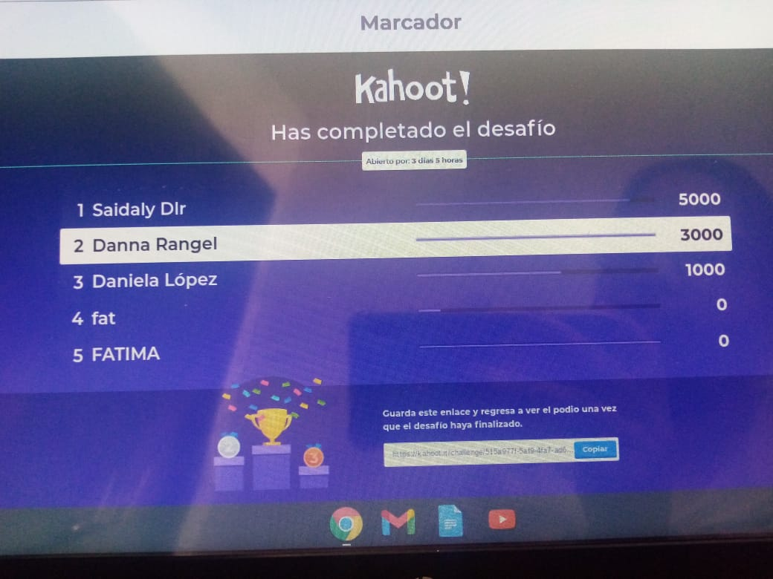
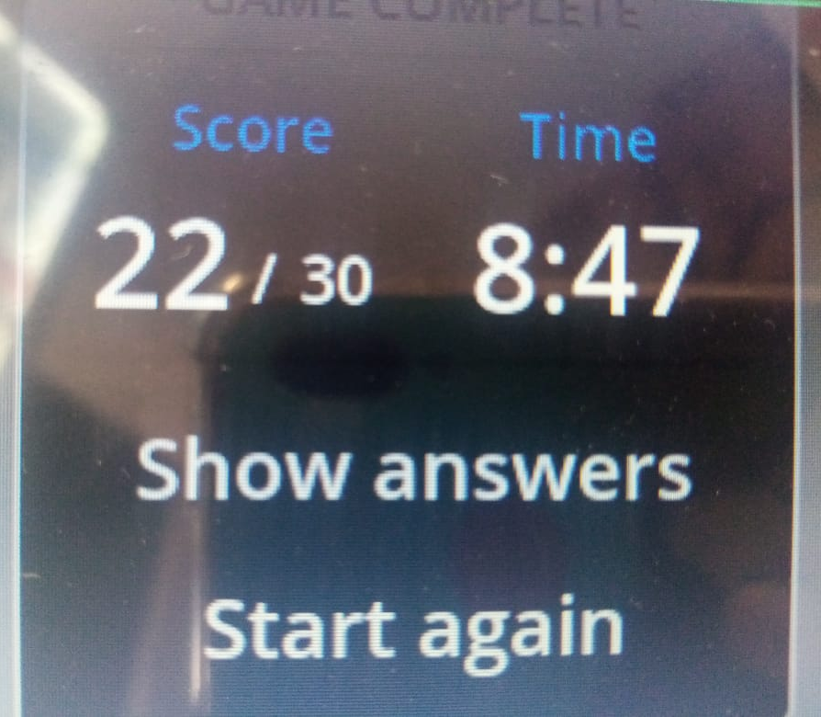
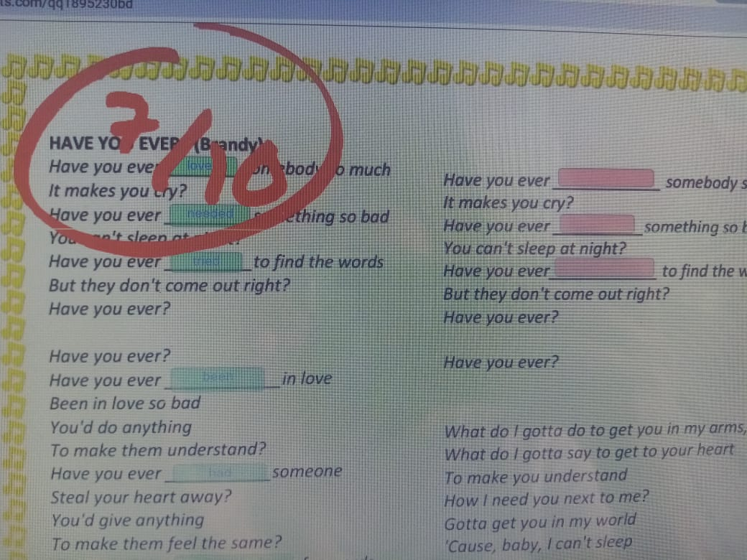
RANGEL IBARRA DANNA SOPHIA
I think that thanks to these activities it is how we learn more, and more than anything practicing is how I have been able to learn the simple present, it was all very fun and I liked doing them

Slide 3
PRODUCTS | score
A kahoot quiz | 10/10
A wordwall quiz | 30/30
A padlet post | 10/10
A liveworksheet task | 10/10
Screenshots of all the activities completed pasted in a Google slides doc | 30
A PDF with evidence of the activities with a cover and formal aspects of the presentation for the portfolio | 10
ESCUELA NORMAL DE EDUCACIÓN PREESCOLAR
UNIT 2
FINAL PROJECT-CHOICE BOARD
“UNUSUAL EXPERIENCES”

