Slide 1
Normal School of Preschool Education
UNIT 3 FINAL PROJECT
Teacher: Brenda Bollain y Goytia de la Peña
Name: Maria Guadalupe Morales Mendoza

Slide 3
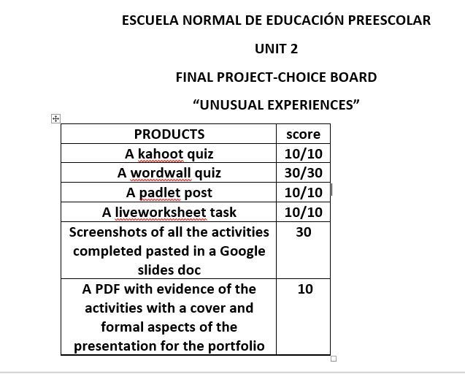
Rubric

